Slide 1
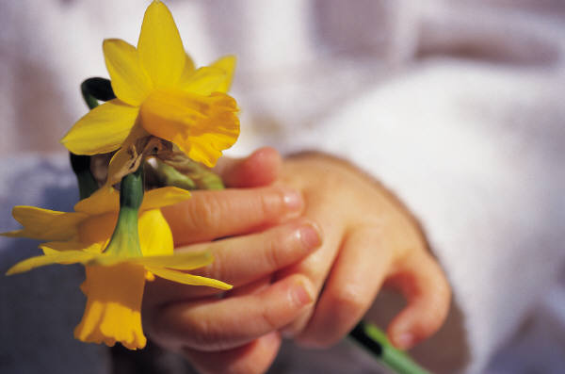
Mothering Sunday

Slide 2
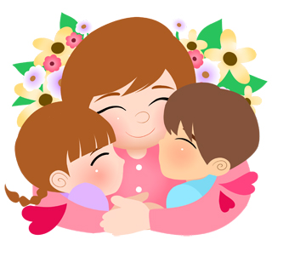
Not everyone has a mother- but everyone has someone who is like a mom to them. Today we will think about all the mother figures in our lives- carers, grans, aunties and sisters- we will think about them all as ‘mom’ or ‘mum’

Slide 3
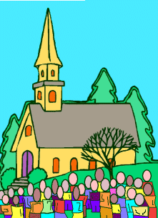
Mothers Day or Mothering Sunday How did it all start?
About 400 years ago the Christian Church decided, that on the 4th Sunday in Lent, families should visit the largest church or cathedral near to where they live.
This was called the Mother Church- and so the day became known as Mothering Sunday

Slide 4

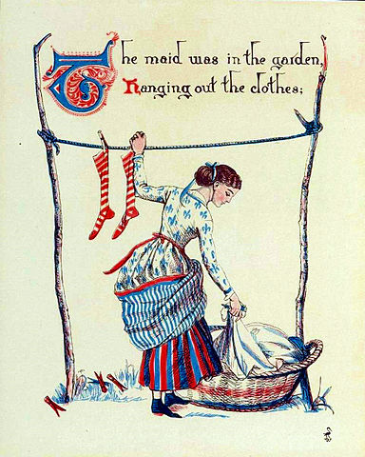
Many children- by age 14 -sometimes as young as 12- lived away from home in large houses where they worked in service as maids and servants for rich people.

Slide 5

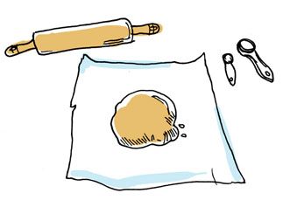
They were only allowed one day off a year to visit their family- Mothering Sunday -so that they could go with their family to their Mother Church.
They were allowed to bake a cake to take home for mom

Slide 6
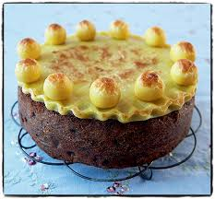
This was called a Simnel cake and was decorated with 11 balls of marzipan to represent the disciples- without Judas!

Slide 7
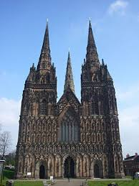
Living here you would have taken the journey to Lichfield Cathedral on Mothering Sunday.

Slide 8
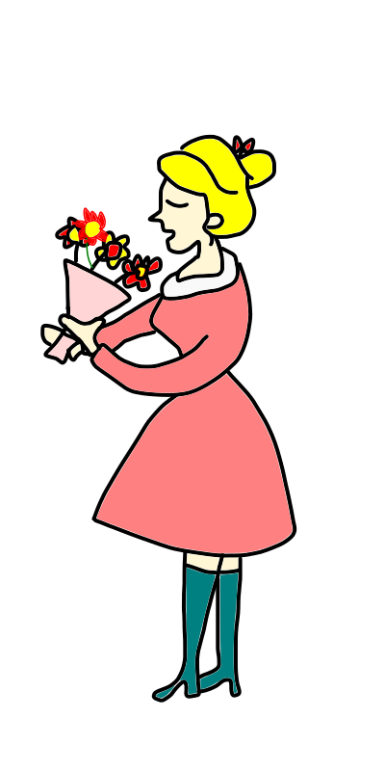

As the children began the long journey home they would pick wild flowers and take them home for mom.
This started the tradition of giving mom flowers. Many Christian churches still give a posy to all the ladies who visit on Sunday.

Slide 9
Have you made a card or planned anything special for Sunday?
All that moms really want from you is a hug and to say thank you for everything they do for you- they love and care for you so much and will do anything for you.

Slide 10
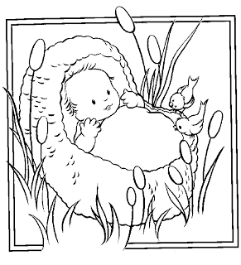
I am now going to read an interactive story from the Bible based on Exodus2:1-10.
‘The Edge of the River’ from ‘Telling the Bible’ by Bob Hartman

Slide 11
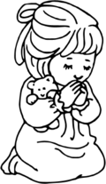
Now I am going to say a prayer and if you want to make it your prayer you can say Amen at the end after me.
Loving God, we give you thanks for all who care for us, who have encouraged us and helped us grow, who have forgiven us, and cared for us when we are unwell, who have supported us when times were hard, who have challenged us, who have told us about you. Thank you, Lord. Amen

Slide 12


