Slide 1
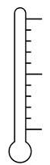

Getting Too Loud
Too Loud
Well done! You are quiet!

Slide 2
Quiet
Too Loud
You are getting too loud!

Slide 3

Quiet
Getting Too Loud
You are too loud!

