Slide 1
50 Homonym Puzzles
What are homonyms?
Homonyms are spelt the same.
They are pronounced the same.
They have different meanings.

Slide 2
Each slide gives first a written clue.
This is followed by picture clues (some with sound) and then finally by the homonyms.
When is the earliest you can guess the words?
Can you spell the homonym on your white board before it is revealed?

Slide 3
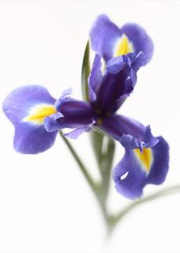

A flower found in your eye.
1
iris

Slide 4
Look at this to see what the time is.
2
watch

Slide 5

Your money is not in danger when it is in this.
3
safe

Slide 6
Practise for a match as you travel on the rails.
4
train

Slide 7


Press down hard with your foot to stick this on the envelope.
5
stamp

Slide 8
A learner in the middle of your eye.
6
pupil

Slide 9
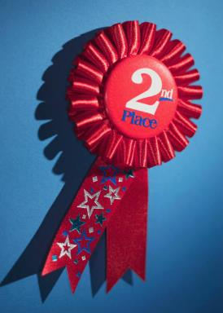

A sixtieth of a minute is not first.
7
second

Slide 10
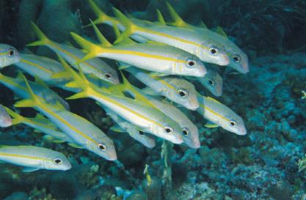
A place where a group of fish learn.
8
school

Slide 11


A keen supporter to cool you down.
9
fan

Slide 12


Move your hand as the water comes in.
10
wave

Slide 13


A less heavy way to start a fire.
11
lighter

Slide 14


A dog does this on the outside of a tree trunk.
12
bark

Slide 15
Shake with fear holding the arrows.
13
quiver

Slide 16

Smooth, not odd numbers.
14
2 8
4 10
6 12
even

Slide 17


Does it squeak when it moves the cursor?
15
mouse

Slide 18
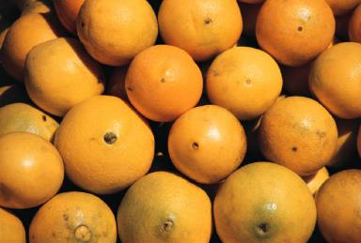
The colour of a fruit.
16
orange

Slide 19
Glue the long piece of wood.
17
stick

Slide 20


A season to go boing!
18
spring

Slide 21
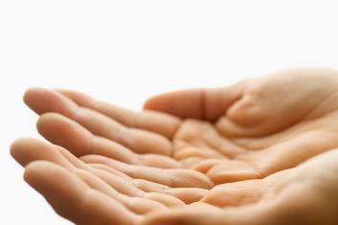
A tree in the middle of your hand.
19
palm

Slide 22
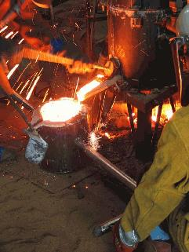
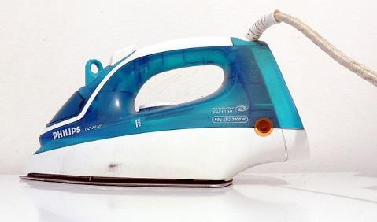
A metal that keeps your clothes free from creases.
20
iron

Slide 23
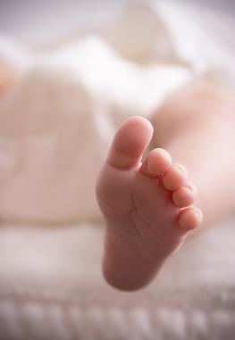

12 inches on the end of your leg.
21
foot

Slide 24
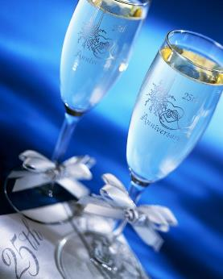
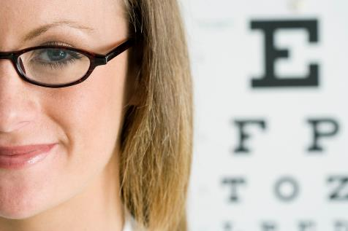
Does drinking from them help you see better?
22
glasses

Slide 25
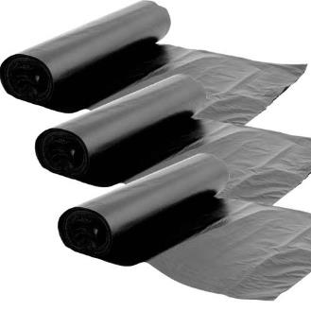
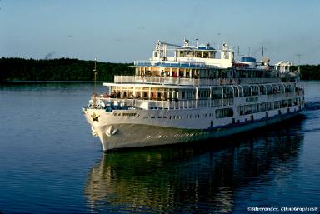
Put this large ship in the bin.
23
liner

Slide 26
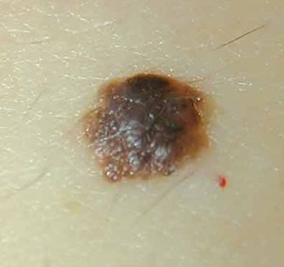
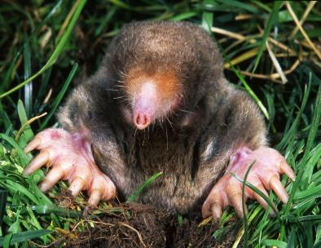
Is this spot caused by a burrowing animal?
24
mole

Slide 27
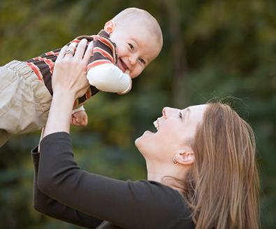
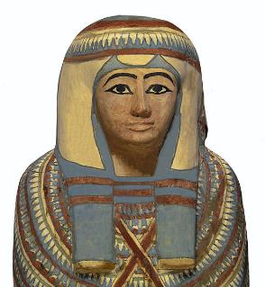
A female parent wrapped in bandages.
25
mummy

Slide 28
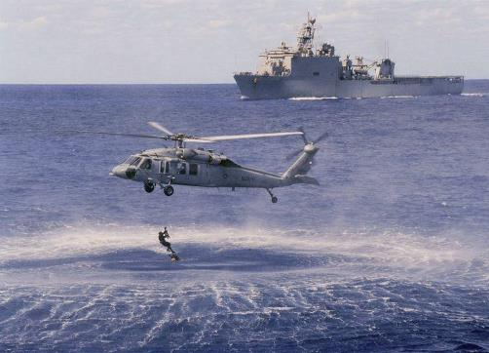
The dark blue warships.
26
navy

Slide 29
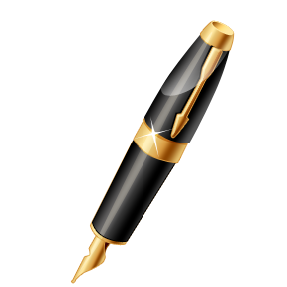
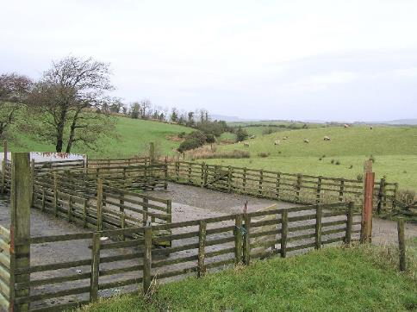
Does the ink in this keep the animals in?
27
pen

Slide 30
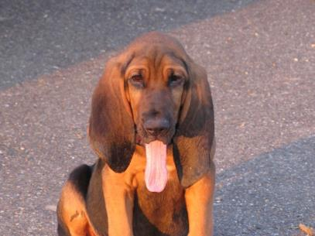
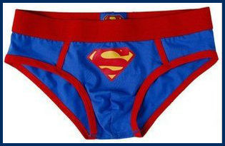
The underwear that breathes quickly!
28
pants

Slide 31
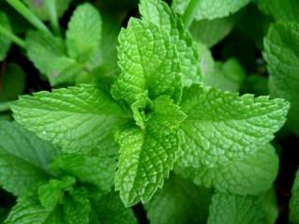
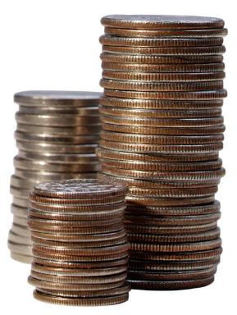
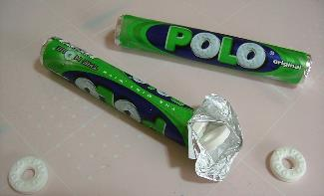
Does this herb make money?
29
mint

Slide 32
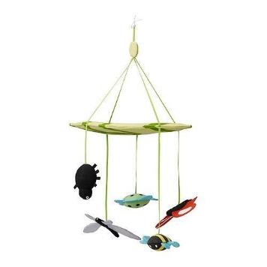
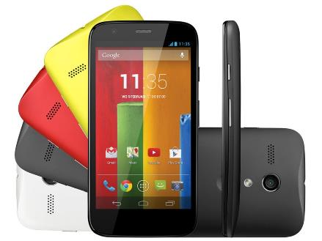
As it hangs down, can you send a text?
30
mobile

Slide 33
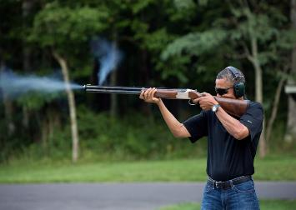
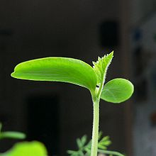
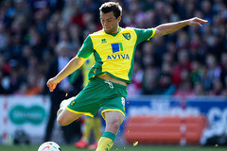
Fire a gun or kick the ball at a new growth on a plant.
31
shoot

Slide 34
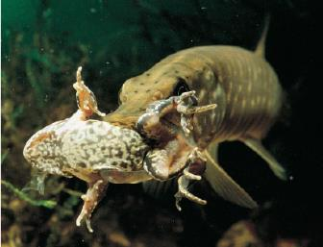
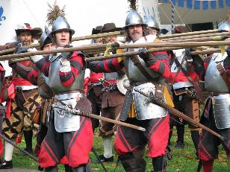
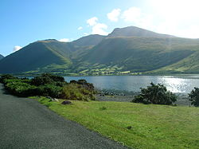
The fierce fish carries the long spear up the mountain.
32
Scarfell
pike

Slide 35
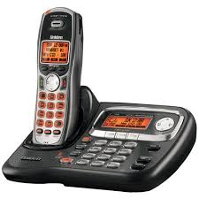
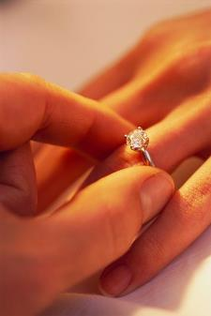

Does the phone do this when you get engaged?
33
ring

Slide 36
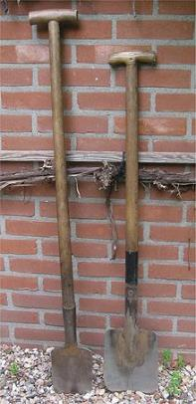
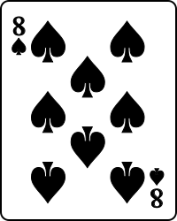
Dig with these in a pack of cards.
34
spades

Slide 37
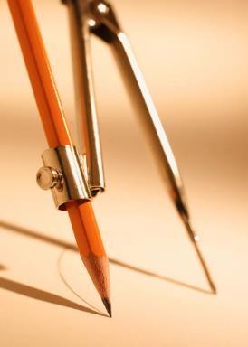

Draw a circle to find where North is.
35
compass

Slide 38
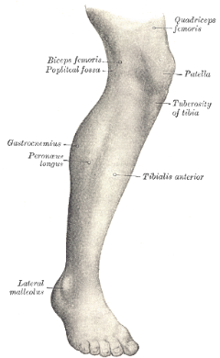
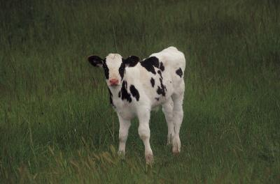
The young cow below the knee.
36
calf

Slide 39
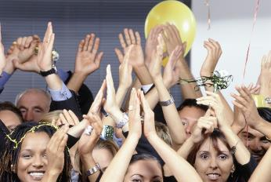

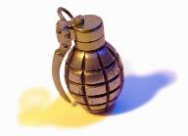
The weapons joined to your shoulders or a coat of ____.
37
arms

Slide 40
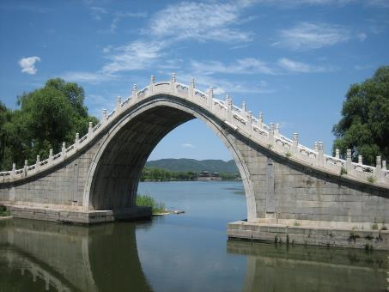
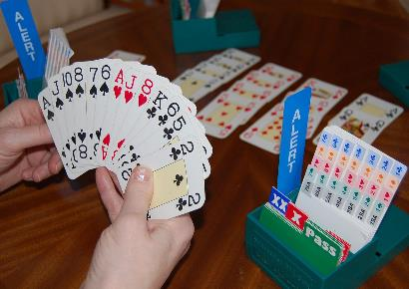
A card game to play crossing the river.
38
bridge

Slide 41
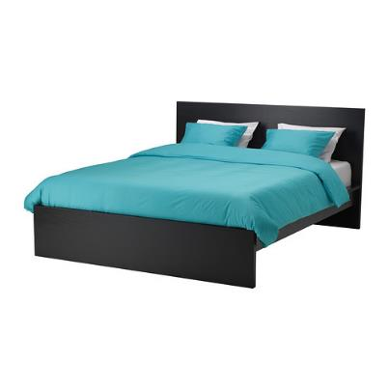
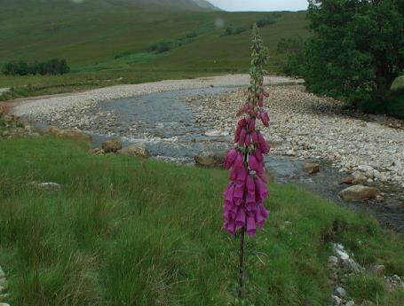
Sleep on this at the bottom of a river.
39
bed

Slide 42
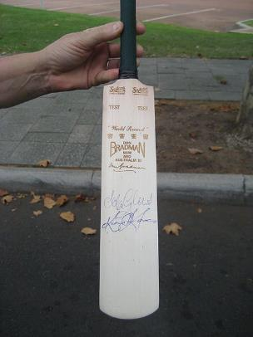
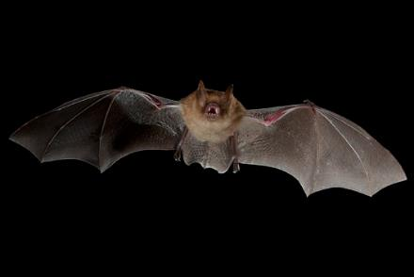
Flies in the dark to hit the ball.
40
bat

Slide 43
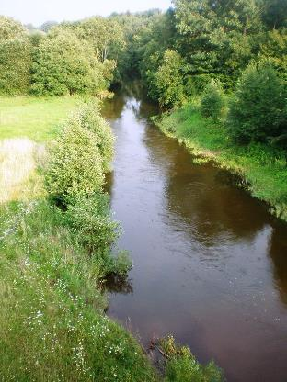
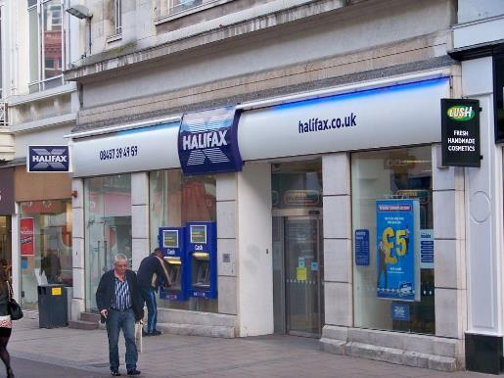
At the side of the river, it keeps your money
41
bank

Slide 44
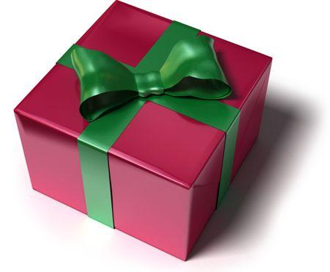

Tie a fancy knot to fire an arrow.
42
bow

Slide 45


Something disgusting from the nose is bad news in golf.
43
bogey
Par 4
Took 5

Slide 46


What is left when this tree is burnt.
44
ash

Slide 47

Is there treasure inside this part of the body?
45
chest

Slide 48


Join one to hit the golf ball.
46
club

Slide 49


A game for an insect.
47
cricket

Slide 50

Get angry when you don’t get a tick.
48
cross

Slide 51

Call out as the frozen rain falls.
49
hail

Slide 52


Jumps on one leg to make beer.
50
hops

Slide 53
The end
Give yourselves a quiet clap!

