Slide 1
50 more homophone puzzles
What are homophones?
Two or more words you pronounce the same.
They have different meanings.
They have different spellings.

Slide 2
Each slide gives first a written clue.
This is followed by picture clues (some with sound) and then finally by the homophones.
When is the earliest you can guess the words?
Can you spell the homophones on your white board before they are revealed?
In most cases there are two homophones. Where there are more, the number is shown in brackets at the end of the written clue.

Slide 3
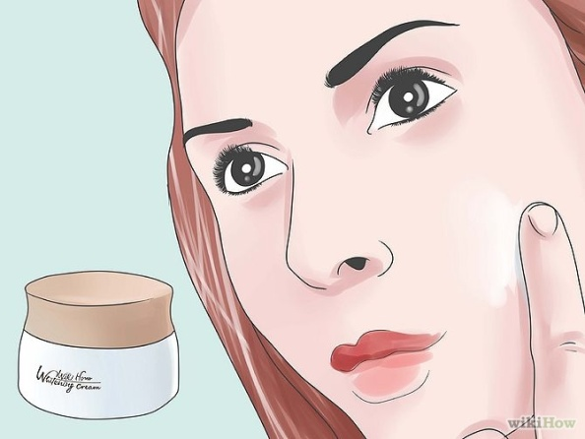
The bucket is light in colour.
pail
pale

Slide 4
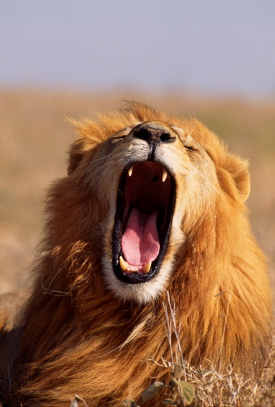
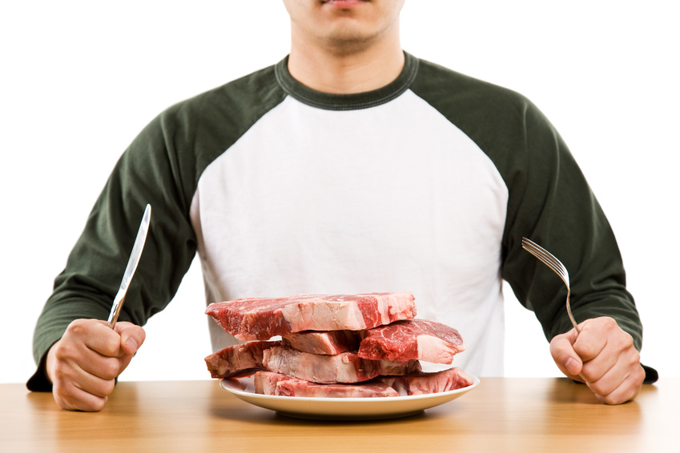

A lion’s cry is not cooked.
roar
raw

Slide 5
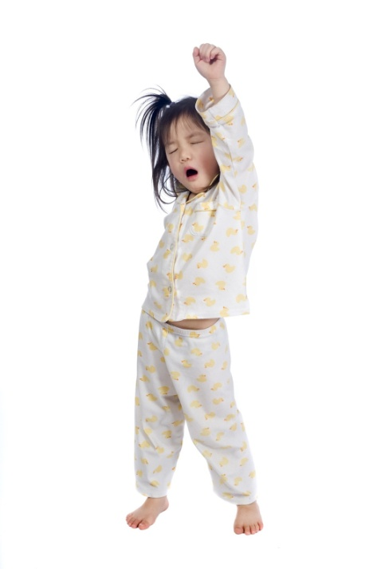
Showing you’re sad early in the day.
mourning
morning

Slide 6
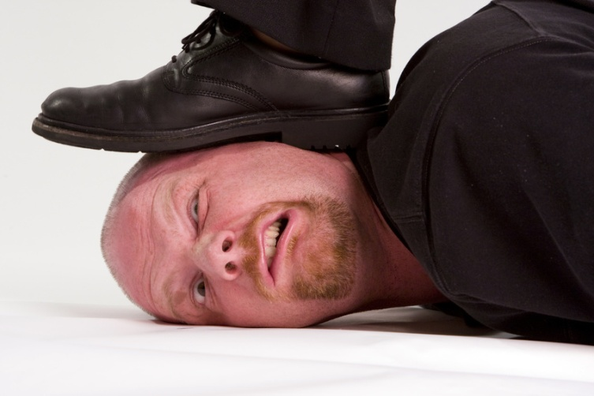
It hurts – this sheet of glass.
pain
pane

Slide 7
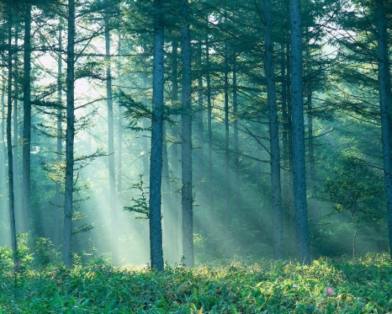
Lift up the beams of light.
raise
rays

Slide 8
You can row a boat with one, alternatively dug from the ground it contains metal. (3)
oar
or
ore

Slide 9

If you take out a ___, you’re on your own.
Only 30% Apr
loan
lone

Slide 10
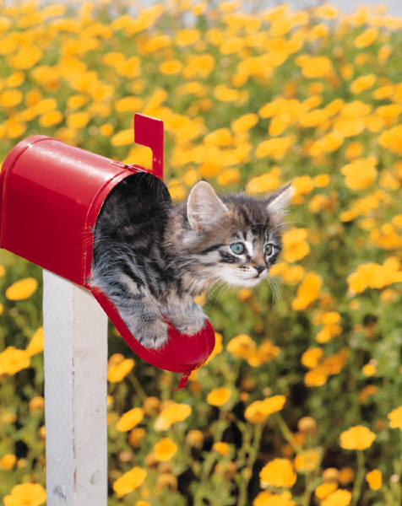
A quick look at the top of a mountain.
peek
peak

Slide 11
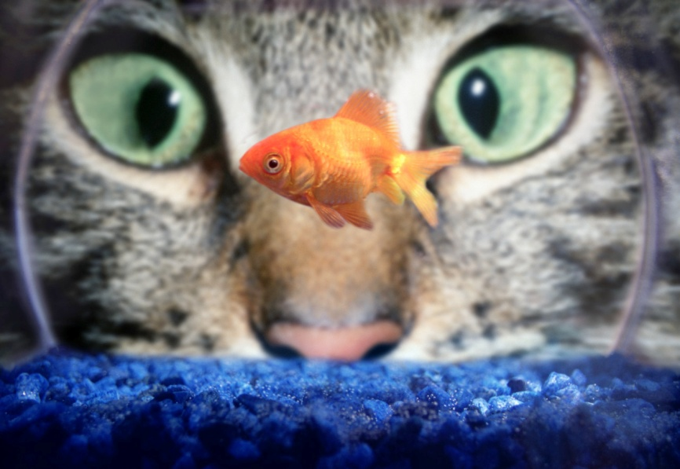
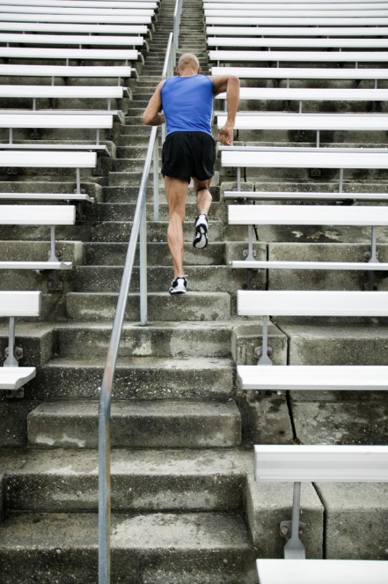
Looks intently while walking up and down them.
stares
stairs

Slide 12
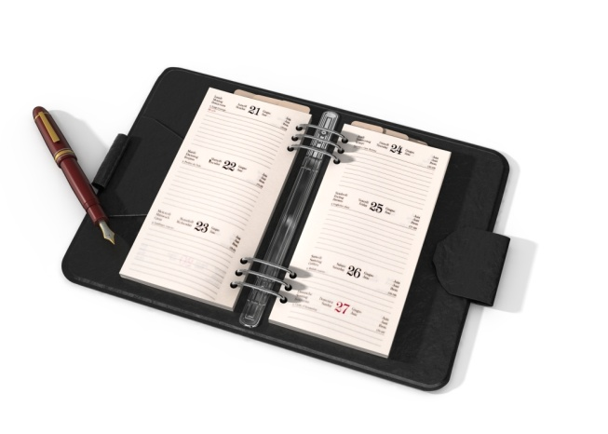
In a muddled dreamy mind for several 24hr periods of time.
daze
days

Slide 13
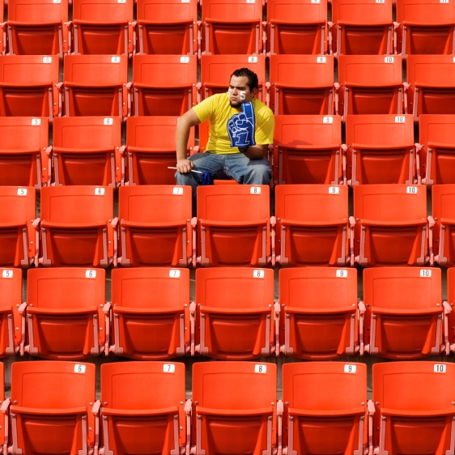
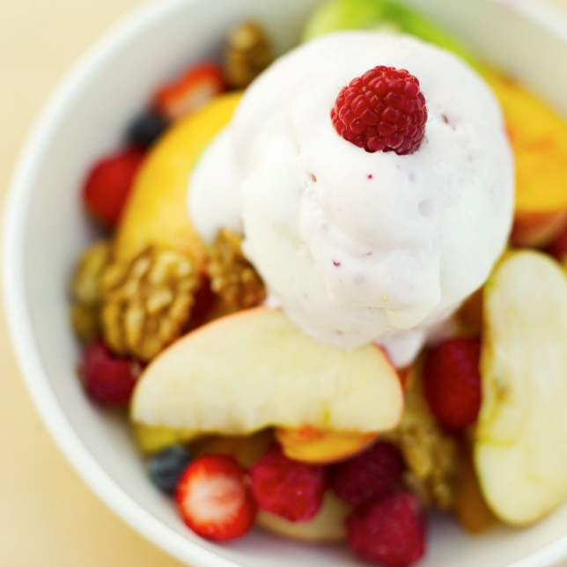
Abandon the pudding.
desert
dessert

Slide 14
Push away with what’s on one foot.
shoo
shoe

Slide 15
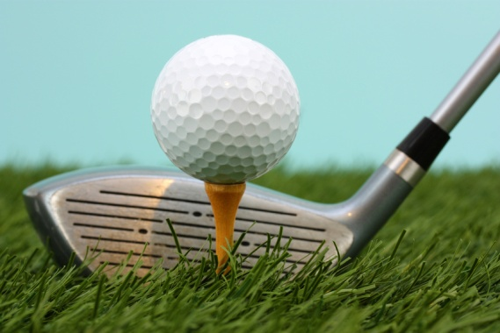
A drink to place a golf ball on.
tea
tee

Slide 16
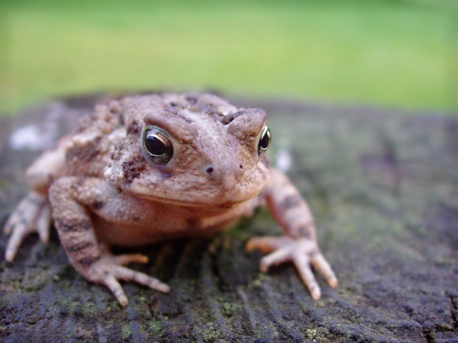
Pulled along like a frog.
towed
toad

Slide 17
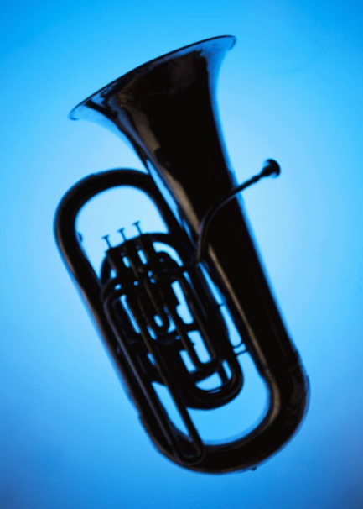
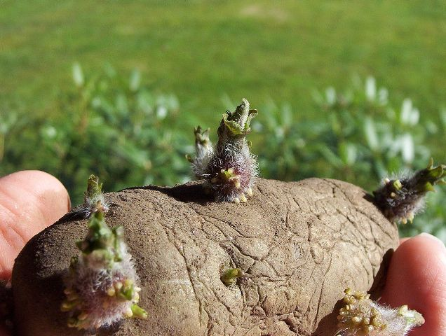
A brass instrument like a potato.
tuba
tuber

Slide 18
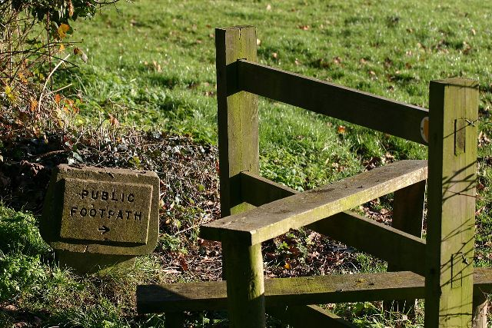
Climb over it with flair.
stile
style

Slide 19
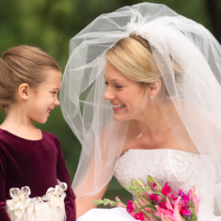
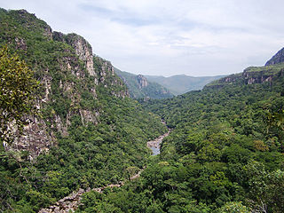
Wear this in a valley.
veil
vale

Slide 20
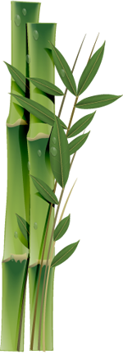
This bird – does it bring babies or is it part of a plant.
stork
stalk

Slide 21
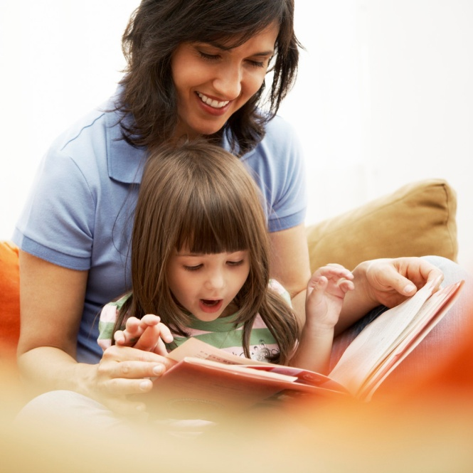
A tale which usually starts on the ground floor and goes up.
story
storey

Slide 22

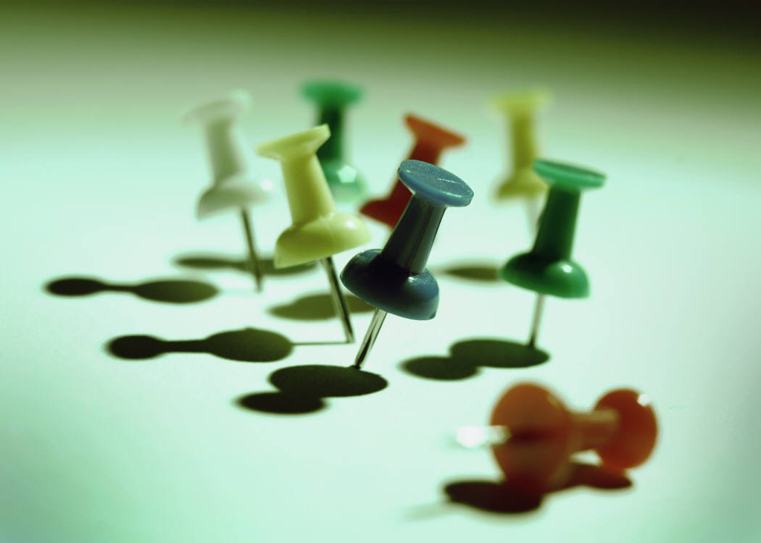
Money paid to the government for small nails.
tax
tacks

Slide 23
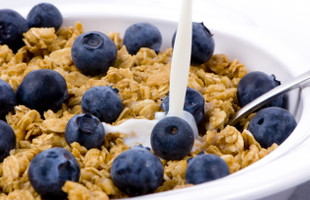
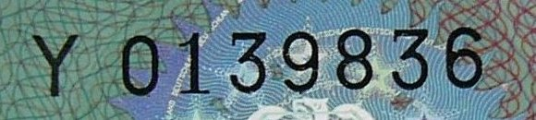
Eaten for breakfast – is it a type of number?
cereal
serial

Slide 24
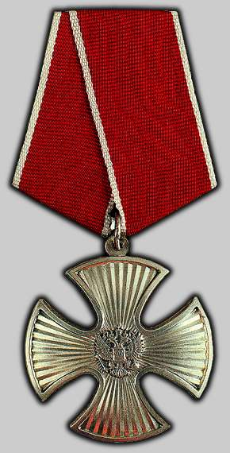
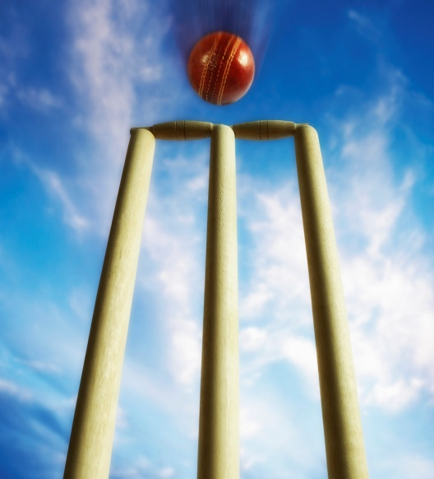
Brave as the ball hits the stumps.
bold
bowled

Slide 25
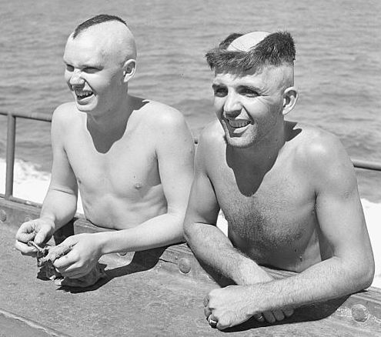
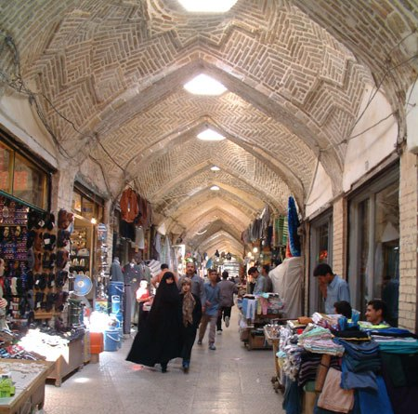
It’s weird in the market.
bizarre
bazaar

Slide 26
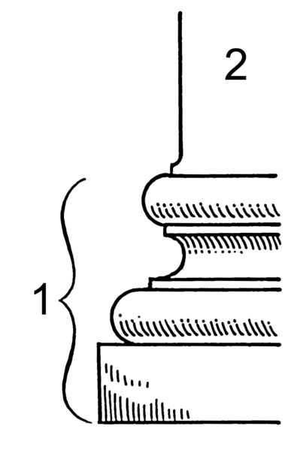
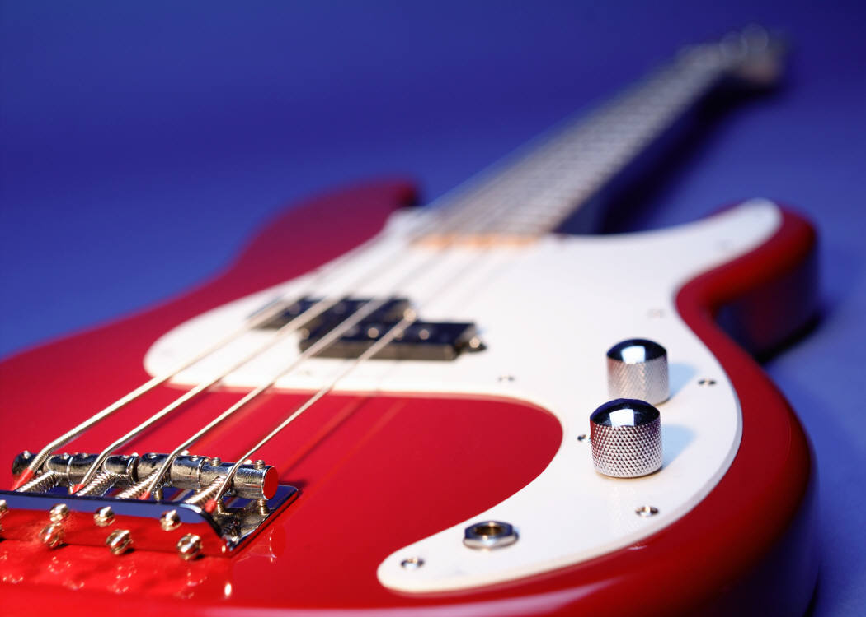
A deep sound from the bottom.
bass
base

Slide 27
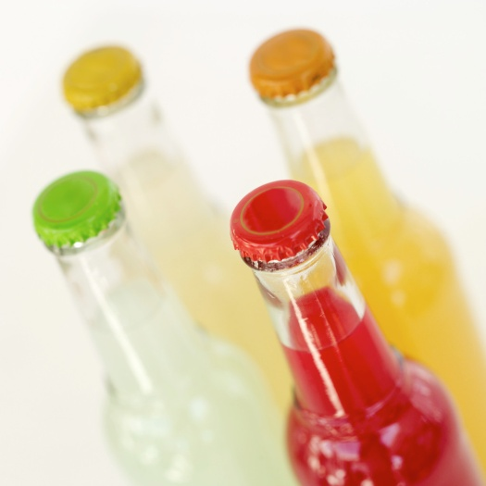
Not against the golfer’s cry between 3 and five. (3)
for
fore
four

Slide 28
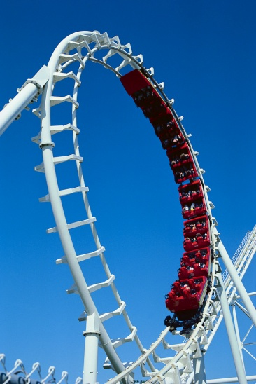
It’s fun and games, up and down – what you pay for a train ride.
fair
fare

Slide 29
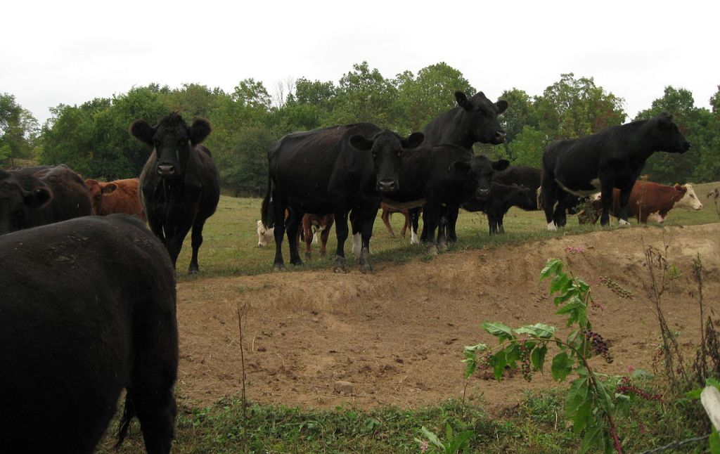
The group of cows listened.
herd
heard

Slide 30
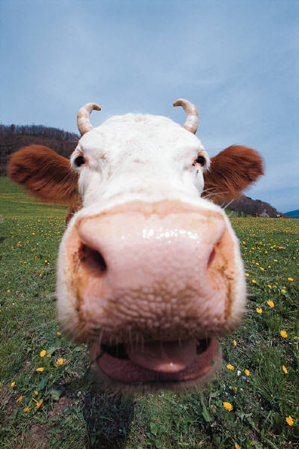

She’s not ignorant she ___– it uses it to smell.
knows
nose

Slide 31
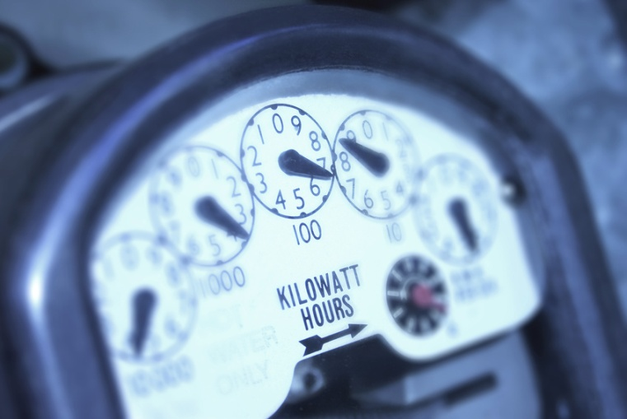
100cm measures your electricity use.
metre
meter

Slide 32
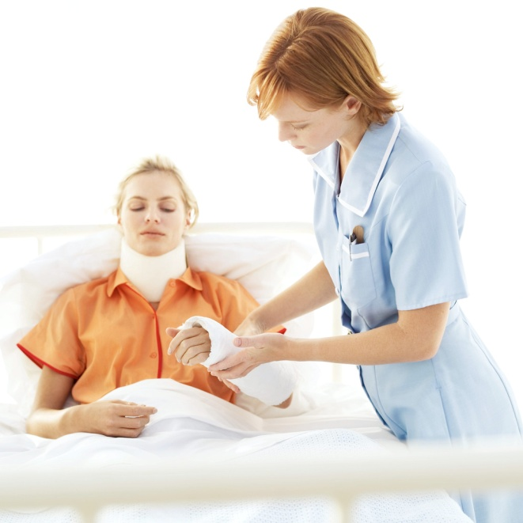
They need this as they wait in hospital.
patience
patients

Slide 33
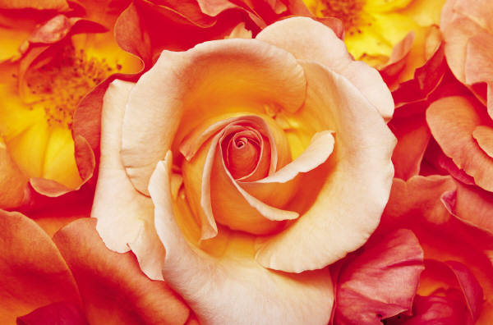
A flower that moves the boat with oars.
rose
rows

Slide 34
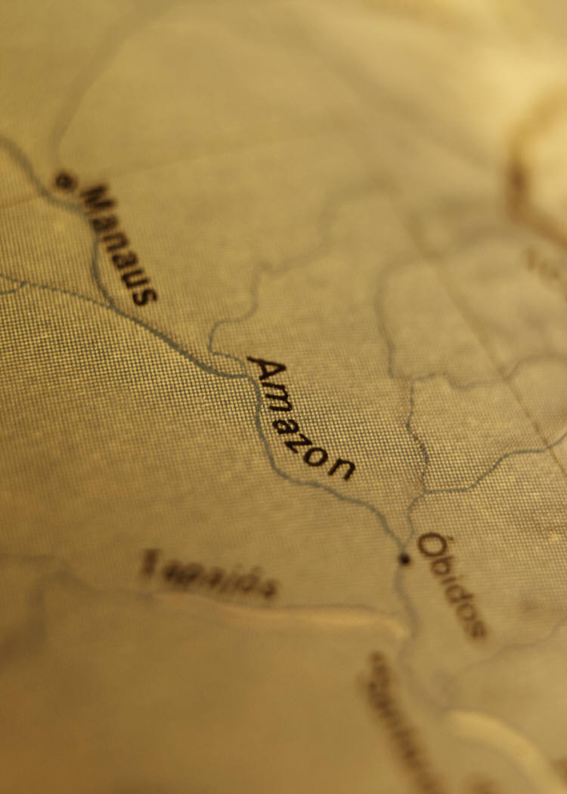


In which place are the clothes put on?
where
wear

Slide 35
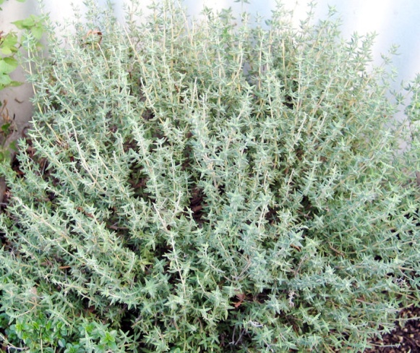
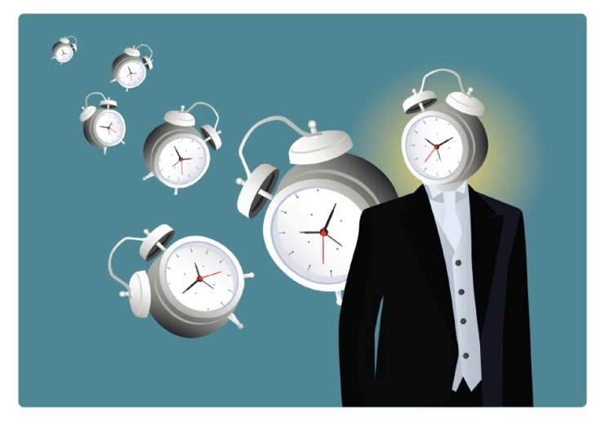
A herb cooked in seconds, minutes or hours.
thyme
time

Slide 36
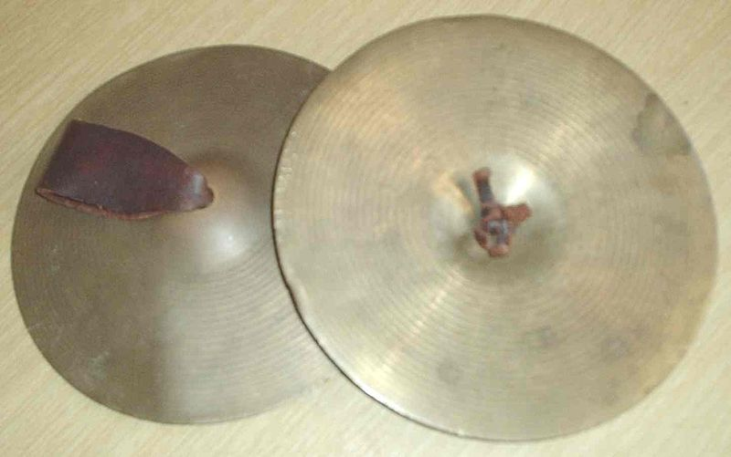
Signs for a clashing percussion instrument.
£ $
÷ °
♪ %
symbols
cymbals

Slide 37
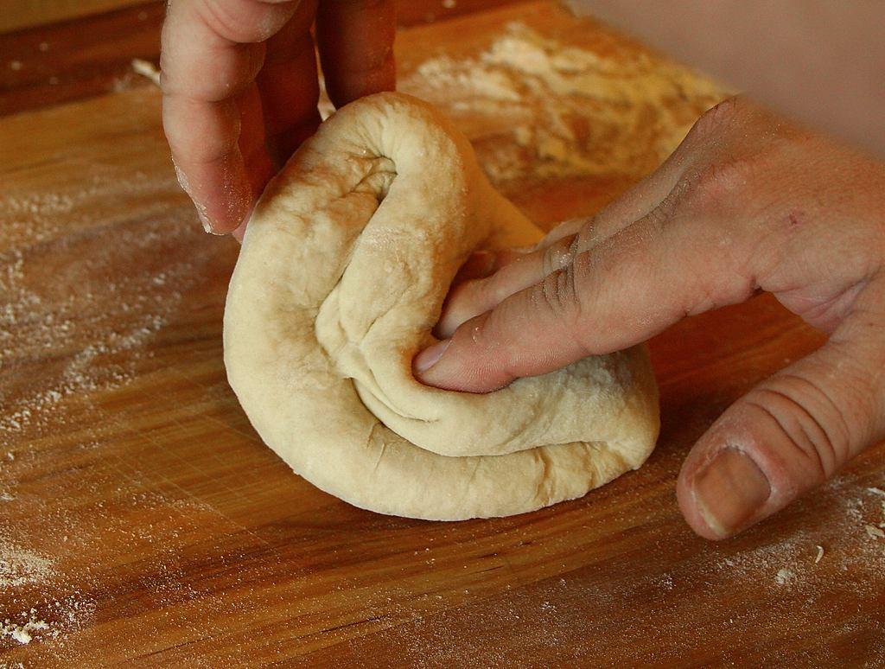
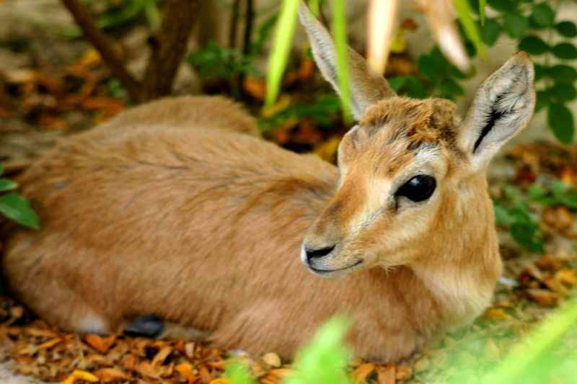
Do you knead this to make a female deer?
dough
doe

Slide 38
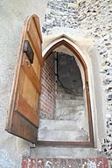
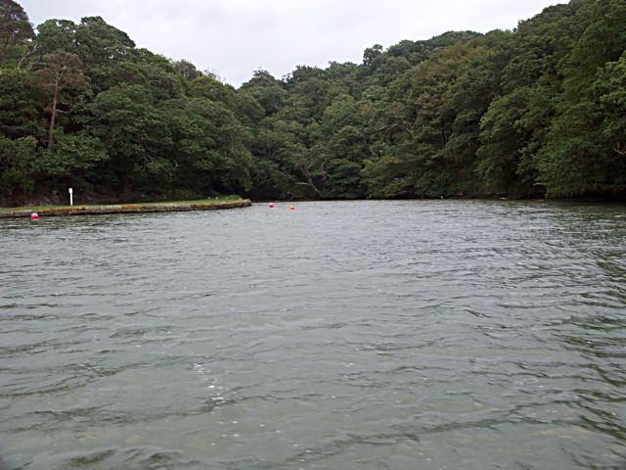
The noise it makes when you are up it without a paddle.
creak
creek

Slide 39
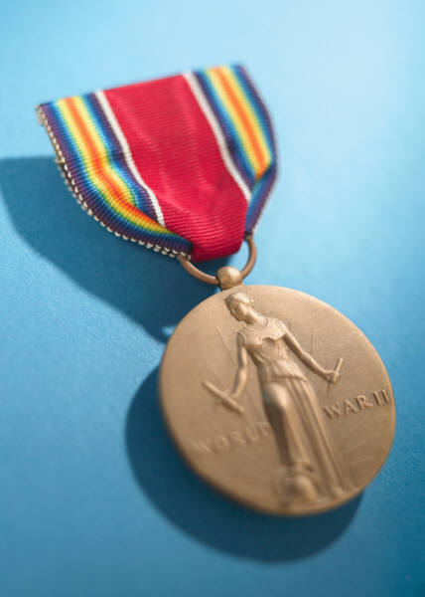
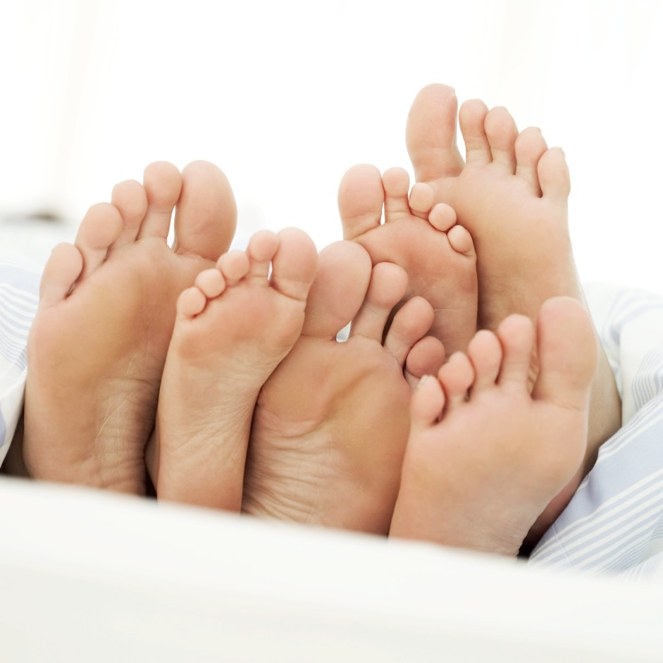
A courageous achievement on the end of your legs.
feat
feet

Slide 40
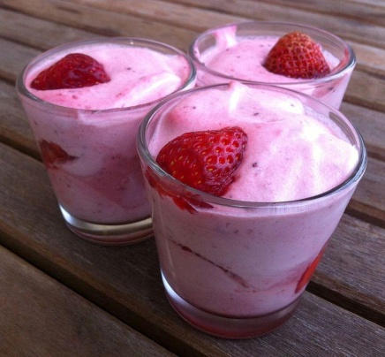
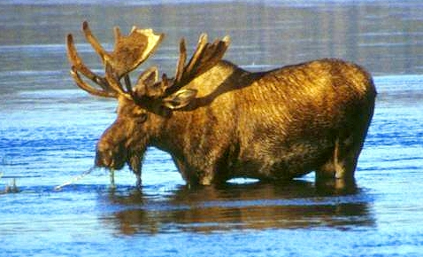
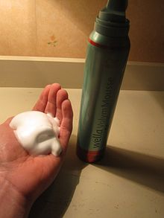
Do you eat this animal or put it on your hair?
moose
mousse

Slide 41




Grab large areas of water and uses eyes. (3)
North
Mediterranean
seize
seas
sees

Slide 42
Thus, to use a needle and thread to plant seeds. (3)
Therefore he was __ clever, he worked it out.
so
sew
sow

Slide 43

Pulls digits on your foot.
tows
toes

Slide 44


Becomes weary of the rubber on wheels.
tires
tyres

Slide 45

The place of one of your 5 senses.
site
sight

Slide 46

How large are the groans?
size
sighs

Slide 47

It’s not fake on a fishing rod.
real
reel

Slide 48

Is this the start of the river of tomato, HP, apple or mint.
source
sauce

Slide 49


A small part means no war.
piece
peace

Slide 50

A plant you could get lost in.
maize
maze

Slide 51


The caterpillar flows from the volcano.
larva
lava

Slide 52

Slow down or smash.
brake
break

