Slide 1

Haiku
Haiku
Syllabic Verse
Syllabic Verse to capture a moment in time

Slide 2


Traditional Japanese pattern
17 syllables
3 lines
1st line: 5 syllables
2nd line: 7 syllables
3rd line: 5 syllables
Contains an image of nature

Slide 3
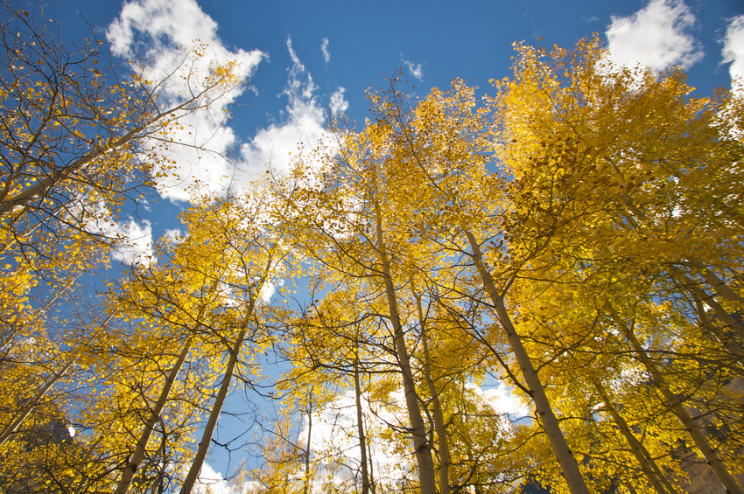
So far and yet near
Heaven above and below
Perspectives change views.

Slide 4

Radiant light shines
Bathing the heavens in love
Reflecting glory.

Slide 5

Mellow autumn mists
Breeze across fields of ripe corn
Tendrils of decay.

Slide 6
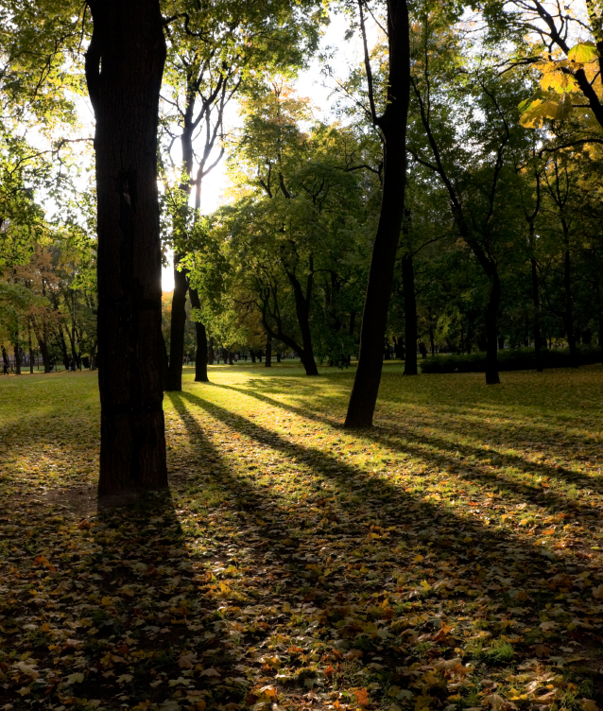
Autumn leaves spin down
Withered life scattered by wind
Trees stand silently.

Slide 7

Wild remote Highland
Beautiful unspoiled nature
Magic Silkie shores.

