Slide 1
Grammar Starter
Interrogative words
All ✰ | Most ✰✰ | Some ✰✰✰
Can I describe the grammar feature using the correct definition? | Can I describe the grammar feature using the correct definition and give my own examples? | Can I describe the grammar feature and give my own examples as well as identifying it in in a range of texts?

Slide 2
In the back of your exercise book...
Grammar Starter: Interrogative words
Definition: These are words which form the basis of a question. When they are used, more than a ‘yes’ or ‘no’ answer is needed.
Example: When shall we next meet?
How many cats do you have?
Why can’t we go swimming?
All ✰ | Most ✰✰ | Some ✰✰✰
Can I describe the grammar feature using the correct definition? | Can I describe the grammar feature using the correct definition and give my own examples? | Can I describe the grammar feature and give my own examples as well as identifying it in in a range of texts?
Notes:
Ask for pupils’ definition before showing the correct one.

Slide 3
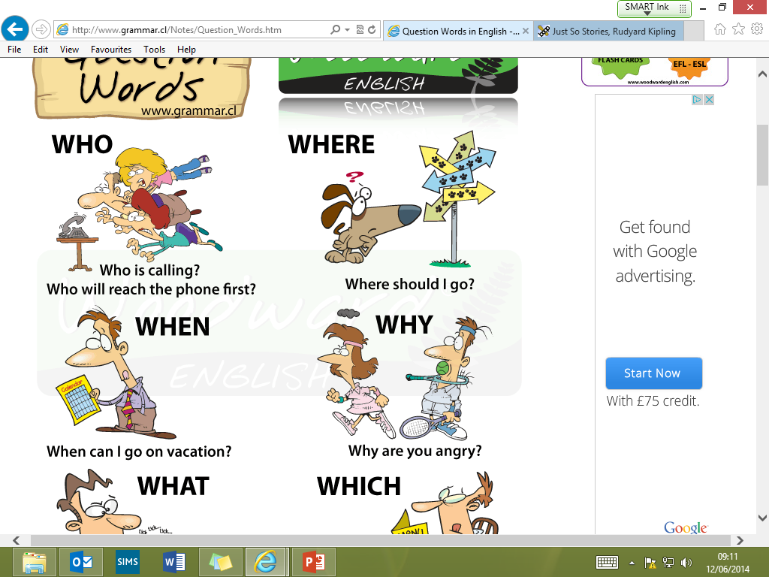
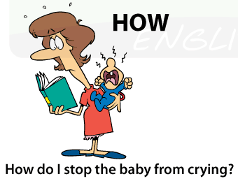
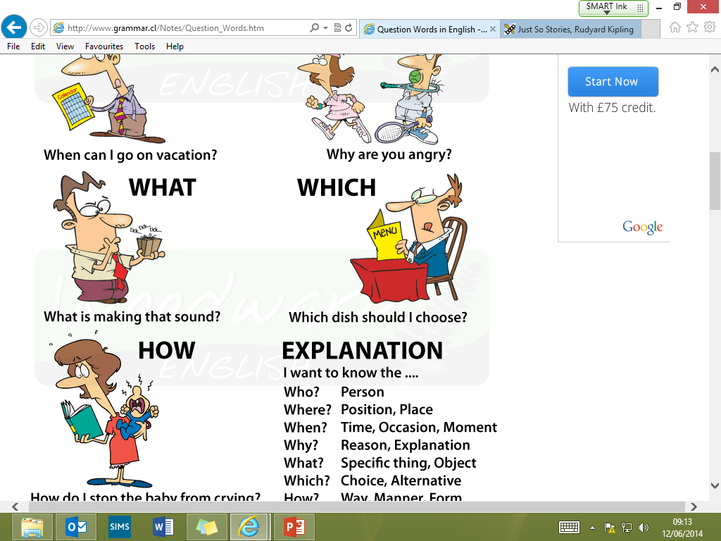
In the back of your exercise book...
I want to know the…
Who? | Person
Where? | Position, Place
When? | Time, Occasion, Moment
Why? | Reason, Explanation
What? | Specific thing, Object
Which? | Choice, Alternative
How? | Way, Manner, Form
All ✰ | Most ✰✰ | Some ✰✰✰
Can I describe the grammar feature using the correct definition? | Can I describe the grammar feature using the correct definition and give my own examples? | Can I describe the grammar feature and give my own examples as well as identifying it in in a range of texts?
Notes:
Ask for pupils’ definition before showing the correct one.

Slide 4
Task time: add them in
Add the correct interrogative word into these sentences and then state why you have used it.
For example: Which ice-cream would you like? = Choice
___________ does water bubble when it is heated?
____________ does baby Harry get christened?
__________ pair of shoes should I buy – the blue ones or the red ones?
_________ broke the vase?
___________ should I decorate the cake?
__________ is that in your hair?
_________ does Sophie live?
_____________ can I get to the library quickly?
All ✰ | Most ✰✰ | Some ✰✰✰
Can I describe the grammar feature using the correct definition? | Can I describe the grammar feature using the correct definition and give my own examples? | Can I describe the grammar feature and give my own examples as well as identifying it in in a range of texts?
Notes:
Hear feedback.

Slide 5
Task time: add them in
Add the correct interrogative word into these sentences and then state why you have used it.
For example: Which ice-cream would you like? = Choice
Why does water bubble when it is heated? = Explanation
When does baby Harry get christened? = Time/Occasion
Which pair of shoes should I buy – the blue ones or the red ones? = Alternative
Who broke the vase? = Person
How should I decorate the cake? = Manner
What is that in your hair? = Specific thing/Object
Where does Sophie live? = Place
How can I get to the library quickly? = Way
All ✰ | Most ✰✰ | Some ✰✰✰
Can I describe the grammar feature using the correct definition? | Can I describe the grammar feature using the correct definition and give my own examples? | Can I describe the grammar feature and give my own examples as well as identifying it in in a range of texts?
Notes:
Hear feedback.

Slide 6
Task time: create your own
Write three sentences for each interrogative word. Be creative!
All ✰ | Most ✰✰ | Some ✰✰✰
Can I describe the grammar feature using the correct definition? | Can I describe the grammar feature using the correct definition and give my own examples? | Can I describe the grammar feature and give my own examples as well as identifying it in in a range of texts?
Notes:
Hear feedback.

