Slide 1
Grammar Starter
Silent letters
All ✰ | Most ✰✰ | Some ✰✰✰
Can I describe the grammar feature using the correct definition? | Can I describe the grammar feature using the correct definition and give my own examples? | Can I describe the grammar feature and give my own examples as well as identifying it in in a range of texts?

Slide 2
In the back of your exercise book...
Grammar Starter: Silent letters
Definition: A silent letter is a letter in a word that you can’t hear when the word is said but when you write it, the silent letter is there.
Example: knife autumn design
All ✰ | Most ✰✰ | Some ✰✰✰
Can I describe the grammar feature using the correct definition? | Can I describe the grammar feature using the correct definition and give my own examples? | Can I describe the grammar feature and give my own examples as well as identifying it in in a range of texts?
Notes:
Ask for pupils’ definition before showing the correct one.

Slide 3
The main silent letters
Silent g
Words like gnome and gnash.
Silent k
Words like knee and know.
Silent w
Words like write and wring.
Silent h
Words like what and why.
All ✰ | Most ✰✰ | Some ✰✰✰
Can I describe the grammar feature using the correct definition? | Can I describe the grammar feature using the correct definition and give my own examples? | Can I describe the grammar feature and give my own examples as well as identifying it in in a range of texts?

Slide 4
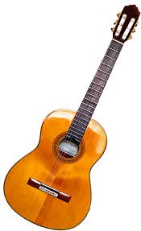
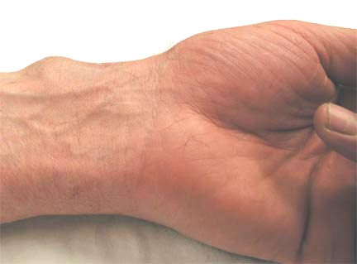
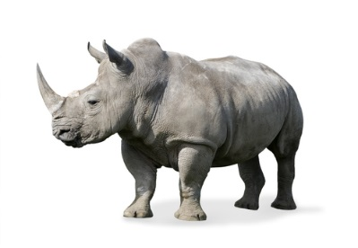
Task time: create your own
List as many words with silent letters as you can.
All ✰ | Most ✰✰ | Some ✰✰✰
Can I describe the grammar feature using the correct definition? | Can I describe the grammar feature using the correct definition and give my own examples? | Can I describe the grammar feature and give my own examples as well as identifying it in in a range of texts?
Notes:
Hear feedback.

Slide 5
Some words with silent letters
Ache
Autumn
Chemical
Column
Crescent
Echo
Fasten
Foreign
Gnat
Guilt
Handkerchief
Hymn
Knee
Knit
Know
Listen
Numb
Psychology
Scene
Scissors
Sword
Technology
Tomb
Whistle
Wrestle
All ✰ | Most ✰✰ | Some ✰✰✰
Can I describe the grammar feature using the correct definition? | Can I describe the grammar feature using the correct definition and give my own examples? | Can I describe the grammar feature and give my own examples as well as identifying it in in a range of texts?

Slide 6
Task time: now find it!
1) Write a paragraph about a day trip to a location of your choice. You need to include as many words with silent letters as you can.
2) Swap your work with a partner.
3) You now need to highlight all the words your partner’s used which have a silent letter in them.
4) Give the work back to your partner. Did they find all your silent letters?
All ✰ | Most ✰✰ | Some ✰✰✰
Can I describe the grammar feature using the correct definition? | Can I describe the grammar feature using the correct definition and give my own examples? | Can I describe the grammar feature and give my own examples as well as identifying it in in a range of texts?

