Slide 1
Rhyming Words
The at family

Slide 2
Choose a letter to make a word.
__at
h
p
c
f
s
r
b
m

Slide 3

Try to spell the at family words
cat
pat
bat
hat
sat
rat
fat
bat
mat

Slide 4
Match the pictures to the words
rat
hat
mat
pat
bat
fat
cat
sat
bat

Slide 5
Rhyming Words
The an family

Slide 6
Choose a letter to make a word.
__an
r
m
c
f
p
t
b
v

Slide 7
Try to spell the an family words
man
van
fan
ran
fan
pan
can
tan

Slide 8
Match the pictures to the words
van
ran
man
pan
can
fan
fan
tan

Slide 9
Rhyming Words
The ar family

Slide 10
Choose a letter to make a word.
__ar
w
st
c
f
p
t
b

Slide 11


Try to spell the ar family words
far
jar
bar
car
tar
war
star

Slide 12
Match the pictures to the words
tar
jar
bar
car
star
war
far

Slide 13
Rhyming Words
The ag family

Slide 14
Choose a letter to make a word.
__ag
w
r
t
b

Slide 15

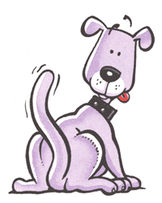
Try to spell the ag family words
bag
wag
tag
rag

Slide 16
Match the pictures to the words
tag
rag
bag
wag

Slide 17
Rhyming Words
The am family

Slide 18
Choose a letter to make a word.
__am
j
r

Slide 19
Try to spell the ag family words
jam
ram

Slide 20
Match the pictures to the words
jam
ram

Slide 21
Rhyming Words
The ad family

Slide 22
Choose a letter to make a word.
__ad
d
s
m
b

Slide 23
Try to spell the ad family words
bad
dad
sad
mad

Slide 24
Match the pictures to the words
mad
dad
bad
sad

Slide 25
Rhyming Words
The ap family

Slide 26
Choose a letter to make a word.
__ap
n
t
l
c
g
m

Slide 27
Try to spell the ap family words
nap
cap
lap
gap
tap
map

Slide 28
Match the pictures to the words
tap
lap
cap
gap
nap
map

Slide 29
Rhyming Words
The ay family

Slide 30
Choose a letter to make a word.
__ay
r
h
d
b
l

Slide 31

Try to spell the ay family words
bay
hay
day
lay
ray

Slide 32
Match the pictures to the words
bay
lay
hay
day
ray

Slide 33
Rhyming Words
The aw family

Slide 34
Choose a letter to make a word.
__aw
r
s
p

Slide 35
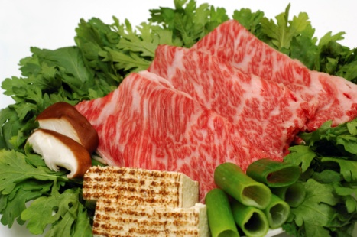


Try to spell the aw family words
saw
raw
paw

Slide 36
Match the pictures to the words
saw
raw
paw

