Slide 1
Rhyming Words
The et family

Slide 2
Choose a letter to make a word.
__et
v
l
p
n
s
w
g
m

Slide 3
Try to spell the at family words
get
vet
net
set
wet
met
let
pet
net

Slide 4
Match the pictures to the words
vet
met
set
net
pet
get
net
wet

Slide 5
Rhyming Words
The en family

Slide 6
Choose a letter to make a word.
__en
h
m
t
d
p

Slide 7

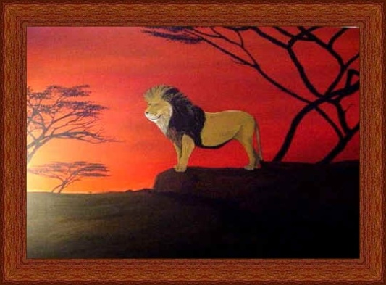

Try to spell the en family words
den
pen
ten
men
hen

Slide 8
Match the pictures to the words
pen
ten
hen
men
den

Slide 9
Rhyming Words
The eg family

Slide 10
Choose a letter to make a word.
__eg
b
p
k
l

Slide 11



Try to spell the eg family words
leg
keg
beg
peg

Slide 12
Match the pictures to the words
beg
leg
peg
keg

