Slide 1
Rhyming Words
The ut family

Slide 2
Choose a letter to make a word.
__ut
n
h
c
p

Slide 3
Try to spell the ut family words
hut
nut
cut

Slide 4
Match the pictures to the words
cut
nut
hut

Slide 5
Rhyming Words
The ub family

Slide 6
Choose a letter to make a word.
__ub
c
t

Slide 7
Try to spell the ub family words
tub
cub

Slide 8
Match the pictures to the words
tub
cub

Slide 9
Rhyming Words
The ud family

Slide 10
Choose a letter to make a word.
__ud
b
m

Slide 11
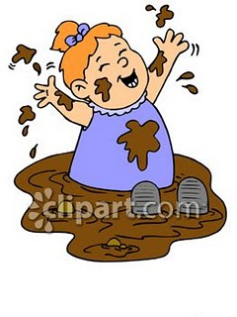
Try to spell the ud family words
mud
bud

Slide 12
Match the pictures to the words
bud
mud

Slide 13
Rhyming Words
The ug family

Slide 14
Choose a letter to make a word.
__ug
r
h
m
b

Slide 15
Try to spell the ug family words
mug
hug
rug
bug

Slide 16
Match the pictures to the words
rug
hug
mug
bug

Slide 17
Rhyming Words
The un family

Slide 18
Choose a letter to make a word.
__un
r
f
b

Slide 19
Try to spell the un family words
bun
fun
run

Slide 20
Match the pictures to the words
fun
bun
run

Slide 21
Word ending with us
bus

