Slide 1

Born to Sing
Sally Morgan

Slide 2

Chapter 1
Name all the characters we are introduced to.
Answer in full sentences.
1. Where did the family go for their holidays last year?
2. What types of transport will the family be using?
3. Why doesn’t Maddie want to go in the caravan?
4. When are the 4 times that Maddie makes up songs?

Slide 3



Research
Find out about the 3 creatures the children like
Write 5 facts about each and draw a picture.
Who is your favourite singer?
Find out 5 facts about them.
List 3 of their songs.

Slide 4

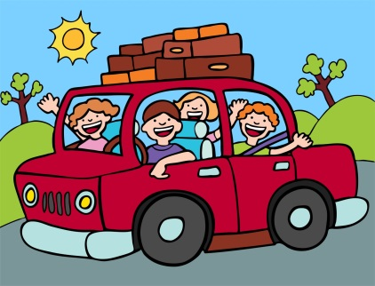
Chapter 2 (page 10-12)
Make a list of the items you would take on a caravan trip to Shark Bay.
Look at a map showing the journey from Perth to Shark Bay.
List 10 of the places you would pass on the journey.

Slide 5
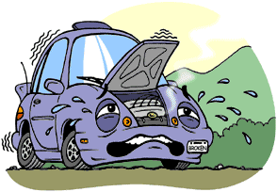
Chapter 2 (p13-22)
Answer in full sentences
1. Name the 2 towns the family stop in.
2. What does ‘we sing our hearts out’ mean?
3. What 2 things do they check when the car breaks down?
4. Predict what happens next.
5. Using the internet sketch a car engine.
Label 5 parts.

Slide 6


Chapter 3
Find out the definitions of these words then write them in an interesting sentence.
Spark plug
Magnificent
Distress
Chuckle
Khaki
What is Maddie worried about?
Draw a large speech bubble and write 3 reassuring sentences to her.

Slide 7
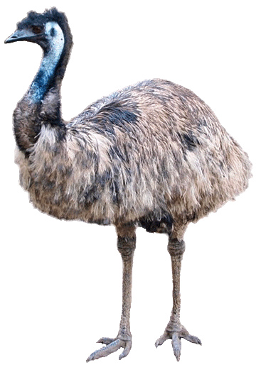
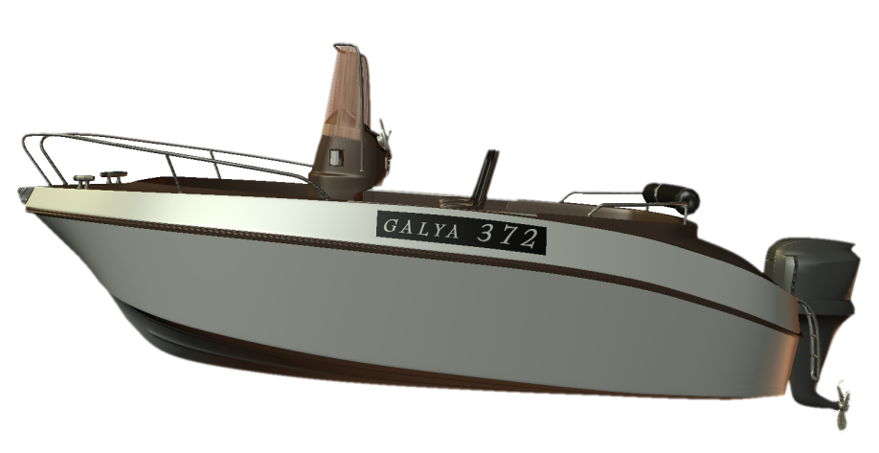
Chapter 4 (page 32-38)
Use the internet to find the names and phone numbers of 3 charter boat cruises in Denham.
Find out about emus.
Write 5 facts and draw a picture.

Slide 8
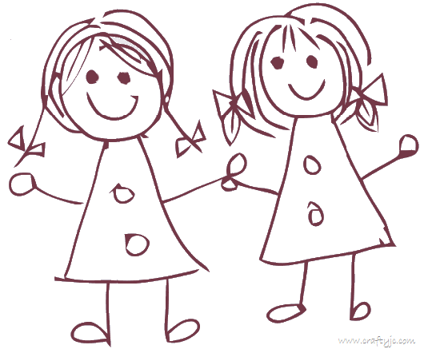
Chapter 4 (p38-42)
This trip is sad, sad, sad
It was my bad, bad, bad.
Find some more words that rhyme with sad and bad.
Help Maddie to make a new friend.
Write 5 things she could say or ask Terry to get to know her better.

Slide 9





Chapter 5
Brainstorm all the emotions/feelings that Maddy would have felt on the whale watching boat trip.
Imagine that Maddie has released her whale song on a CD.
Design the CD cover.

Slide 10

Story Review
Read the introductions to the other 5 books by Sally Morgan.
Which one would you like to read next and why.
Complete a survey with your reading group.
Show the results in a graph.
Complete a book review about Born to Sing.

