Slide 1

English Proverbs

Slide 2
Here are some English proverbs to learn or revise.
Do you know any
of them?
Can you guess them?

Slide 3
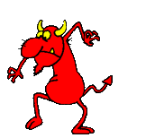
“to choose between two equally bad alternatives in a serious dilemma”
between the devil and the deep blue sea

Slide 4

“a friend who helps when one is in trouble is a real friend”
a friend in need is a
friend indeed

Slide 5
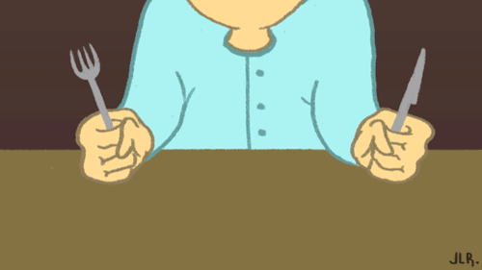
“a person who does not get what he wants or needs is a frustrated person and will be easily provoked to rage”
a hungry man is an angry man

Slide 6

“those people who have little knowledge usually talk the most and make the greatest fuss”
empty vessels make the
most noise

Slide 7
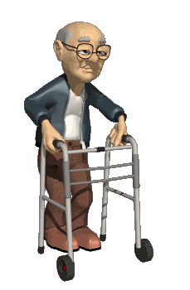
“a person’s age is immaterial – it is only when he thinks and feels that he is ageing that he actually becomes old”
a man is as old as he feels

Slide 8

“to succeed in life one must have the courage to pursue what one wants”
faint heart never won fair lady

Slide 9

“by being thrifty one will be
able to save up”
a penny saved is a
penny gained

Slide 10

“those who make loud threats seldom carry them out”
barking dogs seldom bite

Slide 11

“people of the same sort of character or belief always
go together”
birds of a feather
flock together

Slide 12

“everyone will get a period of success or satisfaction
during his lifetime”
every dog has its day

Slide 13

“when an event is not decided on or planned earlier it will never take place”
any time means no time

Slide 14

“a bad or evil occurrence”
it’s an ill wind that blows nobody any good

Slide 15

“an act done repeatedly and often enough will sooner or later become a habit or second nature”
habit is second nature

Slide 16
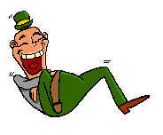
“a person who does his best is the one who will get the greatest satisfaction in the end”
he who laughs best laughs last

Slide 17
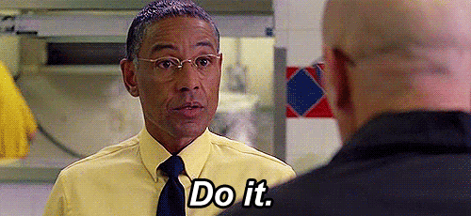
“those people who talk a lot and are always teaching others usually do not do much work”
great talkers are little doers

Slide 18

“it’s never too late to correct one’s mistakes or faults”
it’s never too late to mend

Slide 19
http://efl-fle-chezvous.monsite-orange.fr/

