Slide 1

English Proverbs

Slide 2
Here are some English proverbs to learn or revise.
Do you know any
of them?
Can you guess them?

Slide 3

one who is usually silent and goes about his business quietly may be a very wise person
still waters run deep

Slide 4
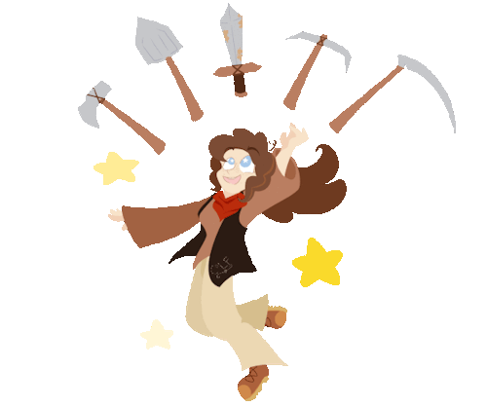
is a person who can do almost anything, but he rarely excels in any of them
Jack of all trades and master of none

Slide 5

one should forgive and forget all the bad deeds done by others
let bygones be bygones

Slide 6

when there is no news, it is likely that everything is all right
no news is good news

Slide 7

being honest is believed to be the best route to take
honesty is the best policy

Slide 8
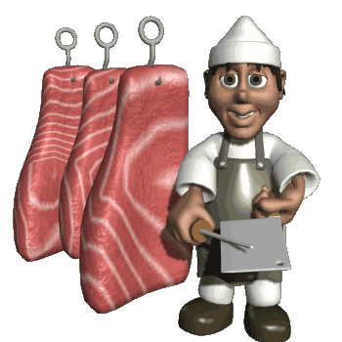
no two people are alike – every one has his own likes and dislikes
one man’s meat is
another man’s poison

Slide 9

talk may be beneficial, but sometimes acquiescence may be the best option to take
speech is silver, silence is golden

Slide 10
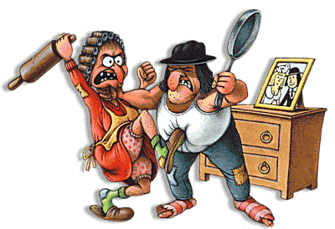
both parties in a quarrel should share the blame or take responsibility
it takes two to make a quarrel

Slide 11

in life there are some things which once done cannot be changed
what’s done is done

Slide 12
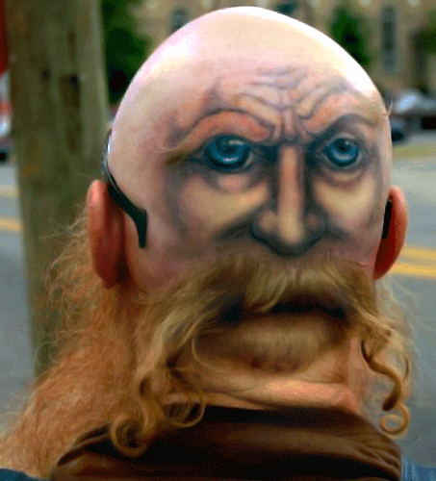
to know what is happening
without seeing it
have eyes in the back of one’s head

Slide 13

troubles seem to go on and on without end
if it’s not one thing it’s another

Slide 14

there is no upper limit to something
the sky is the limit

Slide 15
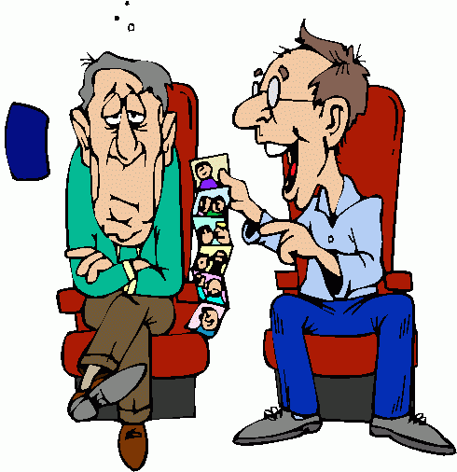
your troubles seem less important when you discuss them with someone
a trouble shared is a trouble halved

Slide 16

something you have is better than something you may not be able to get
a miss is as good as a mile

Slide 17

very much in love with someone
worship the ground somebody walks on

Slide 18

You made a decision and now must accept its consequences
you’ve made your bed, now lie on it

Slide 19

one success doesn’t guarantee complete success
one swallow doesn’t make a summer

Slide 20
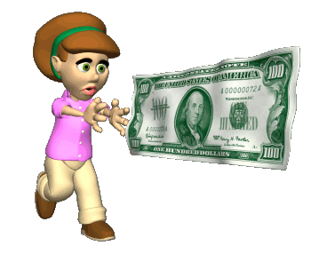
crimes and wickedness are associated with money
money is the root of all evil

Slide 21
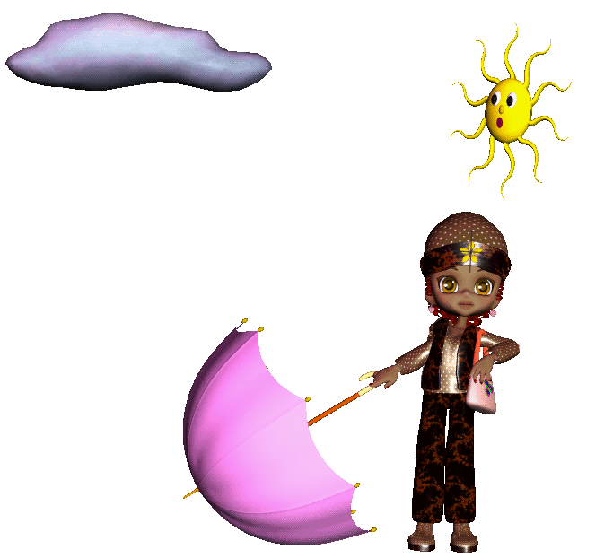
to take special precautions to
avoid making a mistake
to be on the safe side

Slide 22
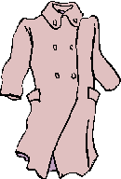
live within your income, don’t be too ambitious in your plans
cut your coat according to your cloth

Slide 23

don’t expect everyone to think and act as you do
it takes all sorts to make a world

Slide 24
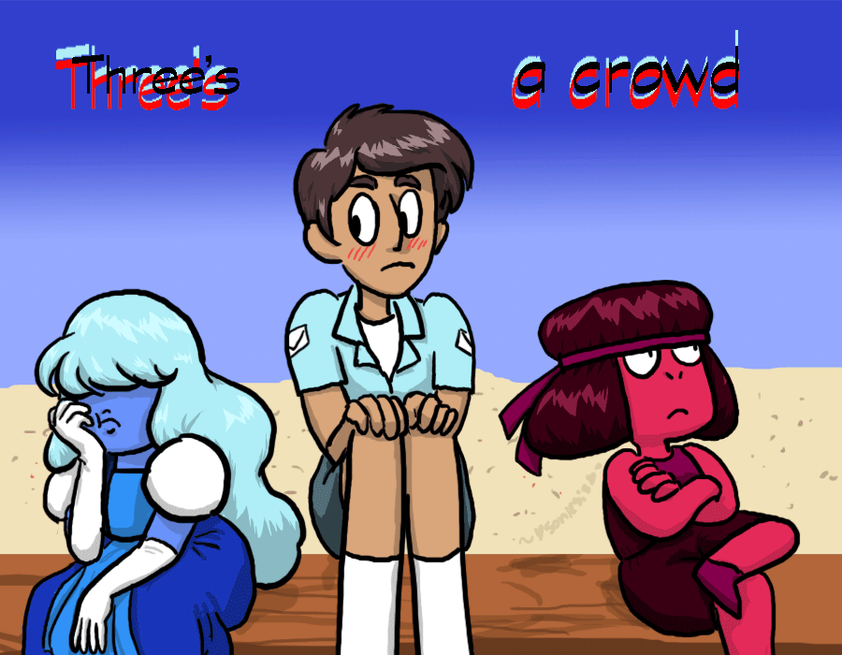
sometimes it’s fun when there are only two people; the third person is often an unwelcome intrusion
two’s (is) company, three’s (is) a crowd

Slide 25
http://efl-fle-chezvous.monsite-orange.fr/
Janet Mournard

