Slide 1
Idioms 1

Slide 2
Each idiom has two slides.
In the first slide you get a picture clue – can you guess the idiom?
In the second slide three possible meanings are given – can you guess the correct one?
Authors of photos are attributed in the notes of the relevant slide.

Slide 3
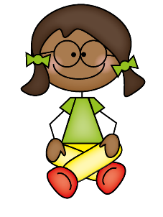

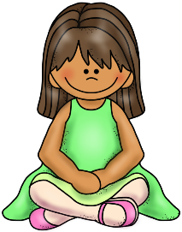

1
Sit on the fence.
Answer

Slide 4



1
Chat with your neighbour over the fence.
?
Not decide on a particular issue.
?
Flatten your neighbour’s fence.
?
Molly could not decide whether to go to France or Germany. In the end, she sat on the fence and let Jane make the decision.

Slide 5



2
1
3
1
4
2
5
7
6
8
Be on cloud nine.
Answer

Slide 6
2
Be extremely happy.
?
Fly in an aeroplane through clouds.
?
Experience high pollution levels – clouds of smoke.
?
When he knew it was English, he was on cloud nine.

Slide 7

3
Rings a bell.
Answer

Slide 8
3
Be the belle of the ball.
?
?
Rings the church bells every Sunday.
?
Sounds familiar.
I couldn’t place her but her name rang a bell.

Slide 9
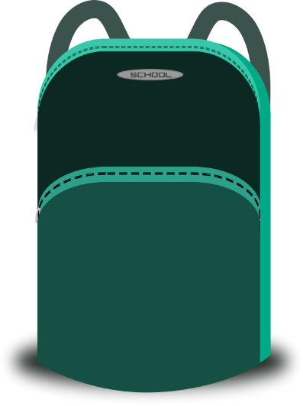
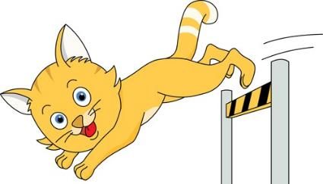
4
Let the cat out of the bag.
Answer

Slide 10
4
Allow the cat to escape.
?
Reveal a secret.
?
Take the cat food out of the shopping bag.
?
Although she’d promised not to tell anyone about the party, when she saw Amy, she couldn’t help let the cat out of the bag.

Slide 11
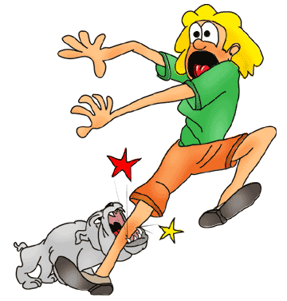
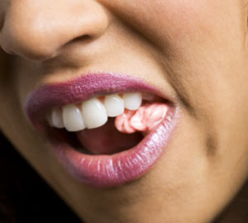
5
>
Bite off more than you can chew.
Answer

Slide 12
5
Attempt too big a task.
?
Stuff your face with too much food.
?
Put too much chewing gum in your mouth.
?
When David came 6th in the 100m having run in the 200m, 400m and 800m, his coach said, “You’ve bitten off more than you can chew.”

Slide 13
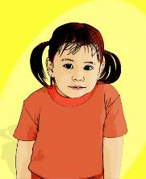
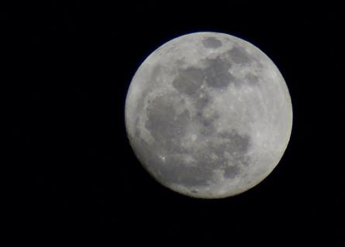
6
She is over the moon.
Answer

Slide 14
6
?
She is looking down on the moon from a window.
She is studying astronomy.
?
?
She is really happy.
A huge slice of chocolate cake – Sarah was over the moon.

Slide 15


7
Feel under the weather
Answer

Slide 16
7
?
Feel the rain or snow as it comes down.
Feel a bit ill.
?
Be happy or sad depending on the weather forecast.
?
Maria, feeling a bit under the weather, reached for another box of tissues to cope with her runny nose.

Slide 17
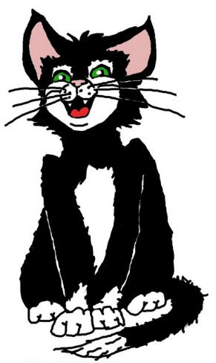

8
?
Cat got your tongue?
Answer

Slide 18
8
Is the situation making you quiet?
?
Is the cat trying to say something?
?
?
Is the cat eating tongue meat from your plate?
“Cat got your tongue?” Mrs Jones asked as John stood holding the missing £100 in his hand.

Slide 19

9
Brand New!
Turn over a new leaf.
Answer

Slide 20
9
Move the plant nearer the window.
?
Make a new start.
?
Do some gardening.
?
Callum has turned over a new leaf this term – all his homework has been handed in on time.

Slide 21
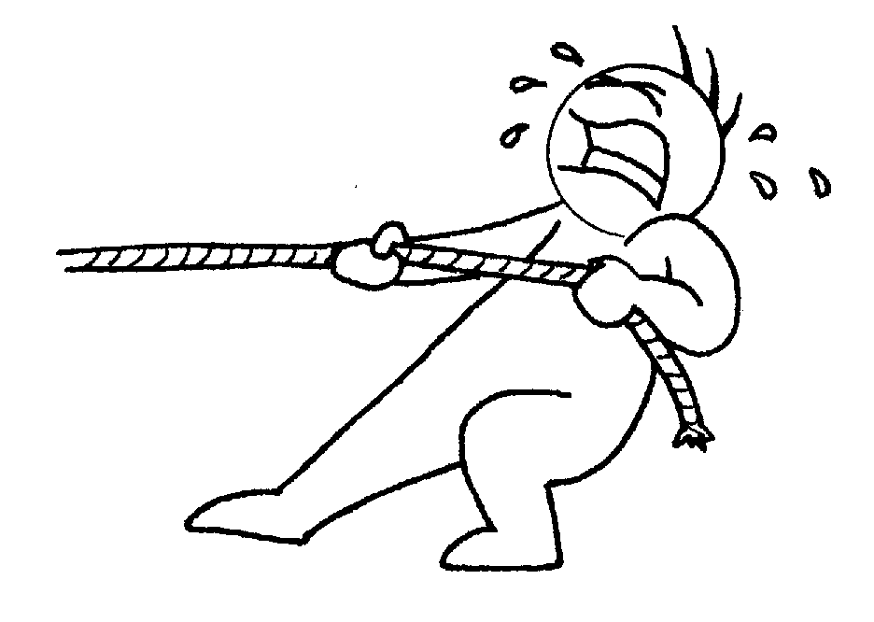

10
Pull someone’s leg.
Answer

Slide 22
10
Tell someone an untrue story.
?
Grab someone’s ankle.
?
Take someone’s boots off.
?
“I was only pulling your leg when I said you’d won 1st prize.”

Slide 23
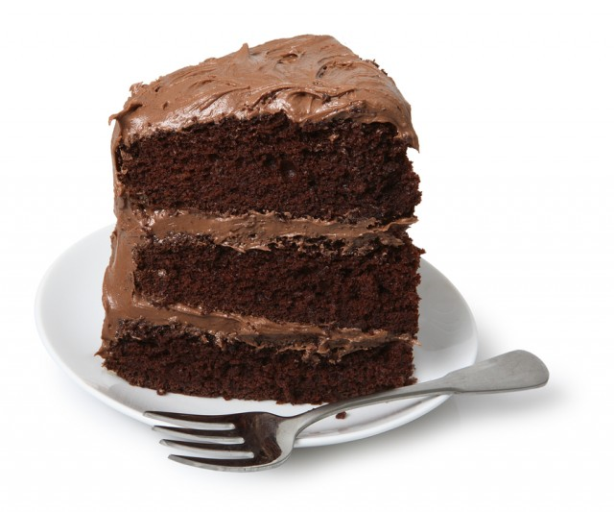
11
A piece of cake.
Answer

Slide 24
11
A delicious snack.
?
An easy task.
?
A sixth of the whole cake.
?
Guessing these idioms is a piece of cake!

Slide 25





12
Bark up the wrong tree.
Answer

Slide 26
12
The cat’s up the other tree!
?
?
Choose the tree with less fruit.
?
Follow the wrong line of inquiry.
Mrs Smith realised she had been barking up the wrong tree when the money turned up in Ben’s drawer. Daniel had been innocent all along.

Slide 27



13
+
Cost an arm and a leg.
Answer

Slide 28
13
Be very expensive.
?
Be dangerous – you might hurt yourself.
?
Find it difficult to move in tight clothing.
?
That new smartphone cost an arm and a leg.

Slide 29
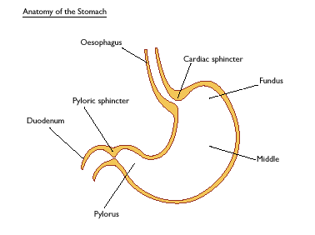

14
Have butterflies in your stomach.
Answer

Slide 30
14
Have an upset stomach.
?
Have eaten some insects.
?
Feel nervous.
?
Melanie could feel the butterflies in her stomach as she headed towards the exam hall.

Slide 31
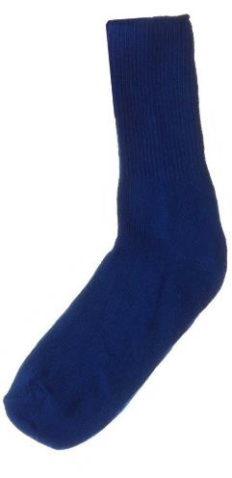
15
+ it i t
Put a sock in it.
Answer

Slide 32
15
Stop talking!
?
Cover up your foot.
?
Block up the hole with a sock.
?
“Oh for goodness sake, put a sock in it – you haven’t stopped talking since we left home two hours ago,” ordered Dad.

Slide 33
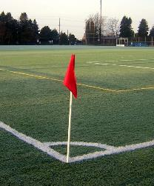



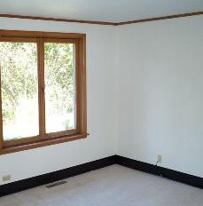
16
Cut corners.
Answer

Slide 34
16
Open a corner yoghurt.
?
Drive in a straight line.
?
Do a less than good job.
?
When water started leaking through the roof, it was clear that the builders had cut corners.

Slide 35

17
Be on the ball.
Answer

Slide 36
17
Dress up ready for the ball.
?
Be alert and up with things.
?
Balance on a ball.
?
Having done her homework, Samantha was on the ball when Miss Jenkins started firing questions about equivalent fractions.

Slide 37
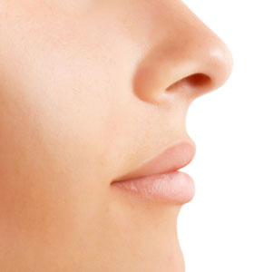
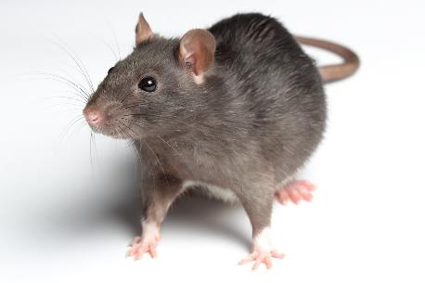
18
Smell a rat.
Answer

Slide 38
18
Suspect that something is not right.
?
Notice rat droppings.
?
Know that it is time to clean out the cage.
?
When Mrs Figgins saw the lid off the biscuit tin and crumbs leading upstairs to Emma’s bedroom, she began to smell a rat.

Slide 39
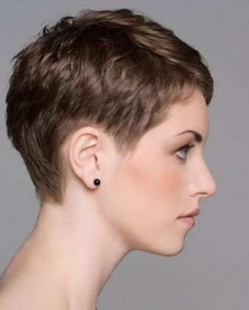
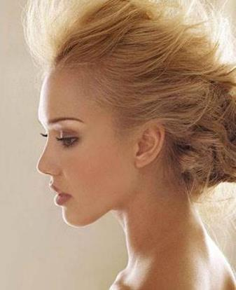
19
See eye to eye.
Answer

Slide 40
19
Be equally short or long sighted.
?
Be in agreement.
?
Look into each other’s eyes.
?
Georgina and Stacey tend to avoid each other – they rarely see eye to eye on anything.

Slide 41
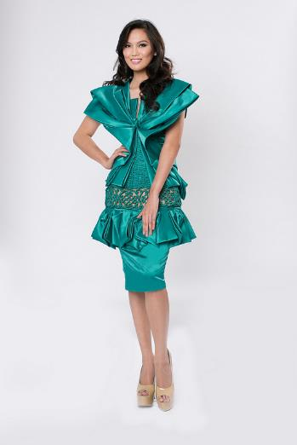
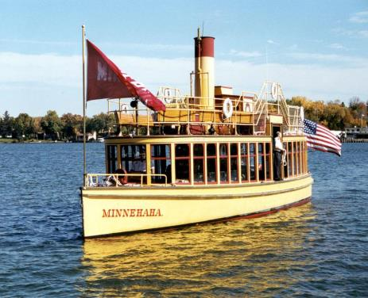
20
not married
Miss the boat.
Answer

Slide 42
20
Arrive late for a boat trip.
?
A beauty queen on board a boat.
?
?
Miss an opportunity.
When Diane saw that there were already 30 names down for the dance sessions, she realised she had missed the boat.

Slide 43
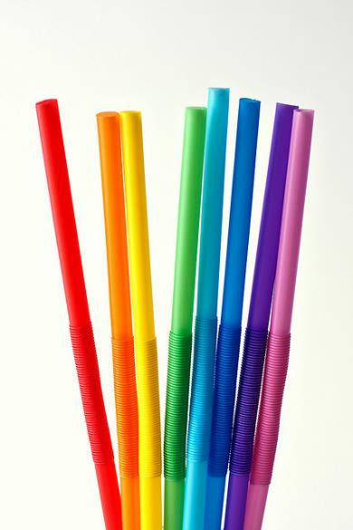
1st
?
21
The last straw.
Answer

Slide 44
21
The last in a series of problems which make the situation unbearable.
?
The final hay collected in from the fields.
?
The lost straw which was separated from the milk carton.
?
It had been a difficult lesson for Miss Smith but the final straw was when the whiteboard projector failed as the inspector walked in.

Slide 45
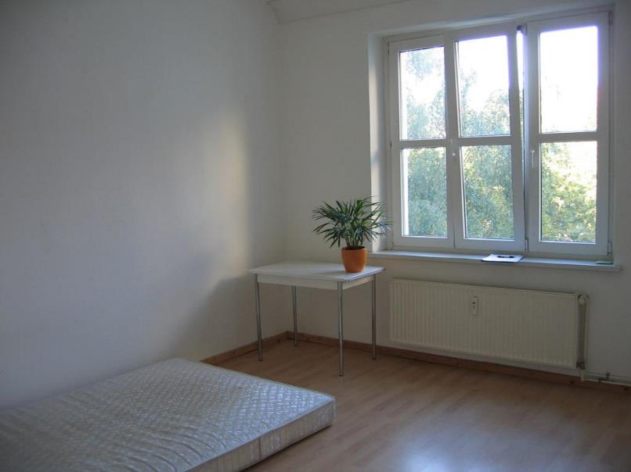

22
The elephant in the room.
Answer
Notes:
"Bleekman zimmer" by Bleekman - Own work. Licensed under CC BY 3.0 via Wikimedia Commons - https://commons.wikimedia.org/wiki/File:Bleekman_zimmer.jpg#/media/File:Bleekman_zimmer.jpg

Slide 46
22
An elephant indoors for winter.
?
?
A large animal entering a house.
?
An obvious problem which is not talked about.
In the Smith family, the strong smell coming from Mike’s feet was the elephant in the room.

Slide 47

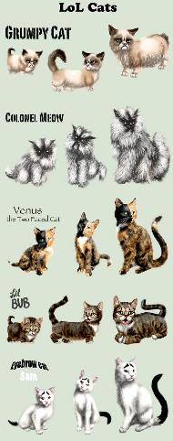
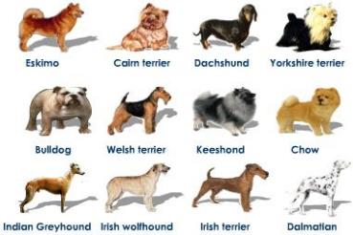
23
+
It’s raining cats and dogs.
Answer

Slide 48
23
It’s raining and pets are getting wet.
?
It’s raining very hard.
?
Cats and dogs are shaking themselves and wetting everyone around them.
?
Don’t go outside now – it’s raining cats and dogs.

Slide 49
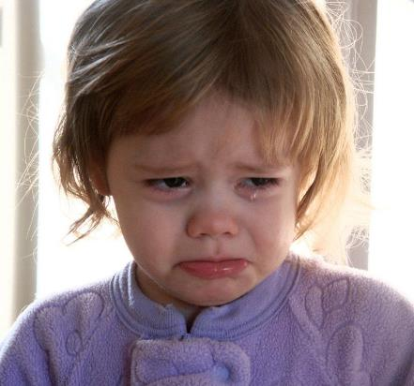

24
Cry over spilt milk.
Answer
Notes:
"Crying-girl" by Crimfants - http://flickr.com/photos/crimfants/327861820/. Licensed under CC BY-SA 2.0 via Wikimedia Commons - https://commons.wikimedia.org/wiki/File:Crying-girl.jpg#/media/File:Crying-girl.jpg

Slide 50
24
Get too upset about things that have happened which you cannot change.
?
Cry when you make a mess at the table.
?
Burst into tears in a dairy.
?
I know that it was an accident when you broke Rebekah’s laptop – it’s no good crying over spilt milk.

Slide 51
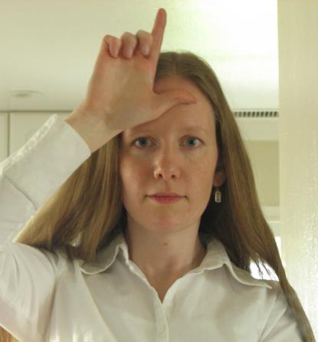
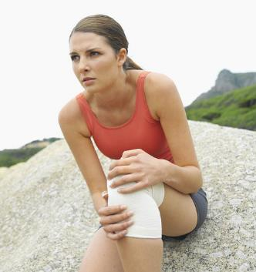
25
+
Add insult to injury.
Answer
Notes:
By Lenore Edman from Sunnyvale, CA (Loser) [CC BY 2.0 (http://creativecommons.org/licenses/by/2.0)], via Wikimedia Commons

Slide 52
25
Ambulance men who laugh.
?
?
Laugh at someone who has fallen over.
?
Make a bad situation worse by upsetting someone.
James ran out of petrol. To add insult to injury he was given a parking ticket while fetching the fuel.

Slide 53
The End
Also available: Idioms 2, Idioms 3 & Idioms 4.

