Slide 1
Idioms 2

Slide 2
Each idiom has two slides.
In the first slide you get a picture clue – can you guess the idiom?
In the second slide three possible meanings are given – can you guess the correct one?
Authors of photos are attributed in the notes of the relevant slide.

Slide 3

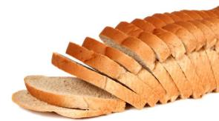
26
A new thing
Timeline
1928
Now
The best thing since sliced bread.
Answer

Slide 4



26
A new way of cutting bread.
?
?
Something or someone with an excellent reputation.
A better tasting bread.
?
This new phone is the best thing since sliced bread!

Slide 5
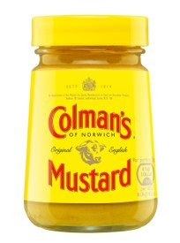

27
Cut the mustard.
Answer

Slide 6
27
Be good enough – up to standard.
?
Harvest mustard plants.
?
?
Cut out mustard from your diet.
This new police car is a bit slow – it doesn’t really cut the mustard.

Slide 7
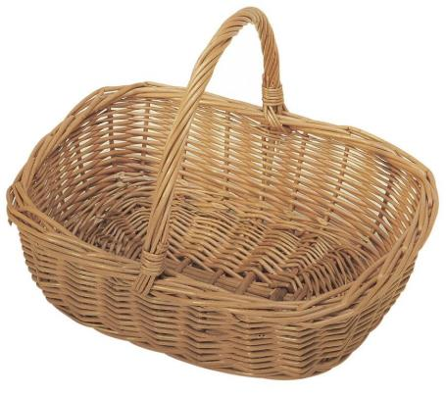
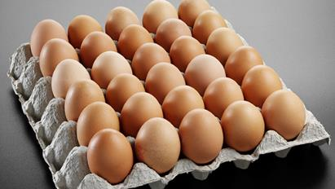
28
All mine
Put all your eggs in one basket.
Answer

Slide 8
28
Don’t keep your eggs in the fridge.
?
?
Store eggs on top of each other.
?
Put all your hopes on one thing.
Ignoring his father’s advice not to put all his eggs in one basket, Matthew left school early to pursue his dream of being a professional footballer.

Slide 9



29
Be on the same page.
Answer

Slide 10
29
Be pictured on the same page.
?
Be in agreement.
?
Read a book together.
?
When Fred showed his plans for a new purple kitchen to his wife, they realised they were not on the same page.

Slide 11
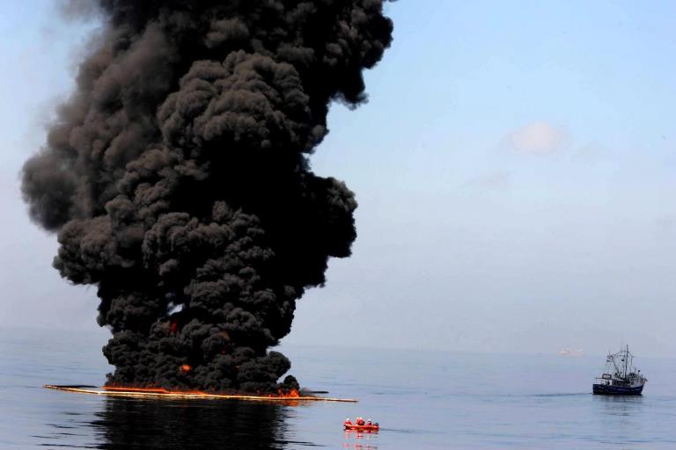

30
Burn the midnight oil.
Answer

Slide 12
30
Work late into the night.
?
Start a fire at night time.
?
Burn oil to make really black smoke.
?
With exams looming, Gemma often found herself burning the midnight oil.

Slide 13
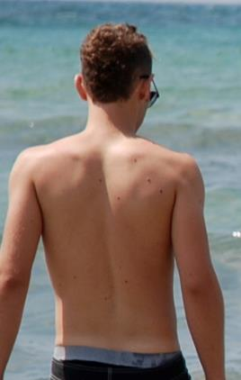
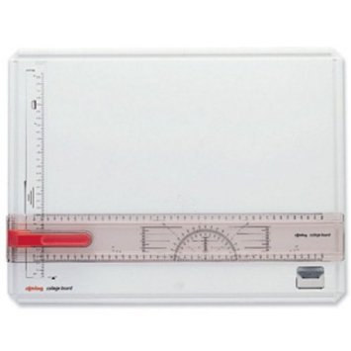
31
Back to the drawing board.
Answer

Slide 14
31
?
Add pictures to help explain a text.
Time to rub something out and make it neater.
?
?
Time to completely rethink plans.
When they heard of the airline strike, they knew it was back to the drawing board for their holiday plans.

Slide 15
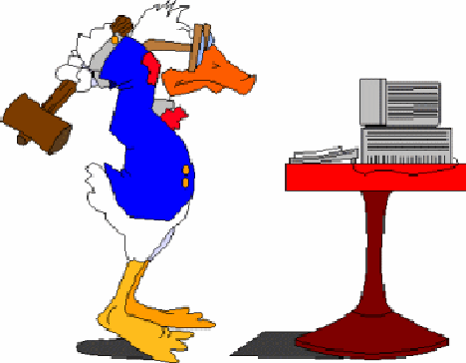
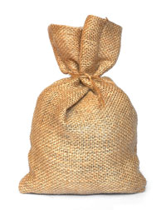
32
Hit the sack.
Answer

Slide 16
32
?
Get the dust out of s sack by beating it.
Go to bed.
?
Play a game called hit the sack.
?
At midnight Frank declared that it was time to hit the sack.

Slide 17
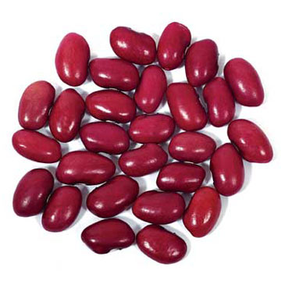
33
Oops!
Spill the beans.
Answer

Slide 18
33
Tell all.
?
Drop some food.
?
?
Plant beans in the garden.
I heard all about lunch time – Sarah spilt the beans.

Slide 19
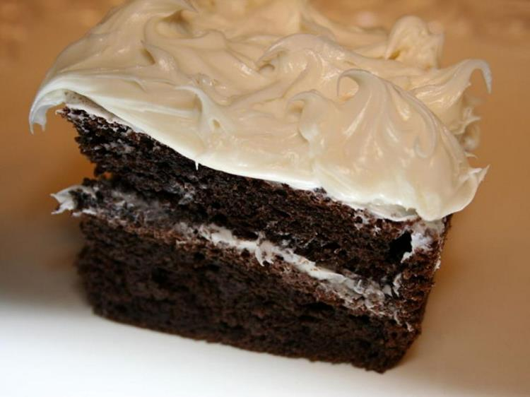
34
The icing on the cake.
Answer

Slide 20
34
The top layer of the cake.
?
?
An extra good thing on top of something already good.
The sweetest spot.
?
Susan loved visiting the zoo. The icing on the cake was being allowed to feed the penguins.

Slide 21
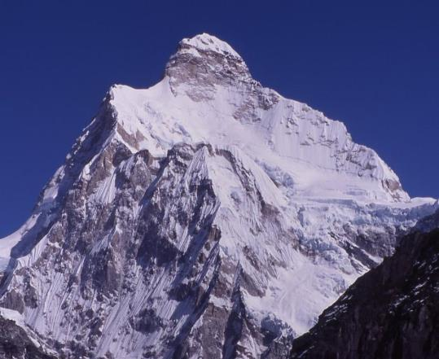
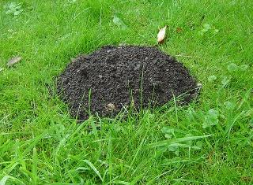
35
Make a mountain out of a mole hill.
Answer
Notes:
"Jannu from South" by Carsten.nebel - Own work. Licensed under CC BY 3.0 via Wikimedia Commons - https://commons.wikimedia.org/wiki/File:Jannu_from_South.jpg#/media/File:Jannu_from_South.jpg

Slide 22
35
Make something small seem very serious.
?
Keep digging.
?
Look at something using a magnifying glass.
?
“It was only a light push – don’t make a mountain out of a mole hill!”

Slide 23

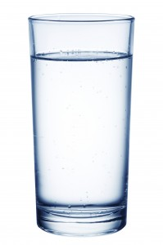
36
In hot water.
Answer

Slide 24
36
Red from a hot bath.
?
In trouble.
?
Hidden by steam.
?
Mark knew he was in hot water when his father discovered he had skipped music lessons for a whole month.

Slide 25
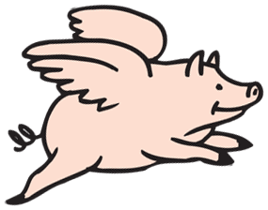

37
Pigs might fly.
Answer

Slide 26
37
A weird dream.
?
?
An airline for pigs.
?
It’s not going to happen.
“Next year I’m going to be Miss World,” said Sandra.
“And pigs might fly!”

Slide 27
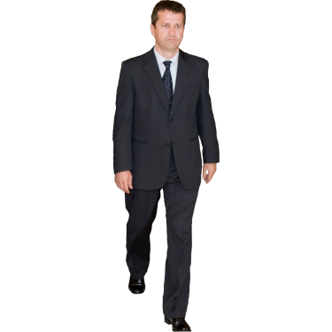
38
Where?
Lose your head.
Answer

Slide 28
38
Lose control and act wildly.
?
Visit the guillotine.
?
Have a bad haircut.
?
When Joe realised that the only food in the house was Brussels sprouts, he lost his head.

Slide 29
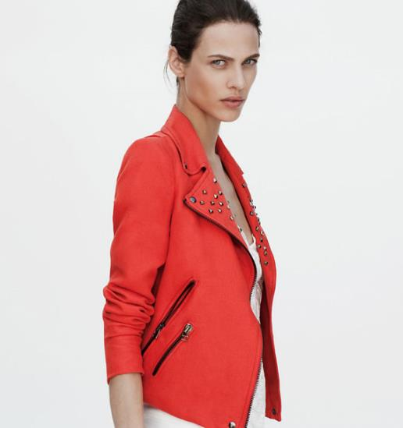
39
Wear your heart on your sleeve.
Answer

Slide 30
39
Wear clothing with hearts on.
?
Feel your pulse at your wrist.
?
Show your true feelings.
?
You always knew how Stacey was – she wore her heart on her sleeve.

Slide 31
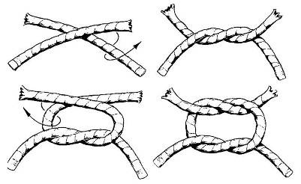
40
Tie the knot.
Answer

Slide 32
40
Get married.
?
Do up your laces.
?
Join 2 pieces of rope together.
?
John and Emma tied the knot last year – it’s their anniversary on Tuesday.

Slide 33
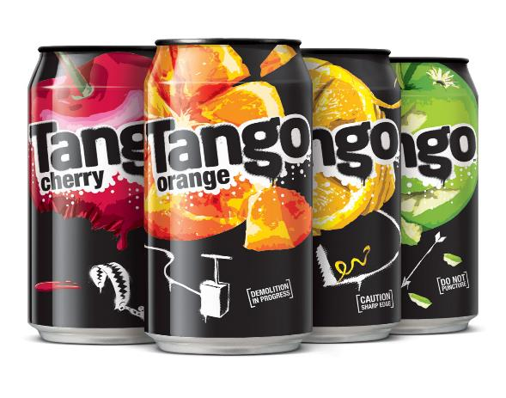

41
1
2
3
4
5
6
7
It takes two to tango.
Answer

Slide 34
41
Share your drink.
?
You can’t dance on your own.
?
When 2 people are involved in something, both must share responsibility.
?
I know it was Gavin and not Beth who had the idea to take the sweets but it takes two to tango .

Slide 35
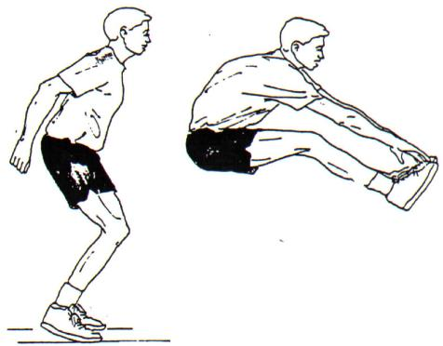

42
Jump the gun.
Answer

Slide 36
42
Leap over the gun.
?
Start before you should.
?
Jump from shock at the bang.
?
The invigilator told Ben that he had jumped the gun – he finished the first page before the exam had even started!

Slide 37
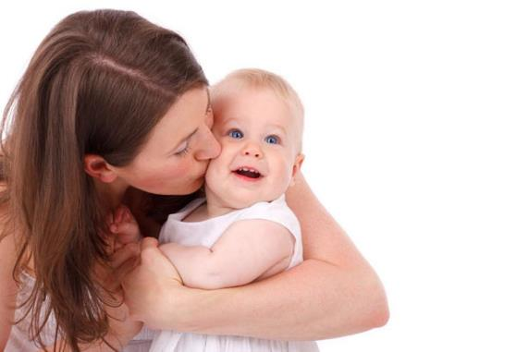

43
Letter
Word
Sentence
Paragraph
Chapter
Simile
Metaphor
Poem
Novel
=
Mum’s the word.
Answer

Slide 38
43
It’s not Dad.
?
Keep quiet.
?
Don’t forget Mothers’ day.
?
“Now remember: about the broken vase, Mum’s the word.”

Slide 39






44
In the same boat.
Answer

Slide 40
44
In similar circumstances.
?
Both without oars.
?
Journeying together.
?
Rachel’s new to the school as well – she’s in the same boat as you.

Slide 41
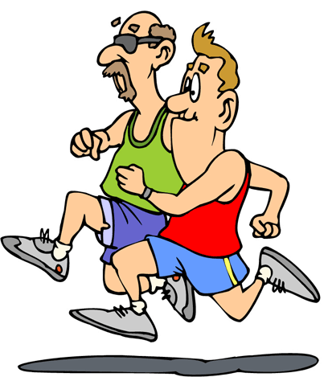
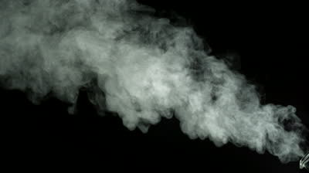
45
Run out of steam.
Answer

Slide 42
45
Boil a kettle dry.
?
Use a steam iron to press your running clothes.
?
?
Run out of energy.
By the time he had swam 8 lengths, he had run out of steam.

Slide 43

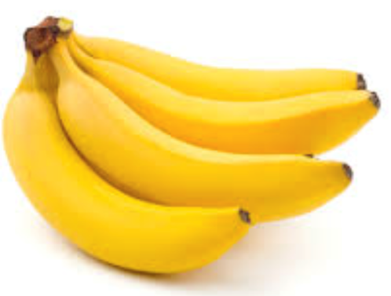
46
Go bananas.
Answer

Slide 44
46
?
Go crazy.
Choose the fruit option.
?
?
Wear yellow.
When he realised that Norwich had been promoted, he went bananas.

Slide 45
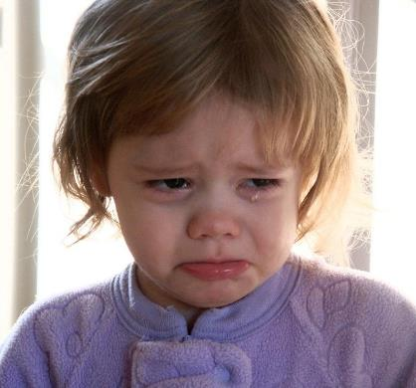
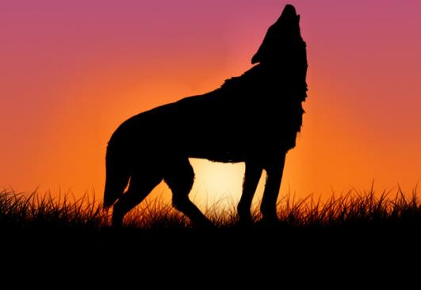
47
Cry wolf.
Answer
Notes:
Pretending sth like wolf howling rec bz Neumann TLM 103
"Crying-girl" by Crimfants - http://flickr.com/photos/crimfants/327861820/. Licensed under CC BY-SA 2.0 via Wikimedia Commons - https://commons.wikimedia.org/wiki/File:Crying-girl.jpg#/media/File:Crying-girl.jpg

Slide 46
47
Cry out of fear of an animal.
?
?
Do a wolf whistle.
Pretend there is a problem when there isn’t - for a joke.
?
The toast wasn’t really burning, it was just Justin crying wolf.

Slide 47

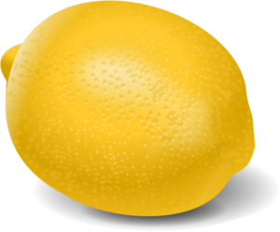
48
Buy a lemon.
Answer

Slide 48
48
Buy something sour.
?
Buy something with plenty of faults which will not run well.
?
Visit the fruit shop.
?
When Bob’s car broke down for the fifth time in a month, he realised he had been sold a lemon.

Slide 49

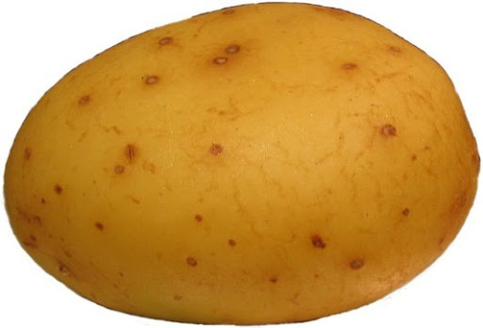
49
A hot potato.
Answer

Slide 50
49
?
A subject which is difficult or controversial.
A potato baking in the oven.
?
Sun cream made from vegetable oil.
?
The new school uniform a bit of a hot potato at the moment.

Slide 51
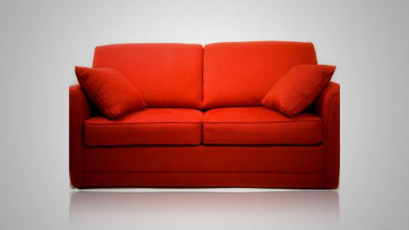
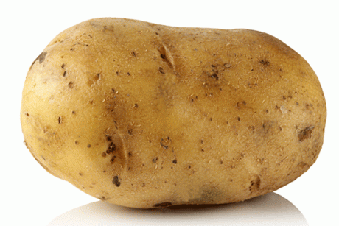
50
Couch potato.
Answer

Slide 52
50
A variety of potato.
?
?
A TV meal including potatoes.
A lazy person who spends too much time sitting around.
?
Thelma watches 9 hours of TV a day – she’s a real couch potato.

Slide 53
The End
Also available: Idioms1, Idioms 3 & Idioms 4

