Slide 1
Idioms 4

Slide 2
Each idiom has two slides.
In the first slide you get a picture clue – can you guess the idiom?
In the second slide three possible meanings are given – can you guess the correct one?
Authors of photos are attributed in the notes of the relevant slide.

Slide 3
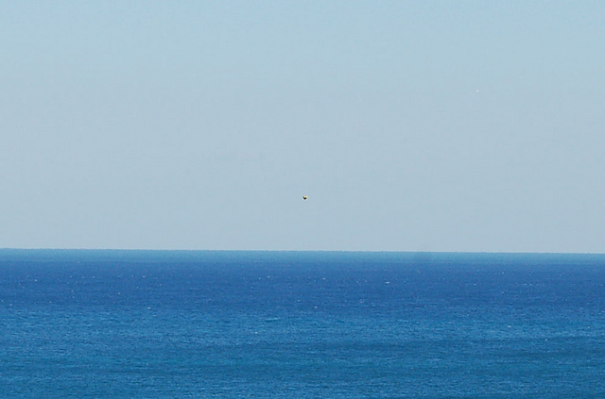

76
A drop in the ocean.
Answer

Slide 4



76
Rain falling at sea.
?
?
An insignificant amount.
Part of the water cycle.
?
The £10 raised for the new school tennis courts was just a drop in the ocean.

Slide 5
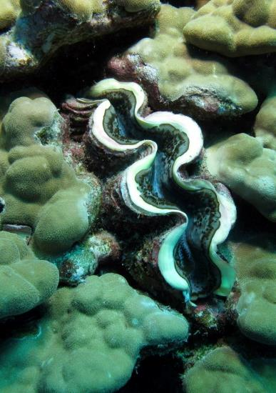
77
Clam up.
Answer
Notes:
By Derek Keats (https://www.flickr.com/photos/dkeats/6329682952) [CC BY 2.0 (http://creativecommons.org/licenses/by/2.0)], via Wikimedia Commons

Slide 6
77
Go silent.
?
Catch a clam for cooking.
?
?
Watch out for the clam up ahead.
As soon as Mum mentioned Emma’s new boyfriend, she clammed up.

Slide 7

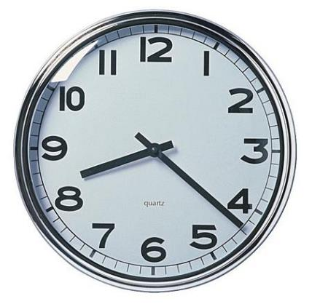
78
Crunch time.
Answer

Slide 8
78
Time for breakfast cereal.
?
?
When your credit runs out.
?
A crucial time when the right action has to be taken.
With the score 1-1 he realised, as he stepped up to take the penalty, that it was crunch time.

Slide 9
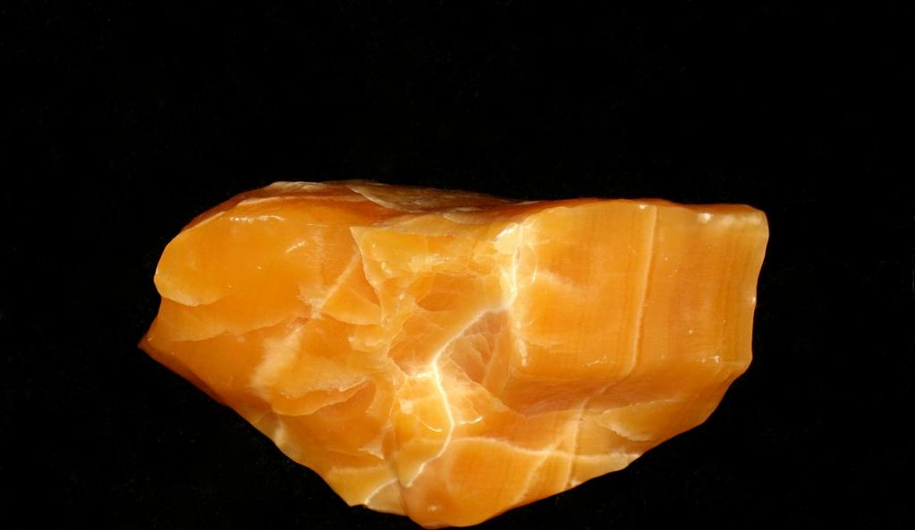

79
79
Kill two birds with one stone.
Answer

Slide 10
79
Lose a stone in weight.
?
Complete two tasks with one action.
?
Drop a stone on two chickens.
?
“If you shop at the supermarket near the office, you can drop me off and kill two birds with one stone.”

Slide 11
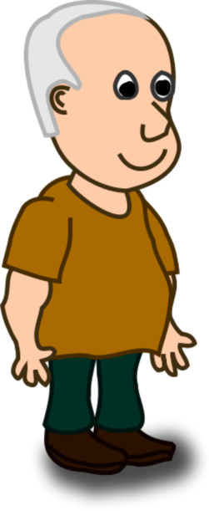

80
Me
Over my dead body.
Answer

Slide 12
80
I am not allowing it.
?
Someone walking on my grave.
?
A coffin lid.
?
“I’m thinking of staying at my boyfriend’s after the party.”
“Over my dead body!”

Slide 13
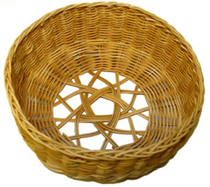
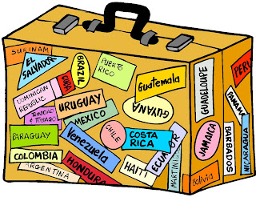
81
A basket case.
Answer

Slide 14
81
?
A battered old case.
A suitcase made of basket material.
?
?
A useless person or thing.
“His football team is a basket case – they let in 12 goals last game.”
.

Slide 15
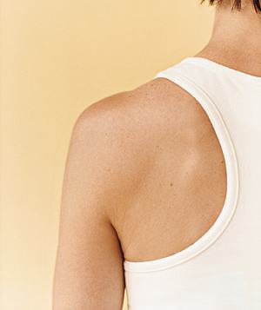
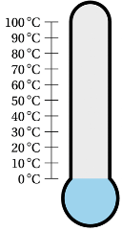
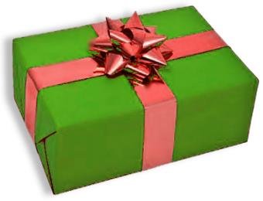
82
Give someone the cold shoulder.
Answer

Slide 16
82
?
Not wear enough clothes.
Ignore someone deliberately.
?
Ice treatment for a sprained arm.
?
“When she found out I had beaten her in the test, she gave me the cold shoulder.”

Slide 17
33
83
Out of the blue.
Answer

Slide 18
83
Unexpectedly.
?
From the ocean.
?
?
From a cold place.
He just turned up out of the blue.

Slide 19
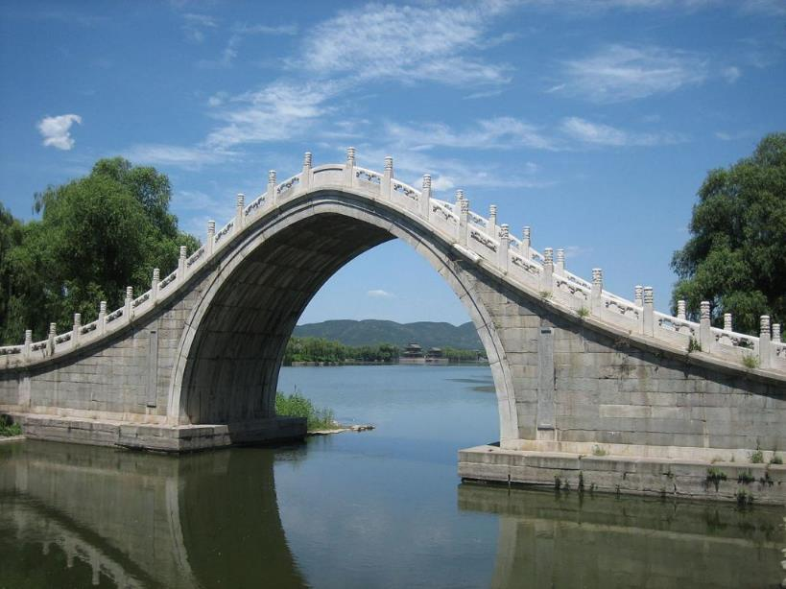
84
Water under the bridge.
Answer
Notes:
"Gaoliang Bridge". Licensed under CC BY-SA 3.0 via Wikimedia Commons - https://commons.wikimedia.org/wiki/File:Gaoliang_Bridge.JPG#/media/File:Gaoliang_Bridge.JPG

Slide 20
84
Fast flowing water.
?
?
In the past and not relevant.
Shaded water.
?
“What you did last term is water under the bridge – we don’t need to discuss it.”

Slide 21


85
=
Be as right as rain.
Answer

Slide 22
85
Be fully fit.
?
Welcome rain for the crops.
?
Not left in the wet.
?
“Last month he had the flu but now he’s as right as rain.”

Slide 23
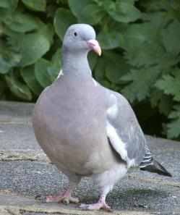
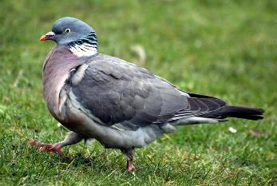
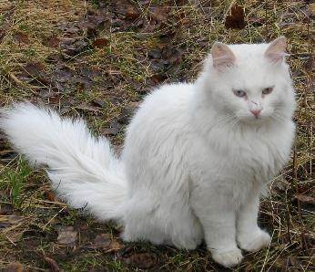
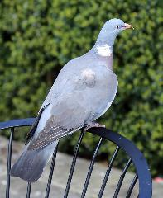
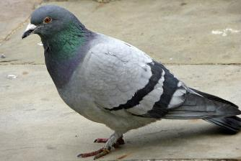
86
Put the cat among the pigeons.
Answer
Notes:
By Acabashi (Own work) [CC BY-SA 4.0 (http://creativecommons.org/licenses/by-sa/4.0)], via Wikimedia Commons
By Keven Law from Los Angeles, USA (Flickr) [CC BY-SA 2.0 (http://creativecommons.org/licenses/by-sa/2.0)], via Wikimedia Commons
Christine Matthews [CC BY-SA 2.0 (http://creativecommons.org/licenses/by-sa/2.0)], via Wikimedia Commons
Christine Matthews [CC BY-SA 2.0 (http://creativecommons.org/licenses/by-sa/2.0)], via Wikimedia Commons
"Cat in Kautokeino" by Barasoaindarra - Own work. Licensed under CC BY-SA 2.5 via Wikimedia Commons - https://commons.wikimedia.org/wiki/File:Cat_in_Kautokeino.jpg#/media/File:Cat_in_Kautokeino.jpg

Slide 24
86
Release a predator.
?
Cause trouble.
?
Let the cat into the garden.
?
“If you sit Megan next to Carla, that will really put the cat among the pigeons.”

Slide 25
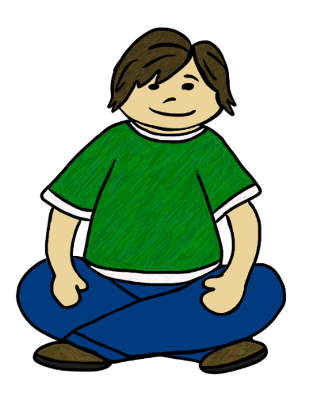
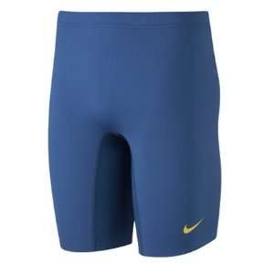
87
Sit tight.
Answer

Slide 26
87
Sit down wearing tight clothes.
?
?
Sit close to the wall.
?
Stay where you are.
“The doctor will be back soon – I suggest you sit tight until he returns.”

Slide 27
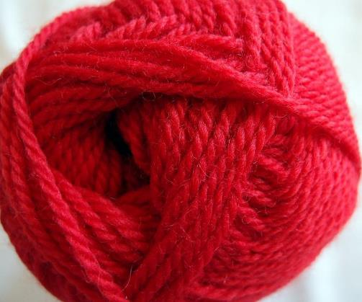
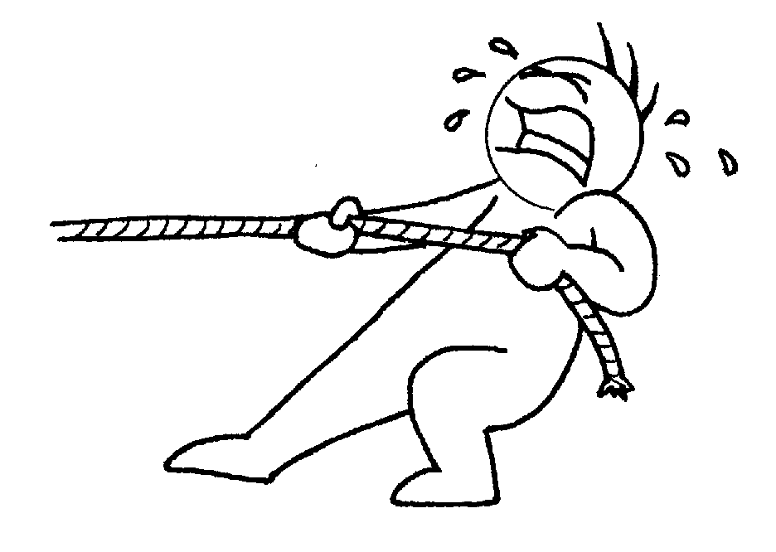

88
Pull the wool over someone’s eyes.
Answer
Notes:
"Worsted wool yarn" by Pschemp - Own work. Licensed under CC BY-SA 3.0 via Commons - https://commons.wikimedia.org/wiki/File:Worsted_wool_yarn.JPG#/media/File:Worsted_wool_yarn.JPG

Slide 28
88
Fool somebody.
?
Pull a woollen bobble hat down over the eyes.
?
Blindfold someone.
?
Megan was pulling the wool over her mother’s eyes when she told her she was doing her homework. In fact she was on her phone all the time.

Slide 29
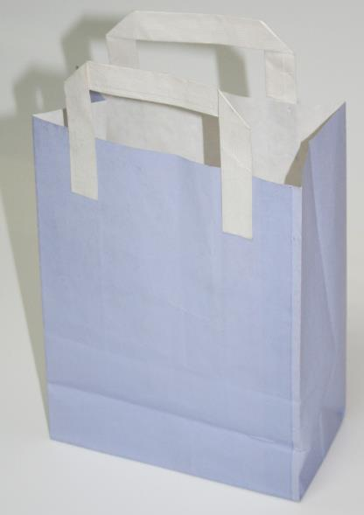
89
In the bag.
Answer
Notes:
"Bolsas-de-asa-plana-exterior-bolsapubli" by Bolsapubli - Own work. Licensed under CC BY-SA 3.0 via Wikimedia Commons - https://commons.wikimedia.org/wiki/File:Bolsas-de-asa-plana-exterior-bolsapubli.jpg#/media/File:Bolsas-de-asa-plana-exterior-bolsapubli.jpg

Slide 30
89
Invisible.
?
Recently purchased.
?
Almost certainly won.
?
“Now that we are 6-0 up, I think the game is in the bag!”

Slide 31
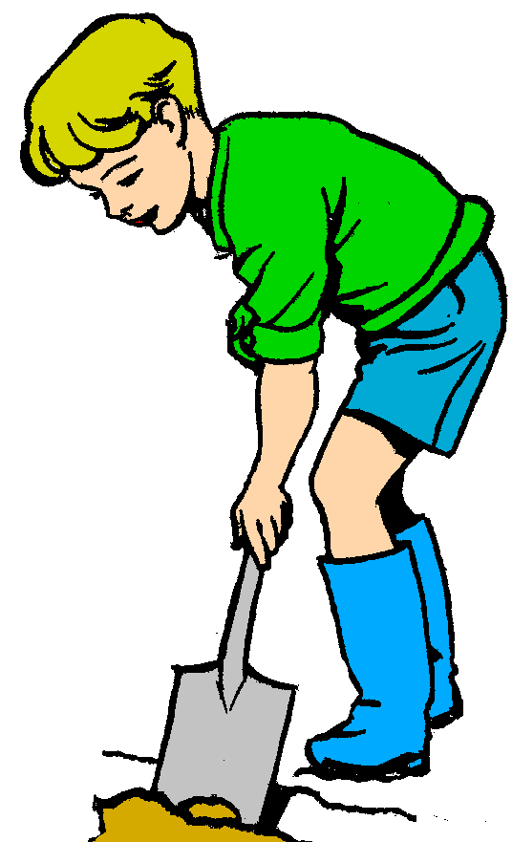
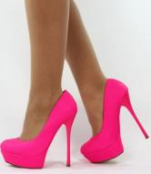
90
Dig in your heels.
Answer

Slide 32
90
Refuse to change your plans.
?
Admire someone well dressed.
?
Wear the wrong footwear for gardening.
?
When I asked him to help in the garden, he dug in his heels and said that he would carry on playing Minecraft.

Slide 33
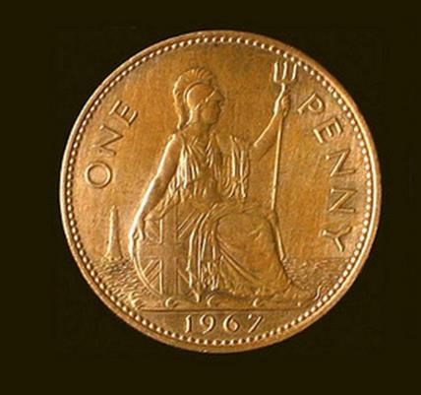

91
A penny for your thoughts.
Answer

Slide 34
91
I’ll pay you for any bright ideas.
?
Your thoughts aren’t worth much.
?
?
Tell me what you are thinking.
As Tom slipped into a daydream, his sister said, “A penny for your thoughts.”

Slide 35
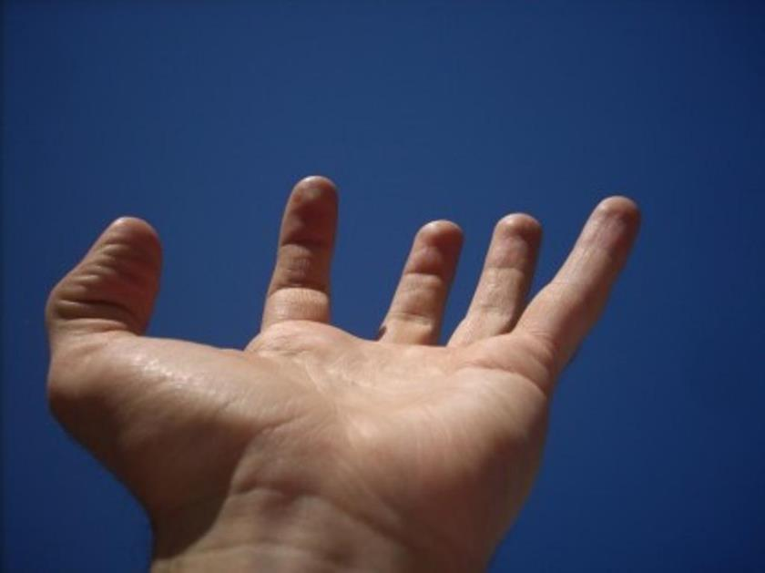
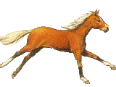


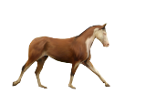

92
Hold your horses.
Answer

Slide 36
92
Don’t let go of the reins.
?
Stop and think.
?
Keep yourself to yourself.
?
“Hold your horses – it’s no good setting off to see Clive – he’s still in Australia.”

Slide 37
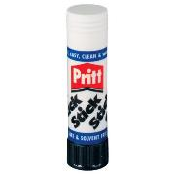




93
93
+
Stick to your guns.
Answer
Notes:
"Hkmp5count-terr-wiki" by Cyrillic at the English language Wikipedia. Licensed under CC BY-SA 3.0 via Commons - https://commons.wikimedia.org/wiki/File:Hkmp5count-terr-wiki.jpg#/media/File:Hkmp5count-terr-wiki.jpg
"M&Prevolver" by Original uploader was Olegvolk at en.wikipedia - Transferred from en.wikipedia; Transfer was stated to be made by User:OhanaUnited.. Licensed under CC BY 2.5 via Commons - https://commons.wikimedia.org/wiki/File:M%26Prevolver.jpg#/media/File:M%26Prevolver.jpg
"Galil-Sniper-Galatz-r001" by Source: Vitaly V. KuzminProcessing and masking: MathKnight - Own work based on File:Fort-301 InterpolitexPart539.jpg. Licensed under CC BY-SA 4.0 via Wikimedia Commons - https://commons.wikimedia.org/wiki/File:Galil-Sniper-Galatz-r001.jpg#/media/File:Galil-Sniper-Galatz-r001.jpg

Slide 38
93
Remain fully armed.
?
Don’t budge from your point of view.
?
Lock onto the target.
?
“My Mum said that I should go to school but I stuck to my guns and insisted I was ill and then stayed at home all day.”

Slide 39

94
On top of the world.
Answer

Slide 40
94
Really happy.
?
At the north pole.
?
At the top of a mountain.
?
Now that she has a new job, she’s on top of the world.

Slide 41
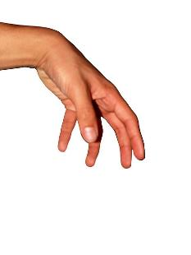
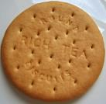
95
That
That really takes the biscuit.
Answer
Notes:
"Rich tea" by Sean Whitton (User:Xyrael) - Own work. Licensed under CC BY-SA 3.0 via Commons - https://commons.wikimedia.org/wiki/File:Rich_tea.jpg#/media/File:Rich_tea.jpg

Slide 42
95
Help yourself to someone else’s food.
?
Be very greedy.
?
?
Be the worst in a series of bad things.
He let in 6 goals but what really took the biscuit was when he got sent off for spitting at the ref.

Slide 43
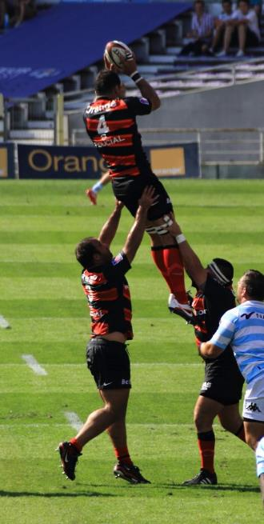
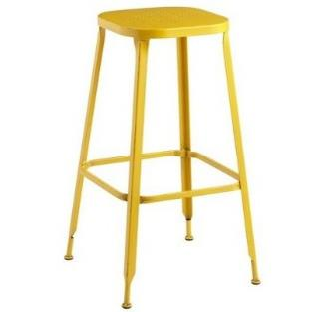
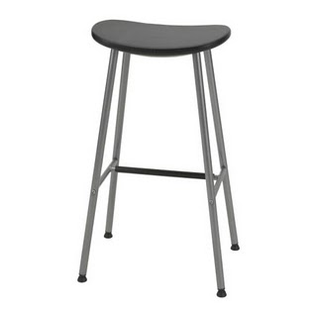
96
Be caught between two stools.
Answer
Notes:
By PierreSelim (Own work) [CC BY 3.0 (http://creativecommons.org/licenses/by/3.0)], via Wikimedia Commons

Slide 44
96
?
Fail to qualify for either of two options.
Become unbalanced.
?
Be unable to reach high enough.
?
At Alton Towers, Sarah (1.3m), too short to go on Nemesis and too tall for Wobble World was caught between two stools.

Slide 45
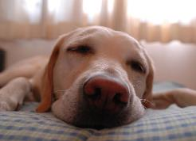
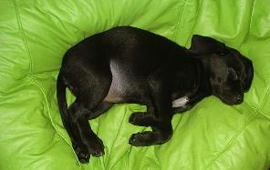


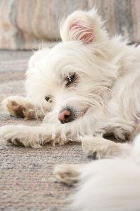
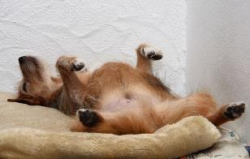
97
Let sleeping dogs lie.
Answer
Notes:
By Maximo leandro83 yogil (es mio gil) [GFDL (http://www.gnu.org/copyleft/fdl.html) or CC BY-SA 4.0-3.0-2.5-2.0-1.0 (http://creativecommons.org/licenses/by-sa/4.0-3.0-2.5-2.0-1.0)], via Wikimedia Commons
By Waugsberg (Own work) [GFDL (http://www.gnu.org/copyleft/fdl.html) or CC BY-SA 3.0 (http://creativecommons.org/licenses/by-sa/3.0)], via Wikimedia Commons
By Eugene0126jp (Own work) [CC BY-SA 3.0 (http://creativecommons.org/licenses/by-sa/3.0) or GFDL (http://www.gnu.org/copyleft/fdl.html)], via Wikimedia Commons
By Eli Duke (Flickr) [CC BY-SA 2.0 (http://creativecommons.org/licenses/by-sa/2.0)], via Wikimedia Commons

Slide 46
97
Make sure your pet gets enough sleep.
?
?
Tread carefully round fierce dogs.
Decide not to mention something you know might be upsetting or uncomfortable.
?
Janice didn’t mention the strong smell coming from Joe’s feet, preferring to let sleeping dogs lie.

Slide 47
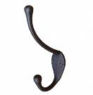
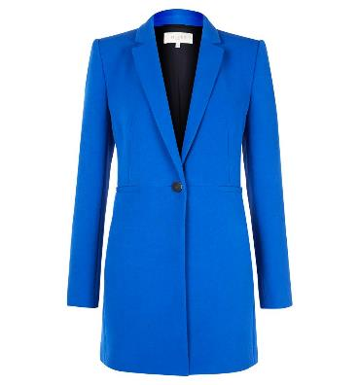
98
Off the hook.
Answer

Slide 48
98
A freshly caught fish.
?
No longer in trouble.
?
Straight out of the wardrobe.
?
“As Miss isn’t here today and we have a nice supply teacher, it doesn’t matter that you haven’t done your homework – you’re off the hook!”

Slide 49
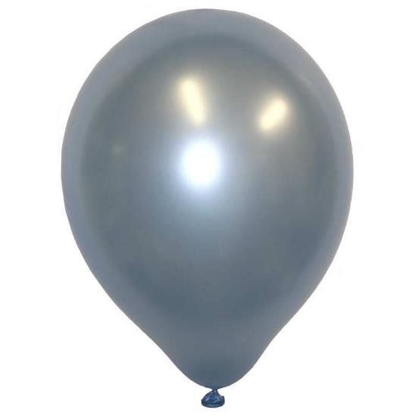
Lead
Go down like a lead balloon.
Answer

Slide 50
99
?
An idea not well received.
Sink very quickly.
?
Give you indigestion.
?
Dad’s idea of going on a long walk in the Peak District went down like a lead balloon.

Slide 51


100
I’m all thumbs.
Answer
Notes:
By Achim Hering (Own work) [GFDL (http://www.gnu.org/copyleft/fdl.html) or CC BY 3.0 (http://creativecommons.org/licenses/by/3.0)], via Wikimedia Commons

Slide 52
100
I’m trying to hitch hike.
?
?
I have fat fingers.
?
I’m clumsy with my hands.
“Don’t ask me to thread the needle – I’m all thumbs”.

Slide 53
The End
Also available: Idioms 1, Idioms 2 & Idioms 3.

