Slide 1
Parts of Speech
A.K.A
Word Classes
LO: To revise parts of speech

Slide 2
Nouns
On your whiteboards
How many different types of nouns can you name?
Write an explanation for each one.

Slide 3
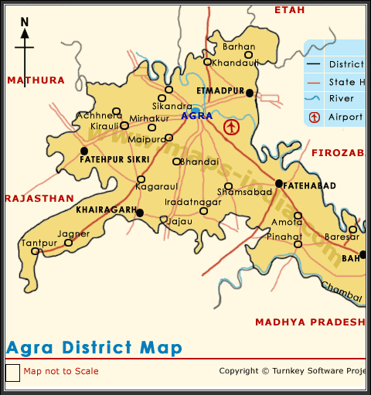
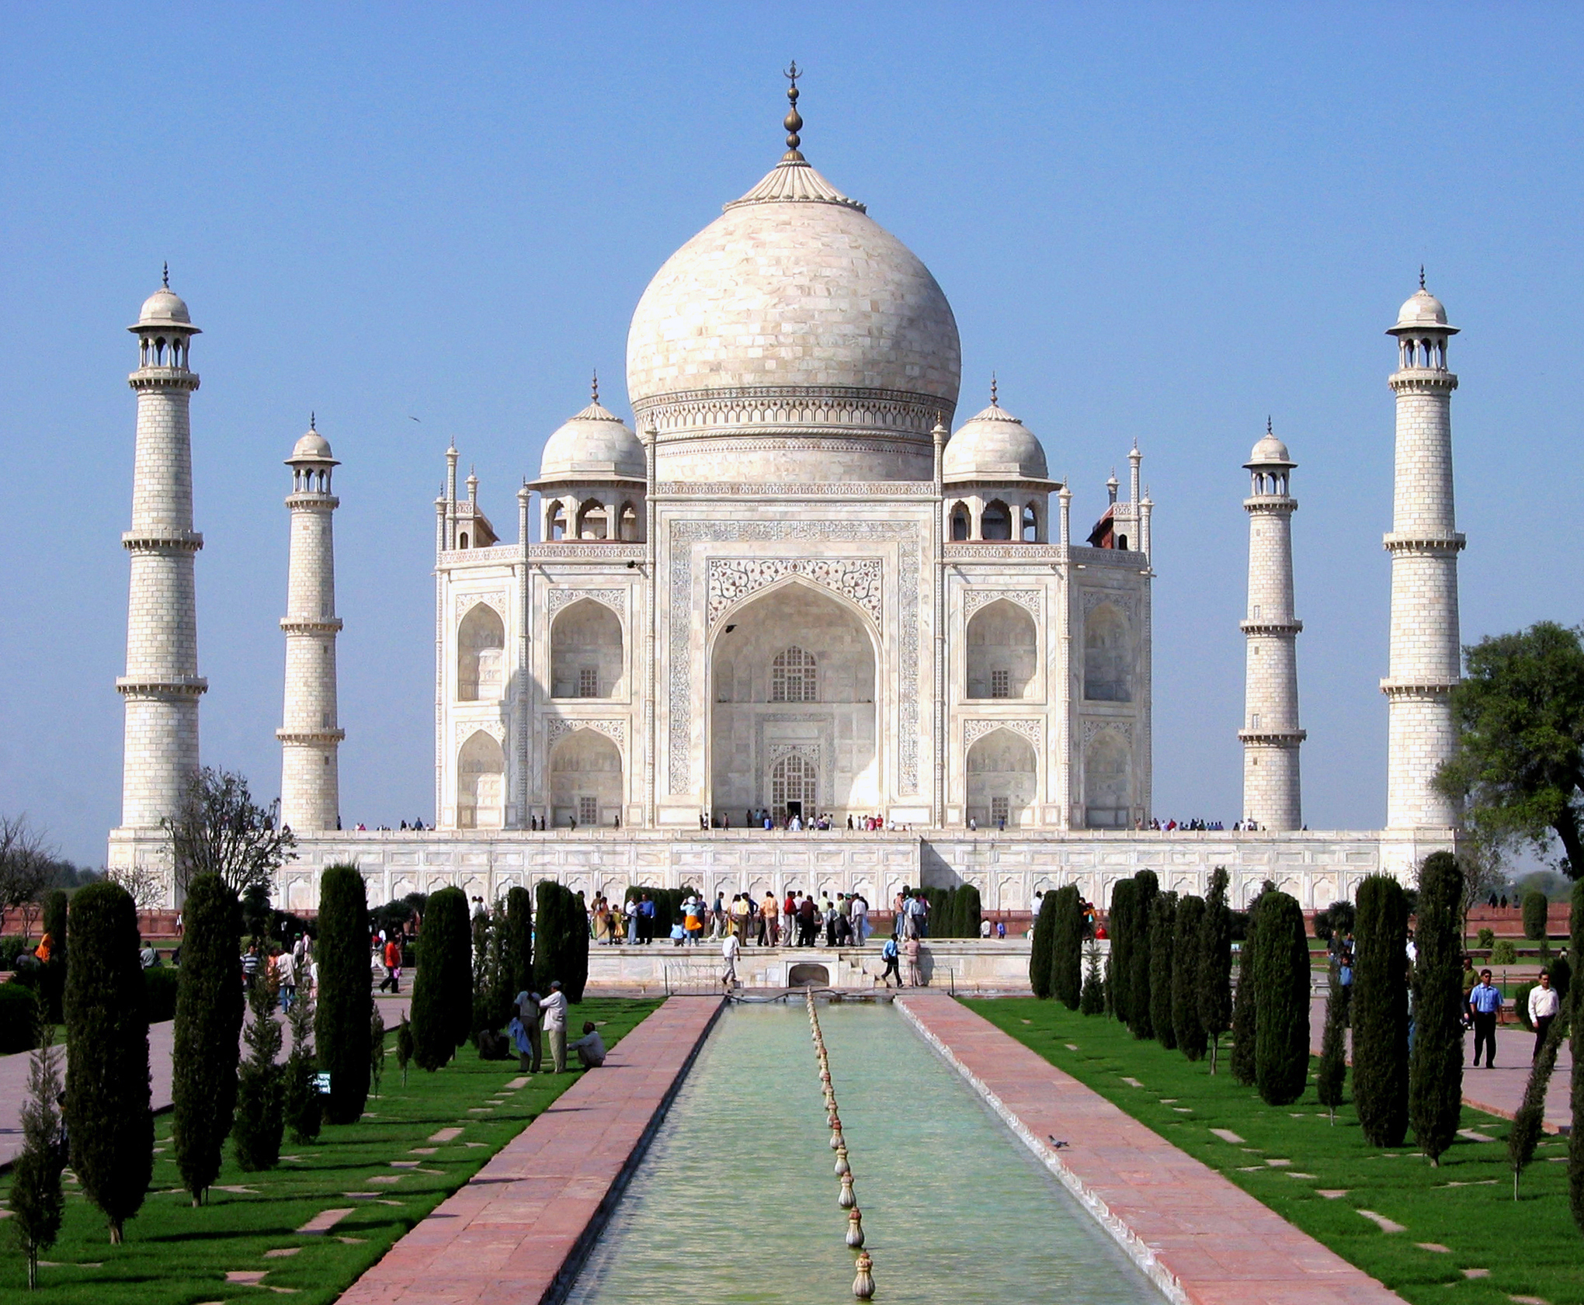

Proper nouns
Proper nouns are the unique names given to people, places and things.
Taj Mahal
Agra
India

Slide 4
Identify the proper nouns
In your books, write the heading ‘Proper nouns’, the number and just the answers.
Julia loved watching the football.
Every weekend, Miss Booth would support Manchester City.
Despite the heat, Russia hosted an incredible tournament.
During the Renaissance, Leonardo da Vinci painted the Mona Lisa.
If every person earned £1 million month, no one would be poor.

Slide 5
Answers
Julia loved watching the football.
Every weekend, Miss Booth would support Manchester City.
Despite the heat, Russia hosted an incredible tournament.
During the Renaissance, Leonardo da Vinci painted the Mona Lisa.
If every person earned £1 million month, no one would be poor. None

Slide 6

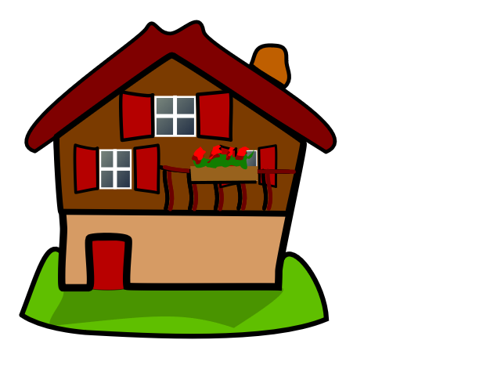
Common nouns
Common nouns are the general names given to objects.
house
table

Slide 7
Identify the Common nouns
In your books, write the heading ‘Common nouns’, the number and just the answers.
Sylvie enjoyed running in the rain.
Although it was scary, the ride was fun.
Jumping through hoops, the dog tried surprised the crowd.

Slide 8
Answers
Sylvie enjoyed running in the rain.
Although it was scary, the ride was fun.
Jumping through hoops, the dog tried surprised the crowd.

Slide 9
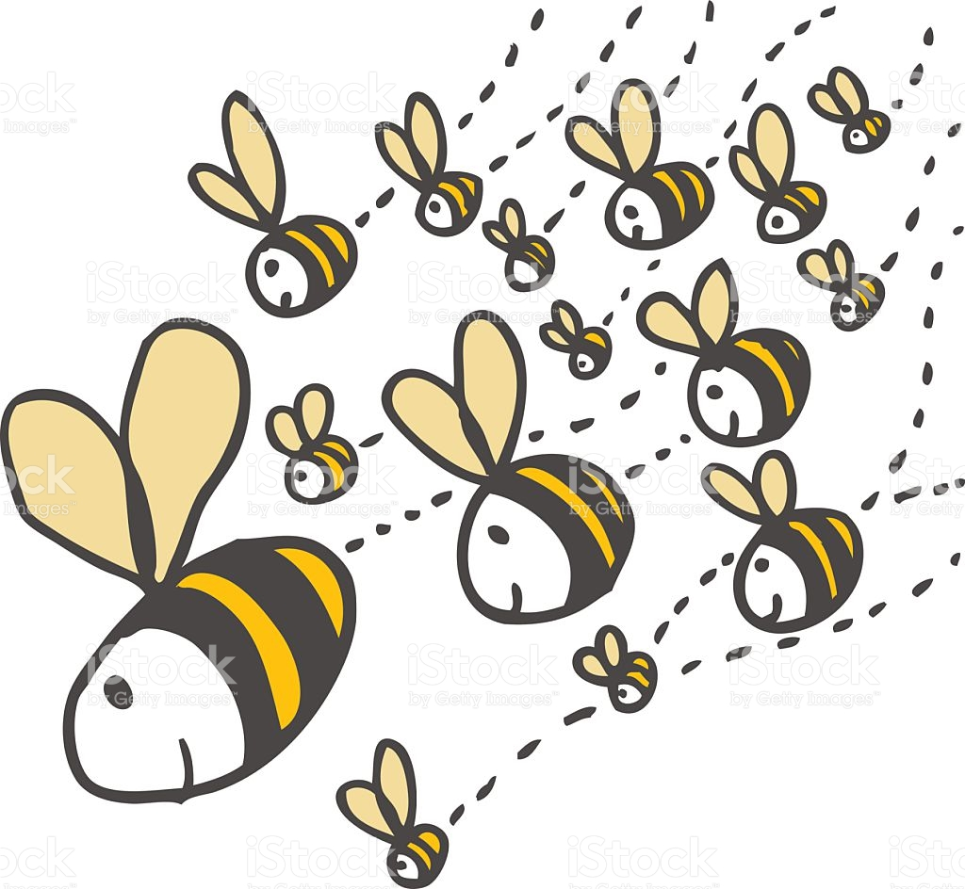
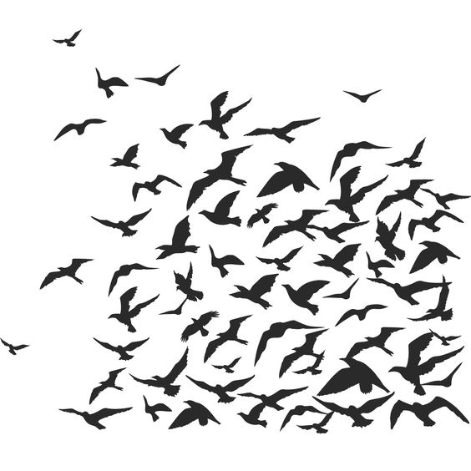
Collective nouns
Collective nouns are the names given for a group.
Swarm of bees
Flock of birds

Slide 10
Collective nouns
In your books, write the heading ‘Collective Nouns’, the number and just the answers
Jumping through hoops, the dog tried surprised the crowd.
The class sat still as the teacher spoke.
During assembly, the choir sang beautifully.
After the march, the troop made their way to their barracks.
The fleet of ships docked in Pearl Harbour.
The farmer moved the flock of sheep to the paddock.

Slide 11
Answers
Jumping through hoops, the dog tried surprised the crowd.
The class sat still as the teacher spoke.
During assembly, the choir sang beautifully.
After the march, the troop made their way to their barracks.
The fleet of ships docked in Pearl Harbour.
The farmer moved the flock of sheep to the paddock.

Slide 12
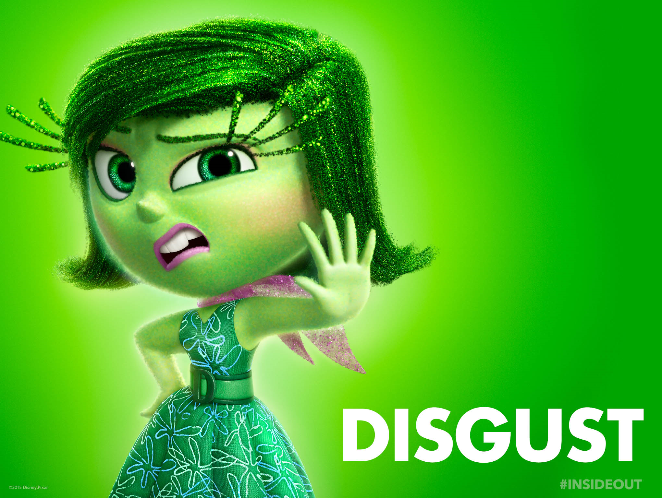
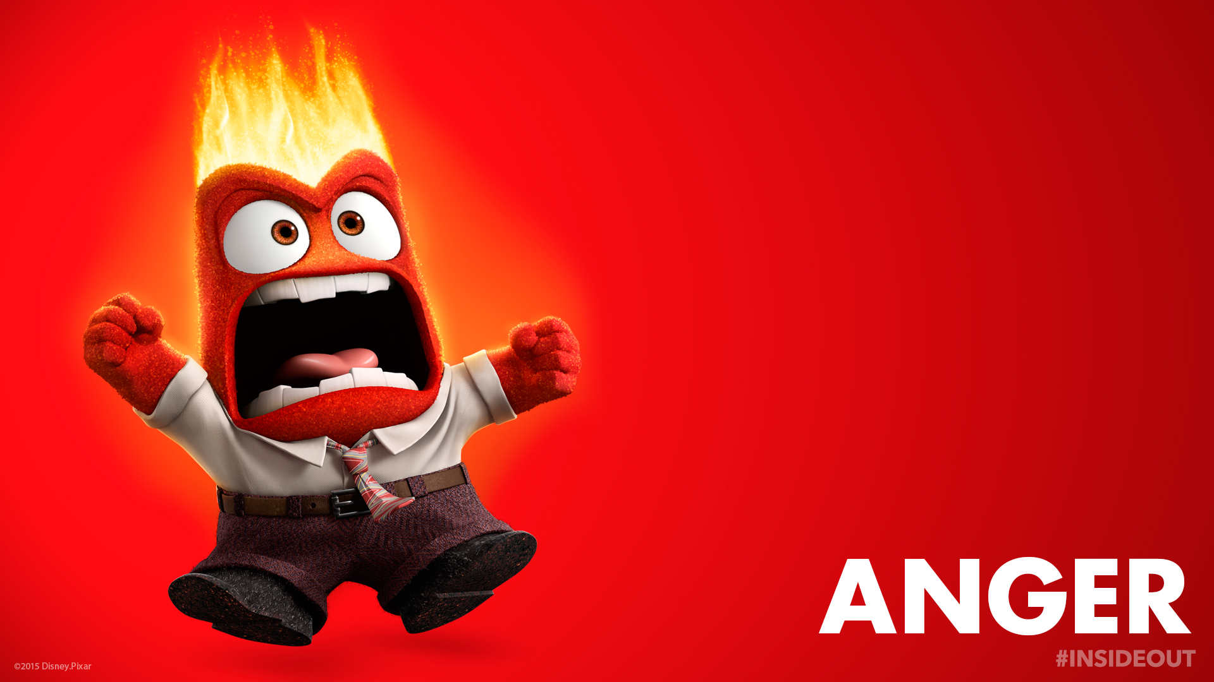
Abstract nouns
Abstract nouns are the names given to emotions.
Be careful! Make sure that you do not confuse the noun with the adjective!

Slide 13
Abstract Nouns
In your books, write the heading ‘Abstract Nouns’, the number and just the answers.
The angry boy felt only disgust at what had happened.
The happiness that filled the bride on her wedding day was overwhelming.
If jealousy were truly green, then Cinderella’s step-sisters would look like aliens.
Talking during a lesson will certainly cause your teachers to be filled with annoyance.

Slide 14
Answers
The angry boy felt only disgust at what had happened.
The happiness that filled the bride on her wedding day was overwhelming.
If jealousy were truly green, then Cinderella’s step-sisters would look like aliens.
Talking during a lesson will certainly cause your teachers to be filled with annoyance.

Slide 15
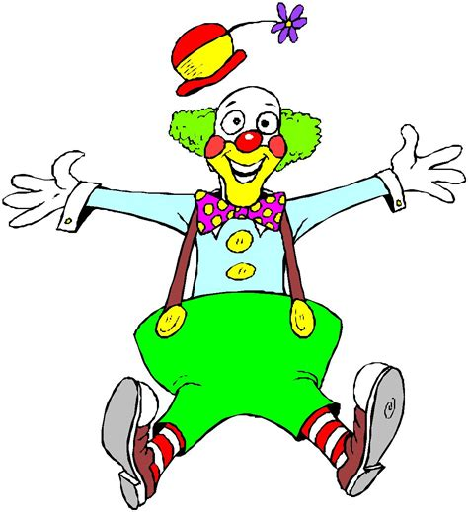
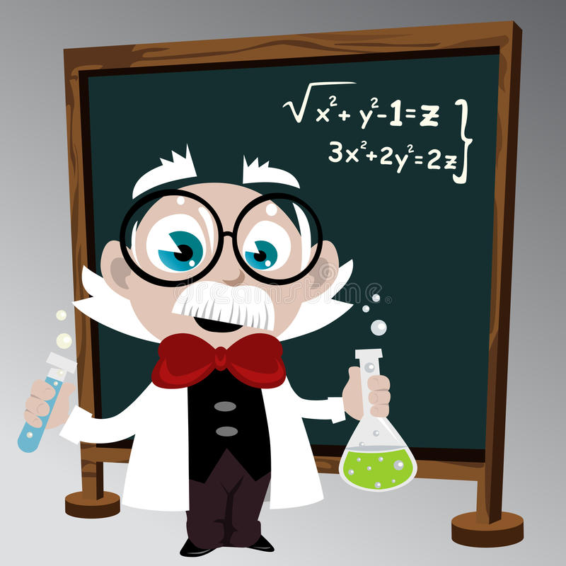
Adjectives
Adjectives have the power to only describe nouns.
The funny clown
The clever professor

Slide 16
Adjectives
In your books, write the heading ‘adjectives’, the number and just the answers.
The studious pupil received excellent results due to her hard work.
If you are a diligent person, you always put in your best effort.
Trying to overcome his phobia, the fearful boy went bungee jumping.
Out of the blue, the teacher bought her class delicious sweets.
The obnoxious student would not stop yelling out in class.

Slide 17
answers
The studious pupil received excellent results due to her hard work.
If you are a diligent person, you always put in your best effort.
Trying to overcome his phobia, the fearful boy went bungee jumping.
Out of the blue, the teacher bought her class delicious sweets.
The obnoxious student would not stop yelling out in class.
* In question 4, ‘blue’ acts as a noun.

Slide 18

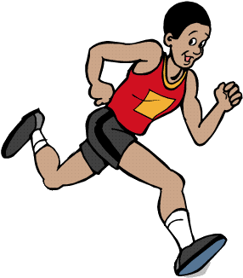
Verbs
Verbs not only show action but they also show tense.
James ran the race.
The emoji was thinking up an evil plan.

Slide 19
Verbs
In your books, write the heading ‘adjectives’, the number and just the answers.
Until the day is done, we will work on the farm.
If only I had had £2000 to spend on new clothes.
When we go swimming, we often float on our inflatables.
I like to run every morning.
Trying not to show any interest in this riveting English is difficult.

Slide 20
answers
Until the day is done, we will work on the farm.
If only I had had £2000 to spend on new clothes.
When we go swimming, we often float on our inflatables.
I like to run every morning.
Trying not to show any interest in this riveting English is difficult.

Slide 21
Adverbs
Adverbs describe verbs, adjectives and other adverbs.
They can tell us HOW something is done: quickly, quietly, fast
They can tell us WHEN something is done: later, after, during
They can tell us HOW OFTEN something is done: everyday, often, frequently
They can tell us WHERE something is done: upstairs, outside, under the table
They can tell us to WHAT DEGREE something is done: almost, nearly, hardly

Slide 22
Adverbs
In your books, write the heading ‘adjectives’, the number and just the answers.
The princess gracefully made her way down the stairs.
I nearly completed the puzzle when my brother boke it.
So far, we have found twelve grammar mistakes.
There aren’t any Pokémon here; we should look elsewhere.
Fred rarely eats fast food.

Slide 23
answers
The princess gracefully made her way down the stairs.
I nearly completed the puzzle when my brother boke it.
So far, we have found twelve grammar mistakes.
There aren’t any Pokémon here; we should look elsewhere.
Fred rarely eats fast food.

Slide 24
Modal verbs and adverbs
https://central.espresso.co.uk/espresso/primary_uk/subject/module/video/item361707/grade2/module305322/collection361827/section361764/index.html?source=search-all-all-all-all&source-keywords=adverbs

