Slide 1
PHRASAL VERBS
Choose the correct verb and preposition to complete each of the following sentences.
Prepositions will
be here:
examples: out; in; on; up; back; away; off
Verbs will be here:
examples: clear; take; work; put; turn

Slide 2


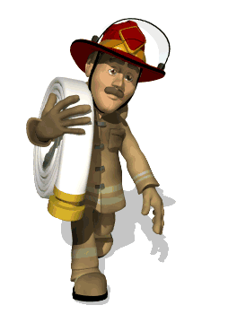
PHRASAL VERBS
choose the correct verb and particle
The firemen took several hours to _______ the fire ________
put
out
sort; pull; fill; find; try; bring; clear; take; work; put; turn
out; in; on; up; back; away; off

Slide 3


PHRASAL VERBS
choose the correct verb and particle
turn
Can I ________ the light _______? I want to go to sleep!
off
sort; pull; fill; find; try; bring; clear; take; work; put; turn
out; in; on; up; back; away; off

Slide 4


PHRASAL VERBS
choose the correct verb and particle
bring
Why did he have to ________ that _______ again at the meeting!
up
sort; pull; fill; find; try; bring; clear; take; work; put; turn
out; in; on; up; back; away; off

Slide 5

PHRASAL VERBS
choose the correct verb and particle
fill
Could you just _________ this form ________ please?
in
sort; pull; fill; find; try; bring; clear; take; work; put; turn
out; in; on; up; back; away; off

Slide 6

PHRASAL VERBS
choose the correct verb and particle
sort
They’ll have to _______ the problem _________ first.
out
sort; pull; fill; find; try; bring; clear; take; work; put; turn
out; in; on; up; back; away; off

Slide 7

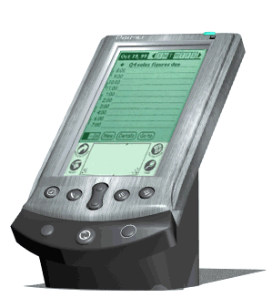
PHRASAL VERBS
choose the correct verb and particle
try
The boss wants to _______ a new product _________ on the market.
out
sort; pull; fill; find; try; bring; clear; take; work; put; turn
out; in; on; up; back; away; off

Slide 8
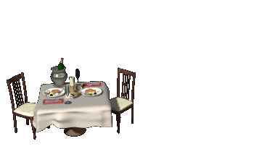


PHRASAL VERBS
choose the correct verb and particle
clear
up
My children never _______ ____ when they’ve finished eating.
sort; pull; fill; find; try; bring; clear; take; work; put; turn
out; in; on; up; back; away; off

Slide 9







PHRASAL VERBS
choose the correct verb and particle
put
Could you please _________ your clothes __________ ?
away
sort; pull; fill; find; try; bring; clear; take; work; put; turn
out; in; on; up; back; away; off

Slide 10

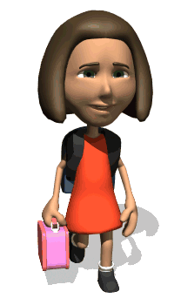
PHRASAL VERBS
choose the correct verb and particle
find
out
Shall we try to ________ ________ where she lives?
sort; pull; fill; find; try; bring; clear; take; work; put; turn
out; in; on; up; back; away; off

Slide 11
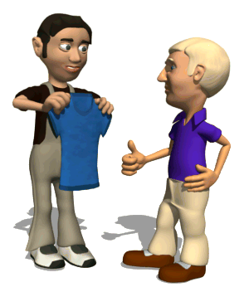

PHRASAL VERBS
choose the correct verb and particle
try
Why don’t you _______ the shirt ________! I’m sure you’ll buy it.
on
sort; pull; fill; find; try; bring; clear; take; work; put; turn
out; in; on; up; back; away; off

Slide 12


PHRASAL VERBS
choose the correct verb and particle
Some of the answers in the maths exams were hard to ______ ______
work
out
sort; pull; fill; find; try; bring; clear; take; work; put; turn
out; in; on; up; back; away; off

Slide 13

PHRASAL VERBS
choose the correct verb and particle
take
I have to ________ this article ________ to the shop, it’s faulty.
back
sort; pull; fill; find; try; bring; clear; take; work; put; turn
out; in; on; up; back; away; off

Slide 14
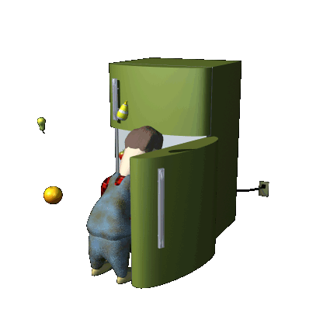
PHRASAL VERBS
choose the correct verb and particle
sort
I must ________ my cupboards ________ this weekend.
out
sort; pull; fill; find; try; bring; clear; take; work; put; turn
out; in; on; up; back; away; off

Slide 15

PHRASAL VERBS
choose the correct verb and particle
put
out
Can you ________ the cat ______ please and lock the door.
sort; pull; fill; find; try; bring; clear; take; work; put; turn
out; in; on; up; back; away; off

Slide 16

PHRASAL VERBS
choose the correct verb and particle
fill
in
I had to ______ ______ an application form for the job.
sort; pull; fill; find; try; bring; clear; take; work; put; turn
out; in; on; up; back; away; off

Slide 17
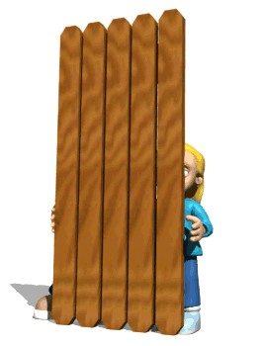
PHRASAL VERBS
choose the correct verb and particle
find
out
They tried to _________ _______ what she was doing in secret.
sort; pull; fill; find; try; bring; clear; take; work; put; turn
out; in; on; up; back; away; off

Slide 18
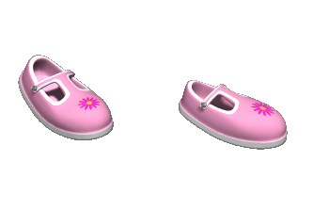
PHRASAL VERBS
choose the correct verb and particle
try
Can I _______ these shoes ________ please?
on
sort; pull; fill; find; try; bring; clear; take; work; put; turn
out; in; on; up; back; away; off

Slide 19
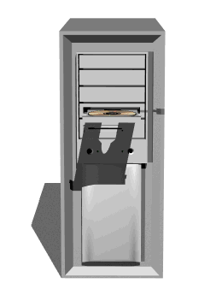

PHRASAL VERBS
choose the correct verb and particle
try
I’m going to ________ this new software _______ this evening.
out
sort; pull; fill; find; try; bring; clear; take; work; put; turn
out; in; on; up; back; away; off

Slide 20
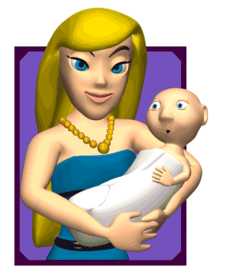


PHRASAL VERBS
choose the correct verb and particle
bring
It’s very difficult to ________ children _______ nowadays.
up
sort; pull; fill; find; try; bring; clear; take; work; put; turn
out; in; on; up; back; away; off

Slide 21
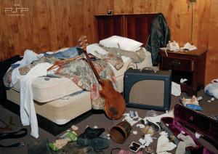

PHRASAL VERBS
choose the correct verb and particle
clear
up
Please________ your room _______ before your mother gets back!
sort; pull; fill; find; try; bring; clear; take; work; put; turn
out; in; on; up; back; away; off

Slide 22


PHRASAL VERBS
choose the correct verb and particle
I have to _________ my nephew _________ home this afternoon.
take
back
sort; pull; fill; find; try; bring; clear; take; work; put; turn
out; in; on; up; back; away; off

Slide 23

PHRASAL VERBS
choose the correct verb and particle
I can’t _________ ________ what to do next.
work
out
sort; pull; fill; find; try; bring; clear; take; work; put; turn
out; in; on; up; back; away; off

Slide 24
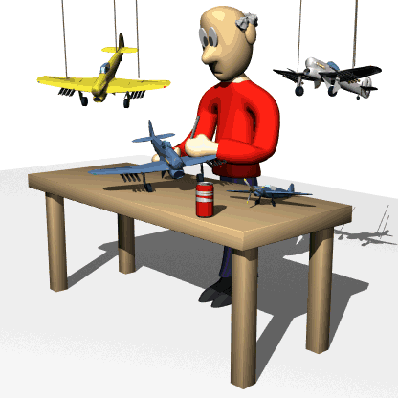
PHRASAL VERBS
choose the correct verb and particle
put
I’ll be ready when I’ve ________ these things ________
away
sort; pull; fill; find; try; bring; clear; take; work; put; turn
out; in; on; up; back; away; off

Slide 25


PHRASAL VERBS
choose the correct verb and particle
turn
Shall I ________ the television _______? Nobody’s watching it.
off
sort; pull; fill; find; try; bring; clear; take; work; put; turn
out; in; on; up; back; away; off

