Slide 1

PHRASAL VERBS
find the correct particle
into
Our house was broken ______ last night.

Slide 2

PHRASAL VERBS
find the correct particle
down
The house burnt ___________ in next to no time.

Slide 3

PHRASAL VERBS
find the correct particle
The meeting was called _______ at the last minute.
off

Slide 4
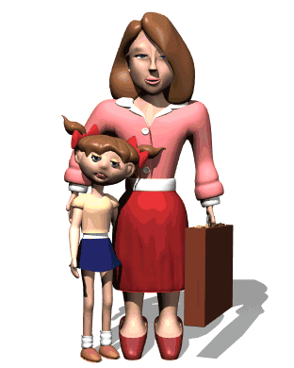
PHRASAL VERBS
find the correct particle
I wish you would try to calm ________, it’s not that bad!
down

Slide 5
PHRASAL VERBS
find the correct particle
on
Don’t stop now, carry ______ with the project, it’s good!

Slide 6
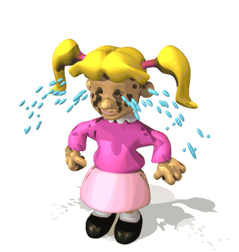
PHRASAL VERBS
find the correct particle
up
Try to cheer _______ before your parents get here.

Slide 7
PHRASAL VERBS
find the correct particle
down
The factory closed ________ last year.

Slide 8
PHRASAL VERBS
find the correct particle
out
You can count me _______! It’s too risky!

Slide 9
PHRASAL VERBS
find the correct particle
Just cross _______ the words which are not correct.
out

Slide 10
PHRASAL VERBS
find the correct particle
off
Their electricity was cut ______ because they couldn’t pay the bill

Slide 11
PHRASAL VERBS
find the correct particle
down
They had to cut _________ a lot of trees to make the new road.

Slide 12
PHRASAL VERBS
find the correct particle
I used to love dressing _____ when I was a child.
up

Slide 13
PHRASAL VERBS
find the correct particle
My parents made us eat all our food _____ before leaving the table.
up

Slide 14
PHRASAL VERBS
find the correct particle
out
I couldn’t figure _________ what he meant to say.

Slide 15
PHRASAL VERBS
find the correct particle
out
The police soon found _______ where the robbers were hiding.

Slide 16




PHRASAL VERBS
find the correct particle
I told her to give the toy __________ to the other child.
back

Slide 17


PHRASAL VERBS
find the correct particle
I don’t know the answer,
I give ________!
up

Slide 18

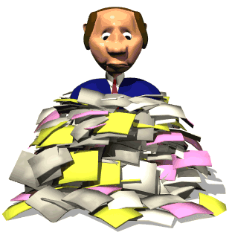
PHRASAL VERBS
find the correct particle
Make sure not to leave anyone _________ when you send the invitations.
out

Slide 19

PHRASAL VERBS
find the correct particle
She’ll be so upset if you
let her _______
down

Slide 20
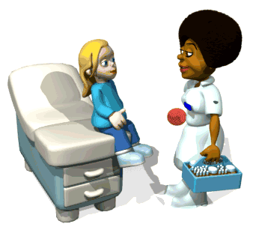
PHRASAL VERBS
find the correct particle
She went white and then passed ________
out

Slide 21



PHRASAL VERBS
find the correct particle
Thanks for the money! I’ll pay you __________ tomorrow.
back

Slide 22
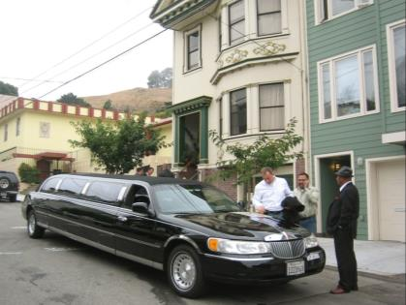
PHRASAL VERBS
find the correct particle
up
I’ll pick you ______ at 8 p.m.

Slide 23
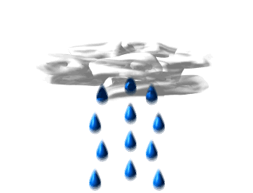
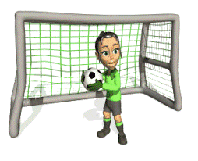


PHRASAL VERBS
find the correct particle
The football match was put ______ because of the rain.
off

Slide 24

PHRASAL VERBS
find the correct particle
She put a nice dress _______ and went out.
on

