Slide 1


phrasal
verbs

Slide 2
Complete the sentences
up
My wife backed me ___ over my decision to quit my job.

Slide 3
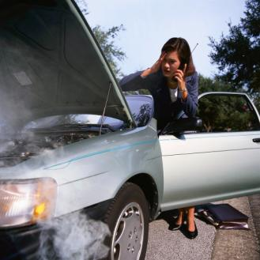
Complete the sentences
down
My car broke _____ on my way to work yesterday.

Slide 4
Complete the sentences
up
Please clean ____ your bedroom before you go outside.

Slide 5
Complete the sentences
in
Just fill ___ the form with your name, address, and phone number, please.

Slide 6
Complete the sentences
in
Somebody broke ____ last night and stole our stereo.

Slide 7
Complete the sentences
The firemen had to break _____ the room to rescue the children.
into

Slide 8
Complete the sentences
The money must have fallen _____ of my pocket.
out

Slide 9
Complete the sentences
off
The phone company cut ___ our phone because we didn't pay the bill.

Slide 10
Complete the sentences
out
The prisoners broke ____ of jail when the guards weren't looking.

Slide 11
Complete the sentences
up
The racing car blew ____ after it crashed into the fence.

Slide 12
Complete the sentences
on
We called ____ you last night but you weren't home.

Slide 13
Complete the sentences
We don't know where he lives. How can we find ____?
out

Slide 14
Complete the sentences
They had to cut the old tree in our yard _____ after the storm.
down

Slide 15
Complete the sentences
We will get the hotel keys when we check _____.
in

