Slide 1

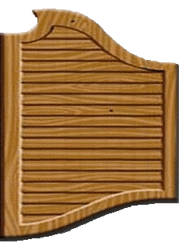
phrasal
verbs

Slide 2
Complete the sentences
on
Hang _____ while I grab my coat and shoes!

Slide 3
Complete the sentences
He didn't say goodbye before he hung ____.
up

Slide 4
Complete the sentences
back
Jamie held _____ his tears at his grandfather's funeral.

Slide 5
Complete the sentences
onto
Hold _____ your hat because it's very windy outside.

Slide 6
Complete the sentences
We kept our relationship _____ our parents for two years.
from

Slide 7
Complete the sentences
Try to keep the wet dog ____ of the living room.
out

Slide 8
Complete the sentences
If you keep those results ___ you will get into a great college.
up

Slide 9
Complete the sentences
I need you to be on time. Don't let me _____ this time.
down

Slide 10
Complete the sentences
in
Can you let the cat ___ before you go to school?

Slide 11
Complete the sentences
after
I have to look ______ my sick grandmother.

Slide 12
Complete the sentences
for
I'm looking ____ an evening gown.

Slide 13
Complete the sentences
forward
I'm looking _________ to the Christmas break.

Slide 14
Complete the sentences
We are going to look _____ the price of snowboards today.
into

Slide 15
Complete the sentences
out
Look ____! That car's going to hit you!

Slide 16
Complete the sentences
We can look her phone number ___ on the Internet.
up

Slide 17
Complete the sentences
up
Jo made ___ a story about why we were late.

Slide 18
Complete the sentences
away
His uncle passed _____ last night after a long illness.

Slide 19
Complete the sentences
It was so hot in the church that an elderly lady passed ____.
out

Slide 20
Complete the sentences
The teacher passed the textbooks ____ before class.
out

