Slide 1
PLACE PREPOSITIONS
at/in/to
to
They went ______ Paris for their honeymoon.

Slide 2
PLACE PREPOSITIONS
at/in/to
We walked ___ the end of the street.
to

Slide 3
PLACE PREPOSITIONS
at/in/to
in
I love swimming ____ the sea.

Slide 4
PLACE PREPOSITIONS
at/in/to
I’ll meet you ____ the cinema.
at

Slide 5
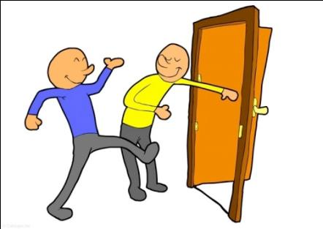
PLACE PREPOSITIONS
at/in/to
There’s someone for you ____ the door.
at

Slide 6
PLACE PREPOSITIONS
at/in/to
She lives ___ the end of the street.
at

Slide 7
PLACE PREPOSITIONS
at/in/to
in
We had to stand ____ a queue to vote.

Slide 8

PLACE PREPOSITIONS
at/in/to
You’ll find the site address ____ the bottom of the page.
at

Slide 9
PLACE PREPOSITIONS
at/in/to
The children are playing ___ the garden.
in

Slide 10
PLACE PREPOSITIONS
at/in/to
in
The Queen lives ____ a palace.

Slide 11
PLACE PREPOSITIONS
at/in/to
In England people drive ___ the left.
on

Slide 12
PLACE PREPOSITIONS
at/in/to
I saw him ___ my way to work.
on

Slide 13
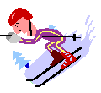
PLACE PREPOSITIONS
at/in/to
We went skiing ___ the Alps.
in

Slide 14
PLACE PREPOSITIONS
at/in/to
on
Biarritz is ___ the west coast of France.

Slide 15
PLACE PREPOSITIONS
at/in/to
My grandmother likes sitting ___ the window.
at

Slide 16
PLACE PREPOSITIONS
at/in/to
The murder was ___ the front page of the newspaper.
on

Slide 17
PLACE PREPOSITIONS
at/in/to
We had seats ___ the front row at the theatre.
in

Slide 18
PLACE PREPOSITIONS
at/in/to
Write your name and address ___ the back of the envelope.
on

Slide 19
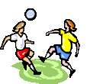
PLACE PREPOSITIONS
at/in/to
It’s dangerous to play
___ the street.
in

Slide 20
PLACE PREPOSITIONS
at/in/to
Look at the horses
___ that field.
in

