Slide 1
POSSESSIVE ADJECTIVES
my, our, your, his, her, their

Slide 2
your
Is this ____ parents car?

Slide 3
This is ____ maths teacher. We like her very much.
our

Slide 4
her
That’s _____ bag.

Slide 5
my
This is ____ teacher.
I like him very much.

Slide 6
Brian is often helped by _____ teacher.
his

Slide 7
I often watch television with ____ parents.
my

Slide 8
her
What’s _____ name?

Slide 9
The children had their photo taken with _____ parents.
their

Slide 10
Hello, what’s _____ name?
your

Slide 11
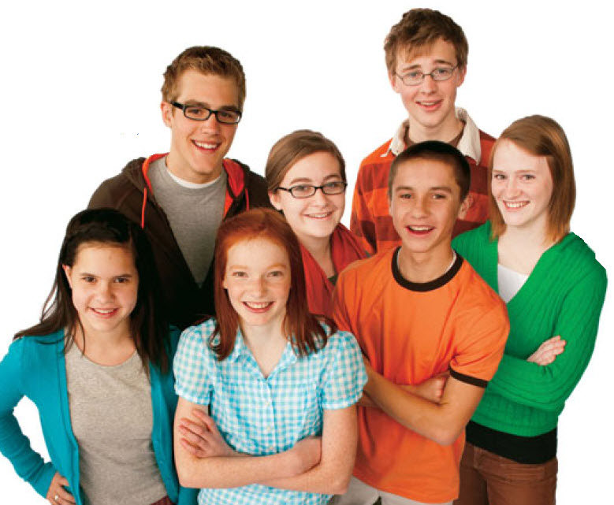
This is ____ theatre group. We all get on well.
our

Slide 12

This is Bob with ___ new girlfriend.
his

Slide 13
They are using ____ new bike for the first time.
their

Slide 14
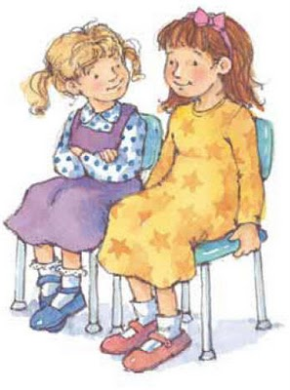
This is Alice with _____ friend Julia.
her

Slide 15
This is ____ church. They go there every Sunday.
their

Slide 16
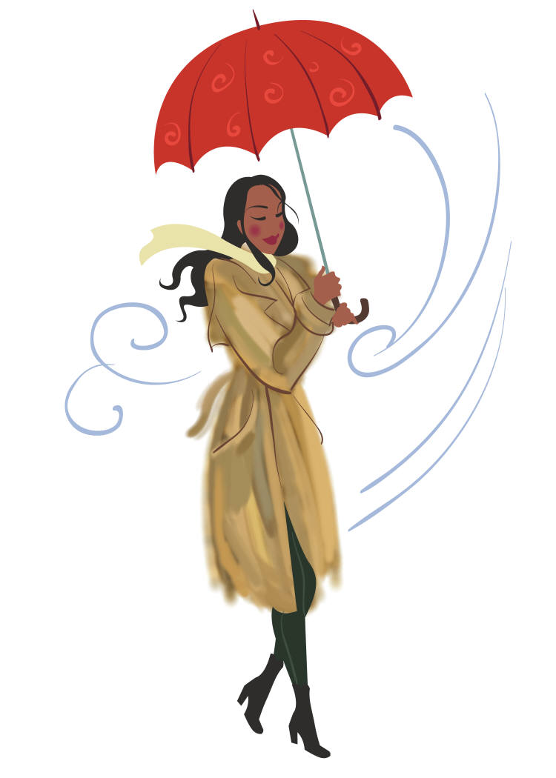
This is Sophie with _____ umbrella.
her

Slide 17
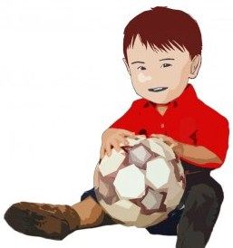
This is my brother with _____ ball.
his

Slide 18
my
This is ____ new car. I bought it yesterday.

Slide 19
our
This is ____ baby. She’s three months old.

Slide 20
Hello, who’s _____ teacher?
your

