Slide 1
Relative Pronouns and Relative Clauses
LO: To identify and use relative pronouns

Slide 2
When is it a pronoun and when is it a determiner?
Discuss with your partner…
What is the difference between a possessive pronoun and a possessive determiner?
Write an explanation on your white board.
For example:
‘His’ and ‘her’ are possessive determiners. Why?
But ‘his’ can also be a possessive pronoun. When?

Slide 3
The answer…
If it looks like a ‘pronoun’ (takes the place of a noun) but is before a noun, then it is a determiner.
E.g.
The boy asked his father for a pay rise – he felt that the promotion to ‘Chief Executive Dishwasher’ was his.
Red = determiner
Green = pronoun

Slide 4
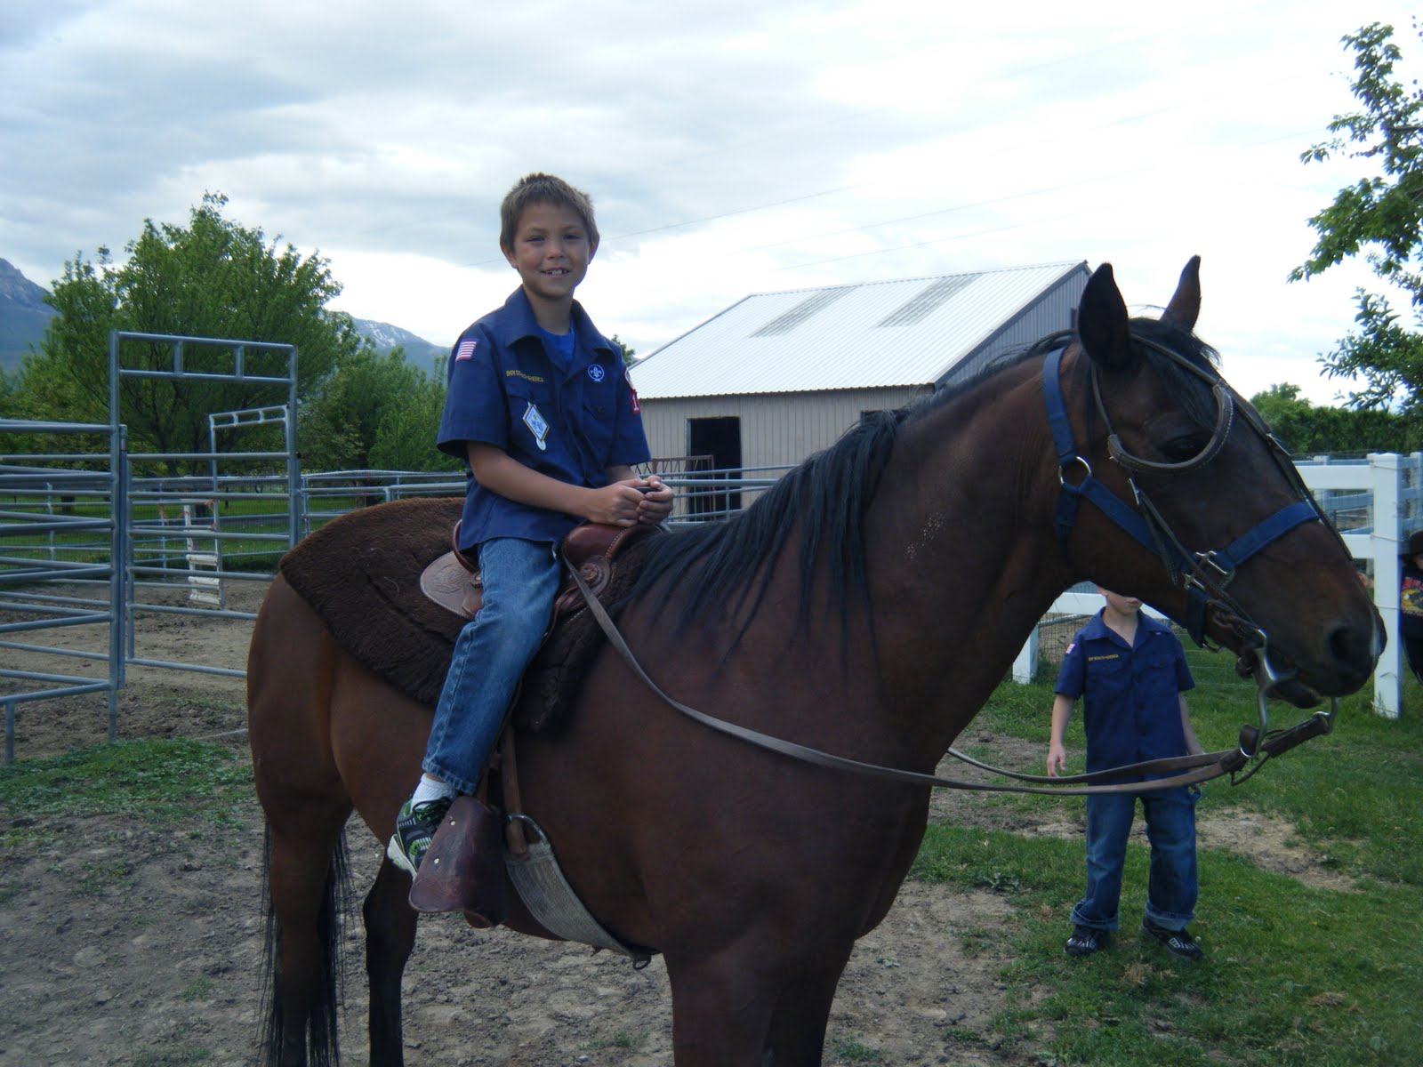
Pronoun or determiner?
Write out the following sentences and underline the pronouns and determiners in different colours.
The boy rode his horse to the shop.
That was an incredible play.
Her voice was as beautiful as an angel’s.
Bruce wanted his orange placed by the kitchen sink.
They went to the circus for a lovely day out.
The socks were hers although she denied it.

Slide 5
Answers
The boy rode his horse to the shop.
That was an incredible play.
Her voice was as beautiful as an angel’s.
Bruce wanted his orange placed by the kitchen sink.
They went to the circus for a lovely day out.
The socks were hers although she denied it.
Green = pronoun
Red = determiner
https://www.bing.com/videos/search?q=YouTube+School+Rock+Pronouns&&view=detail&mid=AB01D0743A4B954A5809AB01D0743A4B954A5809&&FORM=VDRVRV

Slide 6
What is a relative pronoun?
Let’s break it down…
What does relative mean?
What is a pronoun?

Slide 7
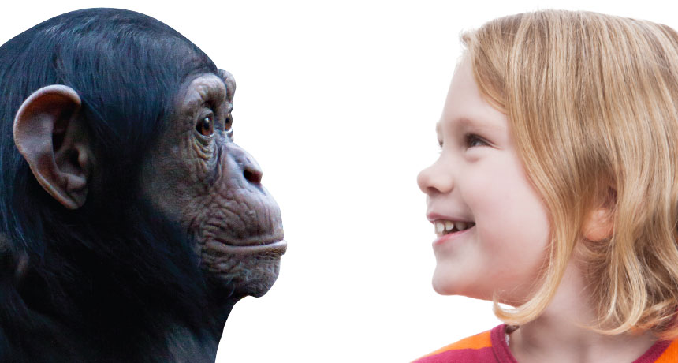
Relative pronouns
Relative pronouns are gender neutral which means that they don’t refer to the gender of what is being spoken about.
Some are used for humans and some are used for animals and objects.

Slide 8
To use relative pronouns
Here is a list of relative pronouns. Can you place them in two categories?
that, who, whom, which, whose
Animals and Objects | Humans

Slide 9
Answers
Objects and animals | Humans
That | Whose
which | Who
 | whom

Slide 10
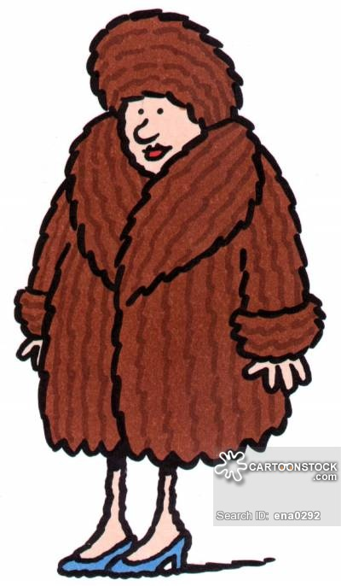
Can you identify the relative pronouns in these sentences?
1. Who is the unusual lady with the brown fuzzy hat?
2. The teacher, whose hair was turning grey, tried not to laugh.
3. The cat that sat on the mat.
4. The girl, with whom the queen spoke, was very polite.
5. Under the bridge, which had just been rebuilt, lived a troll.
Extension
Try to write your own sentences using relative pronouns.

Slide 11
Answers
1. Who is the unusual lady with the brown fuzzy hat?
2. The teacher, whose hair was turning grey, tried not to laugh.
3. The cat that sat on the mat.
4. The girl, with whom the queen spoke, was very polite.
5. Under the bridge, which had just been rebuilt, lived a troll.

Slide 12
LO: To use relative pronouns to produce relative clauses

Slide 13
Clauses Recap
Talk to your partner. You have learnt about two different types of clauses. What are they?

Slide 14
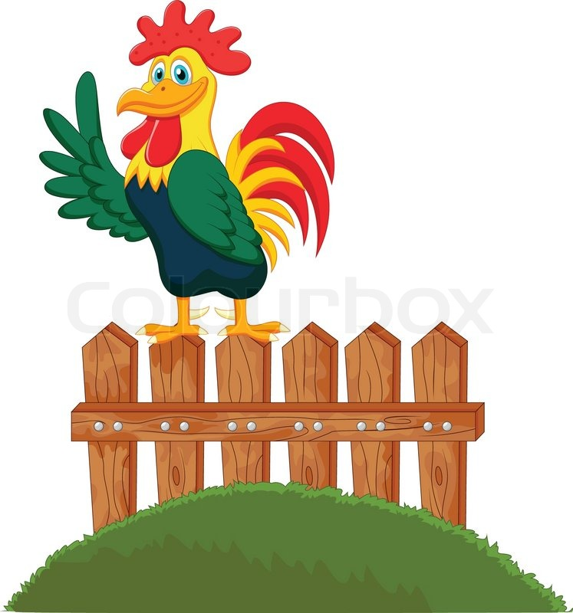
Main clauses
Main clauses make sense on their own.
Example:
The rooster stood on top of the fence.

Slide 15

Subordinate clauses
Subordinate clauses need a main clause to make sense.
Example:
until she saw a ghost
Can you add a main clause to help this subordinate clause?

Slide 16

Relative Clauses
Relative clauses start with a relative pronoun.
The teacher, whose hair was turning grey, tried not to laugh.
Under the bridge, which had just been rebuilt, lived a troll.
The building that was due to be demolished was blown over in the wind.

Slide 17
Let’s identify some relative clauses
Tarzan, who fell into a frying pan, now has a tan.
Jane, whose aeroplane crashed into traffic lane, got hurt.
The cheetah, that danced on a pizza, got grease on his feet.
What do you notice about these clauses? What do they have in common?
Brain break:
https://www.youtube.com/watch?v=PHITaanLbD8

Slide 18
Try some on your own! Add some relative clauses to these.
The green alien ate spaghetti.
In the Pacific Ocean live many dolphins.
Tomorrow we’ll play guitar.
The rainbow shone over the garden.
Fran wanted to eat all of the bananas.

