Slide 1

‘Scumbelina’
Ross McGlinchey

Slide 2


Once upon a time there was a girl called Simmy. Simmy lived the magical land of Arcadia. The magical land of Arcadia was quite hard to describe. I suppose it was a bit like Hackney, only a bit more magical.

Slide 3
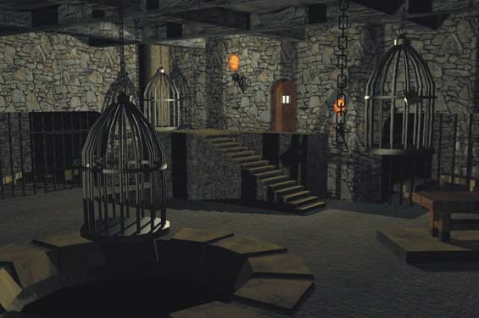
Now, Simmy didn’t have any parents, so she lived in a creepy castle with a Wicked Witch called Wilma. Wilma made Simmy do all the horrible jobs in the creepy castle, jobs like cleaning the scum out of the bath. Because of this Wilma called Simmy ‘Scumbelina’. This made Simmy feel very sad.

Slide 4
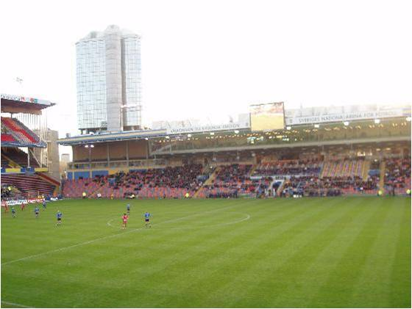
In the very same magical land of Arcadia there was a handsome professional footballer called Reneldo. Reneldo was very lonely and wanted to meet a girlfriend, so he decided to invite all the girls in Arcadia to a disco. He posted the invitations straight away.

Slide 5


Simmy and Wilma both received their invitations to the disco the next day. Simmy was very excited about going to the disco!

Slide 6
“You’re not coming Scumbelina!” laughed Wilma as she put on her best pointy hat. With that she got on her broomstick and flew out of the door and off to the disco.

Slide 7
Simmy was so sad that she started to cry. Poor Simmy!

Slide 8

Suddenly a good fairy appeared. “Don’t cry Simmy!” said the good fairy “You shall go to the disco!”. “What will I wear and how will I get there?” asked Simmy, wiping her eyes.

Slide 9
The good fairy waved her magic wand and made Simmy a splendid sari, some perfect pumps and a lovely limousine. “ Your sari, pumps and limousine will only last until midnight” warned the good fairy. “My wands on the blink at the moment” she explained with a sigh.

Slide 10
“Now for a driver” said the good fairy. “That’s okay” said Simmy as she hopped into the lovely limousine and sped off to the disco.

Slide 11
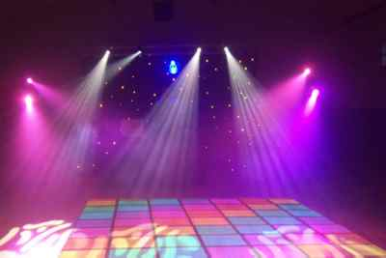
Everyone from Arcadia was at the disco, including wicked witch Wilma. Simmy was worried that Wilma would recognise her, but in her splendid sari and perfect pumps Simmy looked very different.

Slide 12
Reneldo and Simmy’s eyes met across the dance floor. They danced the night away. It was love at first sight!

Slide 13
While Reneldo was getting Simmy a glass of lemonade the clock began to strike midnight. Simmy remembered what the good fairy had said and ran out of the disco and back home as quickly as she could!

Slide 14
When Reneldo returned with the glass of lemonade he was surprised to find Simmy gone. He didn’t know Simmy’s name or where in Arcadia she lived, so how would he ever find her? In her hurry Simmy had left her perfect pumps behind. “I shall search the whole of Arcadia until I find the mystery girl who fits these perfect pumps!” exclaimed Reneldo.

Slide 15
Reneldo searched all over the Arcadia to find the mystery girl he had met at the disco. He met many beautiful girls, but the perfect pumps didn’t fit any of them. Poor Reneldo! He only had one more place left to try - wicked witch Wilma’s castle.

Slide 16
Wilma heard Reneldo knocking at her door. She was pretty sure that Simmy wasn’t the mystery girl from the disco, but she wasn’t going to take any chances. She waved her broomstick and Simmy vanished!

Slide 17
Wilma tried to squeeze her feet into the perfect pumps, but her they were too big. “Does anyone else live here?” asked Reneldo, hopefully. “Oh no” lied Wilma “just little old me”. Suddenly the good fairy appeared. She waved her magic wand and Wilma vanished. With one more wave she returned Simmy in her splendid sari.

Slide 18
After a suitably long engagement Simmy and Reneldo got married. They lived happily ever after...

Slide 19
...and Simmy pursued a successful career as an Olympic swimmer.

Slide 20
The End

Slide 21
Choose an activity...
‘Alliteration Magic’ with wicked witch Wilma.
‘Story Sequence’ with Reneldo.
‘Knowing me, Knowing Who?’ with Simmy.

Slide 22
Look at the things the good fairy made Simmy and how they are described...
Splendid sari
Perfect pumps
Lovely limousine
What do you notice the initial sound of each set of words?

Slide 23
If the good fairy made Simmy a tiara how would you describe it? Just like in the story, try to use a describing word with the same initial sound as the word ‘tiara’...
Tiara
Beautiful
Hairy
Terrific

Slide 24
A beautiful tiara?
Good try!
Beautiful is a good way to describe a tiara, but it doesn’t have the same initial sound as ‘tiara’.

Slide 25
A hairy tiara?
Good try!
The tiara doesn’t look very hairy. What do you think would be a good way to describe a tiara? Also try thinking about the initial sound of the word ‘tiara’.

Slide 26
A terrific tiara?
Well done! That’s right!
Terrific is a good way to describe a tiara. Tiara and terrific both start with the same initial sound, a ‘t’ sound. This is called alliteration.

Slide 27
Which of these things happened first in the story?
Simmy received her invitation to the disco
Simmy met Reneldo

Slide 28
Simmy received her invitation to the disco first?
Well done! That’s right!
Simmy received her invitation to the disco before she went there and met Reneldo.

Slide 29
Simmy met Reneldo first?
Good try!
Simmy did meet Reneldo at the disco, but what did she need to have received to go to the disco?

Slide 30
Who is this character?
Reneldo
Wilma

Slide 31
This character is Reneldo?
Good try!
This character is not Reneldo. Reneldo was a handsome professional footballer.
What do you think a professional footballer would look like?
What does this character look like?

Slide 32
This character is Wilma?
Well done! That’s right!
This character is Wilma the wicked witch.
What do you think is the best word to describe Wilma the wicked witch?
Kind
Cruel
Think about the things Wilma did in the story? How are the things she did best described?

Slide 33
Wilma was kind?
Good try!
In the story Wilma made Simmy do horrible jobs, she called her ‘Scumbelina’, she wouldn’t let her go to the disco and she made her vanish when Reneldo came to find her. Are the things that Wilma did in the story best described as kind’?
Who do you think was kind in the story?

Slide 34
Was Wilma cruel?
Well done! That’s Right!
In the story Wilma made Simmy do horrible jobs, she called her ‘Scumbelina’, she wouldn’t let her go to the disco and she made her vanish when Reneldo came to find her. The things that Wilma did in the story are best described as cruel?
I wonder why wicked witch Wilma was so cruel?

Slide 35
Discuss…
Who was your favourite character? Why?
Who was your least favourite character? Why?
What was the best bit in the story? Why?
What was the worst part of the story? Why?

Slide 36
Try…
Writing your own story (you could even illustrate it or use the perspective of a specific character in ‘Scumbelina’).
Creating a piece of drama based on ‘Scumbelina’.
Having your own class disco. Don’t forget that you’ll need to make some invitations!
The possibilities are endless...

Slide 37
Useful websites…
For educators...
www.webenglishteacher.com/fairytales.html
teacher.scholastic.com/writewit/mff
http://webtech.kennesaw.edu/jcheek3/fairytales.htm
For children....
www.classicfairytales.com/en/main
www.andersenfairytales.com/en/main
www.grimmfairytales.com/en/main

