Slide 1
Singular and Plural
One and More

Slide 2






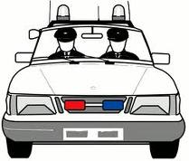
A noun is a name of a person, place or thing.
Ball
Shoe
Leaf
Car
Story
Clock
Brush

Slide 3

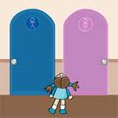
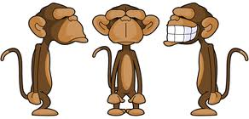


Nouns can be more than one.
Brushes
Monkeys
Doors
Balloons
Cups

Slide 4
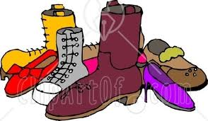
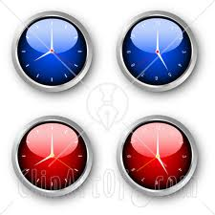

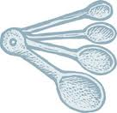

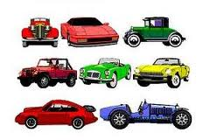

Adding s to make plurals.
Singular
Plural
Singular
Plural
Shoe
Shoes
Clock
Clocks
Ball
Balls
Spoon
Spoons
Cup
Cups
Car
Cars

Slide 5

Match singulars and plurals.
Cups
Spoon
Balls
Doors
Ball
Car
Door
Spoons
Cars
Cup
Clock
Clocks

Slide 6
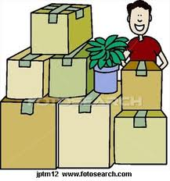


Adding es to make plurals.
Singular
Plural
Box
Boxes
When nouns end with sh, ch, s or x we add es to make plurals.
Brush
Brushes
Fish
Fishes

Slide 7



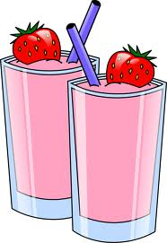

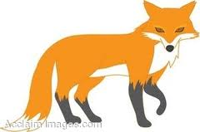
Match singulars and plurals.
Fish
Brush
Boxes
Bunch
Brushes
Foxes
Box
Glass
Fox
Fishes
Glasses
Bunches

Slide 8
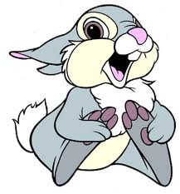

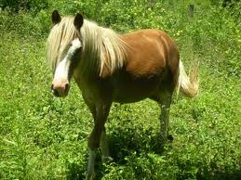
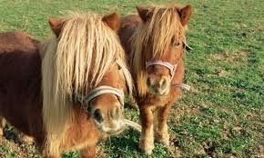
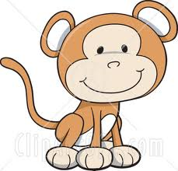

Adding ies to make plurals.
Singular
Plural
When nouns end with y we add ies to make plurals.
If there is a vowel before the y then s is added.
Bunny
Bunnies
Pony
Ponies
Monkey
Monkeys
Story
Stories

Slide 9
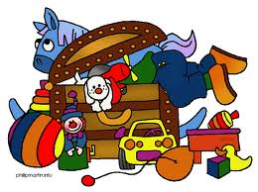

Match singulars and plurals.
Boy
Stories
Bunny
Pony
Toys
Toy
Monkey
Boys
Ponies
Bunnies
Story
Monkeys

Slide 10
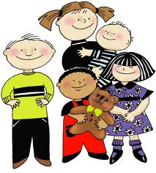
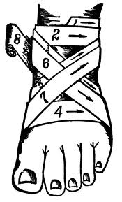


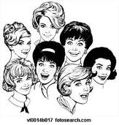

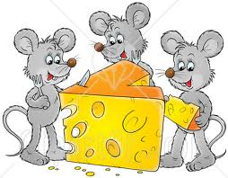


Some nouns have different plurals.
Singular
Plural
Singular
Plural
Foot
Feet
Child
Children
Man
Men
Woman
Women
Tooth
Teeth
Mouse
Mice

Slide 11
Match singulars and plurals.
Foot
Mouse
Teeth
Woman
Mice
Women
Tooth
Child
Men
Man
Feet
Children

Slide 12
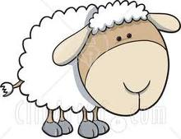

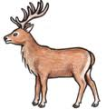
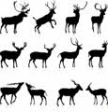
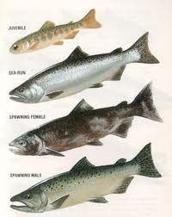

Some singular and plurals are the same.
Singular
Plural
Sheep
Sheep
Deer
Deer
Salmon
Salmon

Slide 13
Match singulars and plurals.
Deer
Salmon
Sheep
Sheep
Salmon
Deer

Slide 14
Write singulars or plurals.
mice
teeth
bag
kid
brush
glass
foxes
children
donkey
spider
cow
ponies
sheep
flower
door
lady

Slide 15
Write singulars or plurals.
toys
dish
tail
baby
box
windows
hats
fish
pot
chair
lunch
cars
salmon
can
cake
balloons

Slide 16
Great Work!!!

