Slide 1

Complete the following sentences using
some
or
any

Slide 2
Don’t forget….
We use some for affirmative and polite sentences (or when you hope/expect the answer to be « yes »):
I’ve got some good news.
They’ve got something to say.
Would you like some tea?
Can I have some more cake, please?

Slide 3
Don’t forget….
We use any for questions and negatives:
I haven’t got any good news.
She hasn’t got any sisters.
Have they got any wine?
Has he got a car?
(mistake on the tapescript)

Slide 4
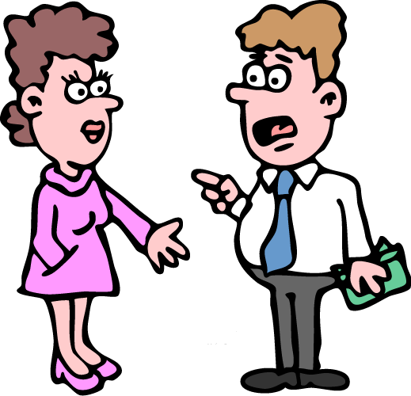
some
I’ve got ………. money.

Slide 5
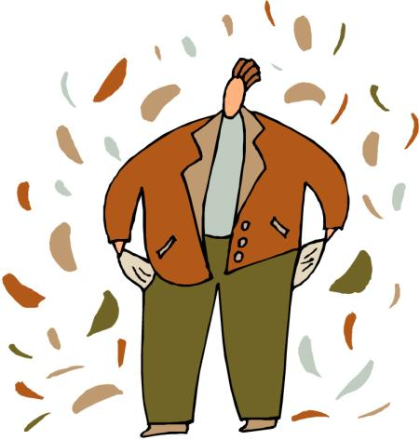
any
He hasn’t got ……. money.

Slide 6
Have Bob and Sam
got …... children?
any

Slide 7
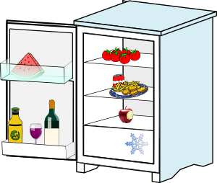
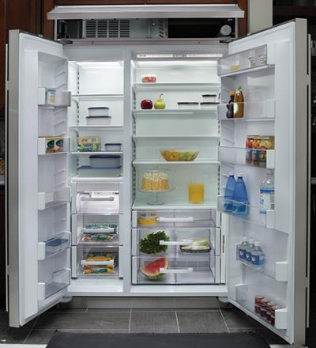
any
There isn’t ……. wine
in the fridge.

Slide 8
X
some
I’ve got ………. cheese
but I haven’t got …… bread.
any

Slide 9
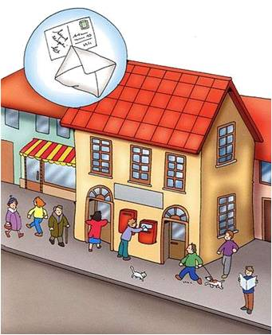
I’m going to the post office.
I need ………. stamps.
some

Slide 10
X
any
There aren’t .….. shops
in this part of town.

Slide 11
Have you got
…….. children?
any

Slide 12
some
There are ……... beautiful flowers in the garden.

Slide 13
any
Do you know ….… good
hotels in London?

Slide 14
Would you like
……….. tea?
some

Slide 15
any
Don’t buy ……… rice.
We don’t need ……..
any

Slide 16

some
I wanted to buy ………. oranges, but they didn’t have
……… in the shop.
any

Slide 17
I’m thirsty. Can I have
……… water, please?
some

Slide 18

some
Let’s listen to ………. music and have ………. tea.
some

Slide 19
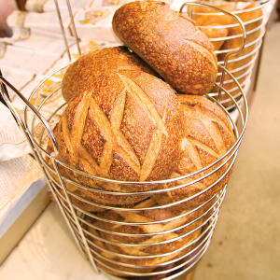
some
We need ……… bread
for dinner.

Slide 20

The children went out without …….. money.
any

Slide 21
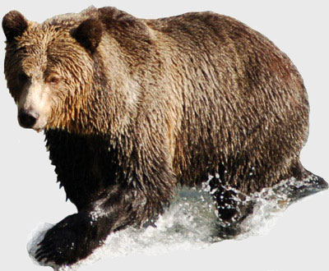
Have you seen
……….. bears?
any

Slide 22

some
Let’s buy ………..
postcards!

Slide 23
http://efl-fle-chezvous.monsite-orange.fr/

