Slide 1
SPaG’s a Joke
Key Stage 2

Slide 2
1
Underline the adverbial in the sentence below.
Every week I clean the mirrors—it’s a job I can see myself doing.
Every week

Slide 3

2
Tick one box in each row to show whether each sentence is a question, statement or command.
Sentence | Question | Statement | Command
What did the envelope say to the stamp
Stick with me and we’ll go places
Why are fish so clever
It is because they go around in schools

Slide 4
3
Add three commas to the second sentence to show that five signs were taken.
I was shocked when the highway police said that my sister was a thief. But when I opened her bedroom door, all the signs were there: STOP Crossroads Roundabout No Waiting and Slippery Road.
,
,
,

Slide 5
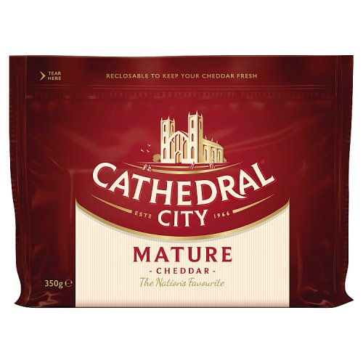
4
Underline five prepositions in the sentences below.
Sarah walked across the playground, threw a lump of cheddar towards Mary and then ducked behind the rubbish bin. Mary, gazing at the cheese, exclaimed, “That’s not very mature.”
across
of
towards
behind
at

Slide 6
5
What is the word class of the words underlined in the sentence below?
My guest slept like a log and woke up in the fireplace.
Tick one
pronouns
determiners
adjectives
nouns

Slide 7
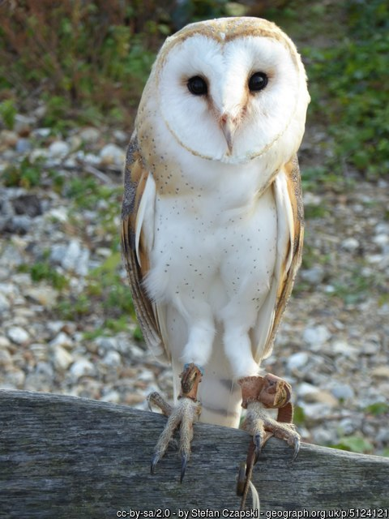
6
Circle the object in the first sentence below.
My pet owl Toby lost his voice last night. He didn’t give a hoot.

Slide 8
7
Which sentence uses capital letters correctly?
The M1 northbound between Sheffield and Barnsley has been blocked by an overturned tesco lorry.
The M1 northbound between sheffield and barnsley has been blocked by an overturned Tesco lorry.
The M1 northbound between Sheffield and Barnsley has been blocked by an overturned Tesco lorry.
The m1 northbound between Sheffield and Barnsley has been blocked by an overturned Tesco lorry.
The lorry was carrying 3 tonnes of onions. Police are advising stranded motorists to find a hard shoulder to cry on.

Slide 9
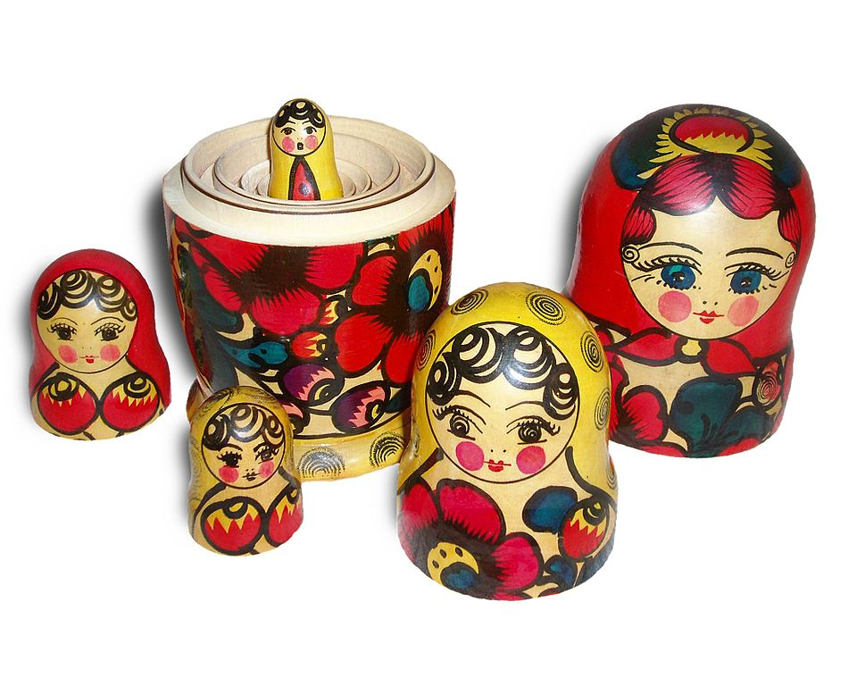
8
Insert a subordinating conjunction to complete the sentence below.
I hate Russian dolls ____________ they’re so full of themselves.
because
By Original photo: User:FanghongDerivative work: User:Gnomz007 [GFDL (http://www.gnu.org/copyleft/fdl.html) or CC-BY-SA-3.0 (http://creativecommons.org/licenses/by-sa/3.0/)], via Wikimedia Commons

Slide 10

9
Tick one box in each row to show whether the sentence is in the present progressive or past progressive.
Sentence | Present progressive | Past progressive
A cement mixer and a police van were driving towards Manchester.
Before the crash, the driver of the cement mixer was checking his mobile phone.
Police are currently searching the area for twelve hardened criminals.

Slide 11
10
I just love our new whiteboards—I find them re-markable.
Tick the meaning of the word re-markable.
Tick one
amazing
can be marked again
magic
should be remarked about

Slide 12

11
Complete the sentence below with an adjective formed from the noun delight.
I don’t quite know why living in Switzerland is so _______________ but the flag really is a big plus.
delightful

Slide 13
12
Replace the underlined words with the correct pronoun. Write one pronoun in each box.
Nadia stayed up all night wondering where the Sun was. Then the Sun dawned on Nadia.
She
it
her

Slide 14
13
Bearing in mind the meaning of the second sentence, add two commas to the first sentence below.
Following the latest bank robbery Chief Inspector Jones said that he was looking for a tall woman dressed in green with one eye. He later stated that if he hadn’t found her by Wednesday, he would open his other eye and use that too.
,
,

Slide 15
14
Underline the subordinate clause in each sentence below.
As frog’s car had been toad away, he had to use the bus to get home.
Beekeepers often have sticky hair because they use honeycombs.
Ever since our dog Bouncer ate the Scrabble tiles, he has been leaving little messages all round the house.
As frog’s car had been toad away,
because they use
honeycombs.
Ever since our dog Bouncer ate the Scrabble tiles,

Slide 16
15
Draw a line to match each prefix to a word to make four different words. Use each prefix only once. Insert the four completed words in the sentences below to complete the joke.
im
fortunately
mis
patiently
un
relevant
ir
fortune
Last Saturday I had the ____________ of watching my football team lose 5-0. The result was __________ as they had already been relegated. _____________as I waited ______________ to leave the ground, the temperature rose. It must have been because so many fans had stayed away.
misfortune
irrelevant
Unfortunately
impatiently

Slide 17
16
Complete the sentence below using the conjunctions from the box. Use each conjunction only once.
You can make notes using scrap paper ___________ a pen _________ biro, ________ not a broken pencil — it’s pointless.
and
or
but
and but or

Slide 18
17
Which sentence is an exclamation?
Did you hear that Felix the cat won a prize at the dog show
It’s a cat-has-trophy
Susan thinks it is a cat-has-trophy
The judges said that no rules had been broken
Tick one

Slide 19
18
Which sentence is grammatically correct?
Two weeks ago, I will order a Chinese takeaway.
Last night I ordered numbers 9, 13, 27 and 53.
Tomorrow, my wife had said the food tasted a bit odd.
Last Thursday I will take it back.
Tick one

Slide 20
19
Tick two boxes to show where the missing inverted commas should go.
Did you know that the toilet paper rolled downhill to get to the bottom? asked Sam.

Slide 21
20
Circle two words that are antonyms in the first sentence below.
A wife phones her husband and advises him to drive sensibly as the local radio had reported that a driver was stupidly driving the wrong way down the motorway. The husband replied, “It’s much worse than that; there are hundreds of drivers going the wrong way.”

Slide 22
21
Which sentence is the most formal?
Did you know the shark ate the clownfish?
Apparently it tasted a little funny.
Kindly inform me which vegetable the librarian likes most.
She simply adores quiet peas.
Tick one

Slide 23
22
Tick one box in each row to show whether the sentence is written in the active or the passive.
Sentence | Active | Passive
The grape was trodden on by Joe.
It let out a little wine.
The clock was eaten by Amira yesterday.
She found it very time-consuming.

Slide 24
23
Circle the possessive pronoun in the sentence below.
Although my shoes have Velcro, Sara refuses to have Velcro on hers as she thinks it is a total rip-off.

Slide 25
244
Insert a colon in the correct place in the sentence below.
I was left with two impressions after my visit to the Space Restaurant fabulous food but no atmosphere.
:

Slide 26
25
Which sentence uses the word round as a noun?
When it was time to cut Alice’s cake, Mrs Smith asked her husband to round up the girls.
First Mr Smith finished his round of crazy golf.
Then he set off round the side of the house to find the girls in the back garden.
Finally, passing the round flower bed, he entered the kitchen through the back door.
“I’ve rounded them all up—there’s 30”
“Are you sure? I only invited 26 of Alice’s friends.”
“You did ask me to round them up.”
Tick one

Slide 27
26
Circle the conjunction in each sentence.
After I explained to the doctor that no one listens to me, he called out, “Next please!”
I was fired from the keyboard factory today as I wasn’t putting in enough shifts.
Because I hadn’t changed out of my army clothes, I still had a grenade in my pocket.
Things went horribly wrong when the checkout assistant asked for my PIN.

Slide 28
27
What is the subject of the first sentence below?
After break, Joseph sat on the floor to complete his long multiplication calculations. He explained that Mrs Jones had told him to do them without tables.
break
floor
Joseph
calculations
Tick one

Slide 29
28
Which verb form completes the sentence?
After the patient _______ that he thought he was a pair of curtains, the doctor told him to pull himself together.
was explaining
has explained
had explained
is explaining
Tick one

Slide 30
294
Tick one box in each row to show whether the apostrophe is used for a contracted form or possession.
Sentence | Apostrophe for contracted form | Apostrophe for possession
Sue’s luggage had been lost by the airline.
She wasn’t going to take that lying down so she decided to sue.
Unfortunately Sue’s now lost a different sort of case.

Slide 31
30
Which of the first four sentences uses brackets correctly?
John the butcher wears size 10 (EU 44.5) shoes.
Yesterday he went (to the market and) bought a new shirt with collar size 16.
Last week he replaced his hat (with a purple striped bobble) hat size XL 60cm.
He is hoping that his wife (will remember his chest size is M) when she buys him a new jumper at Christmas.
From the information above, you should be able to work out what he weighs. Answer in Question 40.
Tick one

Slide 32
31
Add two hyphens to the first sentence below.
Last night, the captain of container ship Seabulk, whose cargo consisted of sixty five tonnes of red paint, made a half hearted, unsuccessful attempt to avoid a collision with the ship Seabreeze carrying violet paint.
Both crews are believed to be marooned.
-
-

Slide 33
32
Circle the relative pronoun in the sentence below.
Mr Tomkins, whose dog liked to bite its tail, always carried two water bottles when he played golf—in case he got a hole in one.

Slide 34
33
Which sentence shows that the walls are most likely to meet?
One wall said to the other, “I may meet you in the corner.”
One wall said to the other, “I will meet you in the corner.”
One wall said to the other, “I could meet you in the corner.”
One wall said to the other, “I might meet you in the corner.”
Tick one

Slide 35
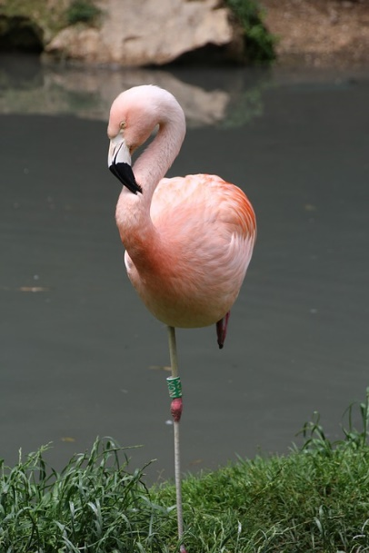
34
Rewrite the first sentence below as direct speech.
Remember to punctuate your sentence correctly.
My daughter told me to stop acting like a flamingo.
___________________________________________
So I had to put my foot down.
My daughter said, “Stop acting like a flamingo.”

Slide 36
35
Which sentence is written in the subjunctive mood?
Life is short so it is essential that she smile before she lose her teeth.
Smile before you lose your teeth—life is short.
Because life is short, it is important that she smiles before she loses her teeth.
Once you’ve lost your teeth, your smile is never the same.
Tick one

Slide 37
36
Which sentence uses the underlined word as a verb?
Just beside the exit to the bank, I was approached by an old lady.
She wanted me to help her check her balance.
So without hesitation, I pushed her over.
I will never date another apostrophe—the last one was too possessive.
Tick one

Slide 38
37
Insert a semi-colon in the correct place in the sentence below.
I am good at sleeping I can do it with my eyes closed.
;

Slide 39
38
Circle the correct verb form in each underlined pair to complete the sentences below.
Roger and Mariam was / were working in a shoe-recycling factory.
They found that the work was / were sole destroying.
The number 6 was / were very afraid as 7 ate 9.

Slide 40
39
Circle the two words that are synonyms in the sentences below.
I was amazed that Sophie had painted her eyebrows so quickly. When I pointed out that they looked a little high to me, she looked surprised.

Slide 41

40
Tick one box in each row to show whether the underlined noun is singular or plural.
 | Singular | Plural
John’s scales are used to weigh meat.
One customer’s comment read, ‘My wife’s gone vegetarian—big missed steak.’
The sign on the children’s section reads, ‘Nice to meat you!’

Slide 42
41
Insert two commas in the sentence below to stop Granny being eaten.
When we have finished baking let’s eat Granny.
,
,

Slide 43
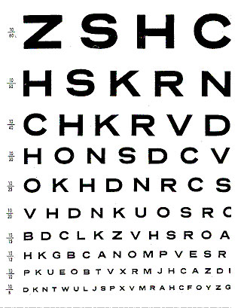
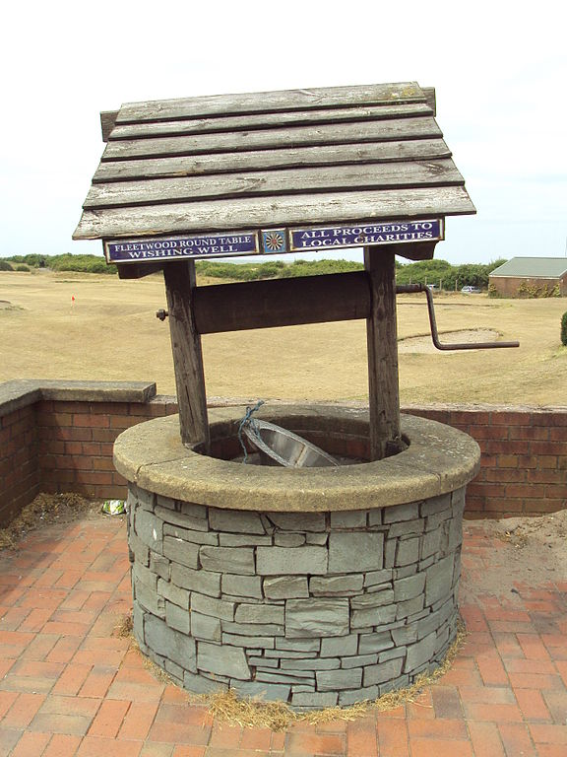
42
In the second sentence, what word class could well be?
Hamza fell down the well. She could not see that well.
noun only
adverb only
noun or adverb
adjective only
Tick one
By Rept0n1x [GFDL (http://www.gnu.org/copyleft/fdl.html) or CC BY-SA 3.0 (https://creativecommons.org/licenses/by-sa/3.0)], from Wikimedia Commons

Slide 44
43
Rewrite the statement below to make it into a question. You may need to add extra words. Remember to punctuate your sentence correctly.
If you look really closely, all mirrors look like eyeballs.
Any of:
If you look really closely, what do all mirrors look like?
What do all mirrors look like if you look really closely?
If you look really closely, do all mirrors look like eyeballs?

Slide 45
44
Which option completes the sentence in the past perfect?
As soon as Black Jack the pirate _______ the age of 80, he exclaimed, “Aye matey!”
had reached
has reached
was reaching
reached
Tick one

Slide 46
45
Complete the sentence below with a verb formed from the adjective thick.
As I had suspected all along, someone has been adding manure to my allotment.
The plot _________.
thickens

Slide 47
46
Rewrite the two sentences below as one sentence using an appropriate co-ordinating conjunction. Remember to punctuate your answer correctly.
Parallel lines have so much in common. It’s a shame they’ll never meet.
Parallel lines have so much in common so it’s a shame they’ll never meet.
Parallel lines have so much in common yet it’s a shame they’ll never meet.
Parallel lines have so much in common but it’s a shame they’ll never meet.

Slide 48
47
Which one prefix can be added to all three words below to make their antonyms? Write the prefix in the box.
partial
possible
plausible
My mum says nothing is ___________ but I do nothing every day
im
Complete the sentence below using one of the antonyms you formed.
impossible

Slide 49
48
Circle two proper nouns in the sentences below.
Mrs Smith strode into the top class at St Mary’s Primary School and announced that 8/10 pupils had failed the latest maths test. I was proud that I would be in the other 2%.

Slide 50
49
From the sentences below, complete the table with one example of each of the three different noun types.
I went shopping yesterday with my family and bought a blindfold. Now I am having some regrets as I can’t see myself wearing it.
Noun type | Example
concrete
abstract
collective
blindfold
regrets
family

Slide 51

50
Circle four different determiners in the sentences below.
Every meal my mum would feed me some alphabet soup, claiming that I was very fond of it. The truth is that she was just putting words in my mouth.
End of Test

