Slide 1
The Spag Dress Disaster

Slide 2
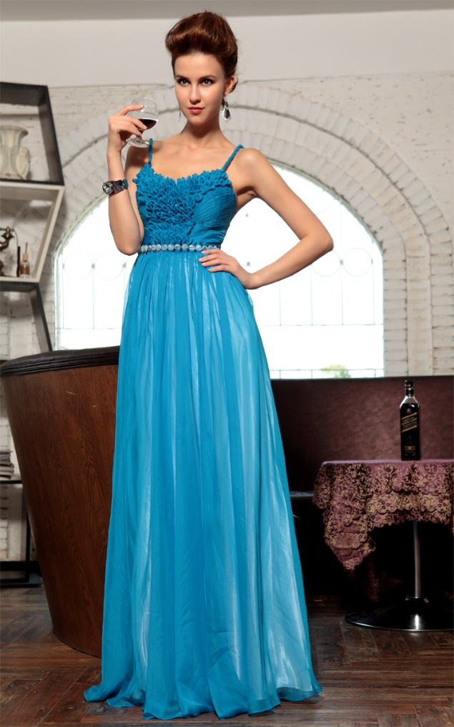
The Spag Dress Disaster
Lady Henrietta was heavily in debt. Her large staff, exotic holidays and the upkeep on Pemby Hall, the mansion which had been the family home for several generations, were all costing her serious money. In order to put the situation right, she had approached the Chinese Peng Corporation who were looking to invest several million pounds in suitable opportunities in the UK. Lady Henrietta’s proposal, if successful, would create a golf course out of some spare farm land, clear her debts and give her a healthy income for the rest of her life.
Notes:
https://www.flickr.com/photos/xubangwen/9638440194

Slide 3
But, what to wear for the presentation? After extensive and exhaustive—not to mention exhausting– research, she finally settled on a Spag dress, ordered online from Spag Face.
Putting the dress on just before going to meet the Chinese investors, she was a little surprised to find that the shoulder straps felt rather cold and clammy.

Slide 4
The Chinese investors had been treated to tour of the estate followed by a sumptuous meal in the large dining room at Pemby Hall. Everything was going swimmingly, and when Lady Henrietta rose from her seat at the head of the table to give her well-rehearsed pitch to the investors, she was confident of success. Barely three words into her speech, however, she felt both straps on her dress snap. The potential investors, horrified at her wardrobe malfunction, immediately upped and left. Her chances of rescue lay in tatters; her estate would never be Peng.

Slide 5
On close examination of the dress, it turned out that the original straps had been replaced with dyed cooked spaghetti. Lady Henrietta was mortified and immediately began an investigation to find the culprit.
32 suspects were identified along with 5 clues. Each clue removes half the suspects. Can you use your SPaG skills to discover the culprit to ensure they get both a dressing down and the sack?

Slide 6
Clue 1 Nouns
Take the 4th letter of any abstract nouns. For concrete nouns: take the 1st letter of common nouns; the 2nd letter of proper nouns and the 3rd letter of collective nouns.
Stacey pulled back her hood. Hope was fading fast. Gnats swarmed around Helen, some settling on her nose. Adrian, sensing the uncertainty, crossed the river warily, surrounded by a cloud of flies. Stacey thought she heard a hyena laughing. An eagle glided overhead, its eyes spotting vultures feeding below. A pride of lions hunting plovers disturbed an elephant, which in turn frightened a herd of swine who stampeded towards Rodney.

Slide 7
He panicked, his nails scratched his wrist as he lowered his camouflage hood before running madly, his precious opal safely tucked into his sock. Panting heavily, he noticed a swarm of bees milling around an owl which was holed up in a large tree. The team gathered together, relieved to have escaped the recent danger and looking forward to reaching safety. Adrian and Stacey held hands, their eyes showing the pride they both felt. Their courage, which had brought them to Kenya and to the slow-flowing Tsavo, was still burning bright.

Slide 8
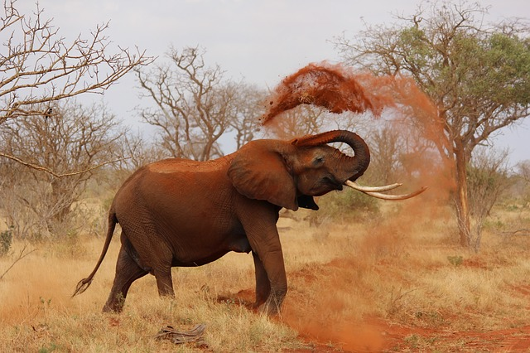
Later, they visited the supermarket which they entered via a flight of stairs. They bought food and some Destroyer – to combat the army of ants that could be found on the same ledge as their Nescafe.
Notes:
http://maxpixel.freegreatpicture.com/photo-111695

Slide 9
Clue 2 Nouns
Identify the noun phrases in the following text. The number(s) at the end of each sentence indicate(s) which word in a noun phrase(s) forms part of the clue. Hyphenated words count as two words, not one.
Eg The two older children showed no love for the leftover school spag bol. (4,2,4)
The two older children showed no love for the leftover school spag bol. = Children love spag.
The girl in the fourth row of the plane removed the original wrapper from her new dress. (1,2,3) The straps were decorated with sequins that were blue or green. (2,3) The pilot with recently cut hair began to prepare for imminent take-off. (5,3) Leaving the airport shrouded with mist, a sharp turn would need to be executed. (4,2)

Slide 10
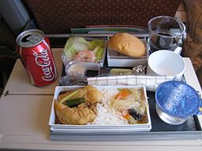
Sharp scissors were used by the stewardesses in their new red and blue uniforms to open the carefully prepared boxes of sandwiches. (2,7,2) One of the newly replaced light bulbs flickered in the toilet by the exit and then finally stopped working. (5,3)
“Someone with a phone needs to complain to the company with the maintenance contract,” complained the black-suited passenger. (1,3,2) His brown curly hair tinged with grey remained unbrushed. (4)
Notes:
https://commons.wikimedia.org/wiki/File%3ASingapore_Airlines_inflight_meal_lunch.jpg

Slide 11
Clue 3 Adverbials
Identify all the adverbials in the following text. To find the clue, take the 1st word for adverbials that answer the question “how?”; the 2nd for those that answer the question “when?”; the 4th for those that answer the question “where?”; and the 5th for those which answer the question “why?”. The total number of clue words is given in brackets at the end of each sentence. Hyphenated words count as two words, not one.
“During Spag lessons, time flies because a good mystery is so much fun,” commented Harry sitting next to his great-aunt. (3)
“During Spag lessons, time flies because a good mystery is so much fun,” commented Harry sitting beside his great-aunt. = Spag is great

Slide 12
James stopped in front of the department store because he spotted the person he was trying to ambush. (2) He ducked behind the Doctor Who display very quickly and boldly opened the cupboard door marked ‘Private’. (3) Once adjusted to the dim light, he spotted a catapult high up on the third shelf next to a box of mouldy grapes. (2) His first shot hit an old lady beside the summer dress rack. (1) He retreated so quickly! (1) He reloaded his catapult with raspberries from just beside that box of grapes. (1)

Slide 13
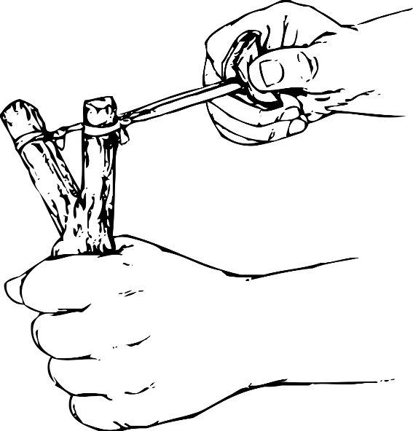
As it began to strike 10 o’clock he let fly at his arch enemy because he realised he would be caught. (2) Two security guards appeared from behind the Fall Fashions display. (1) Standing two metres apart, the guards stared. (1) James ran because he knew it was time to escape. (1)
Not looking at the shoppers around him, he raced past the new-born nappy packs and into the street. (2) In many ways, he was lucky. (1) Staying well within the warmth of the store, the guards had given up the chase. (1) Just beyond the United ground, he stopped running. (1) He saw his father’s car parked further up Kingdom Street. (1)

Slide 14
Clue 4 Forming adjectives
Form a suitable adjective from each of the nouns in brackets by adding the correct suffix (note that in some cases there may be more than one possible answer). The number tells you which column the clue word is found in. eg “Form an ____1___ (order) queue,” said the ____2___(mystery) man with a strong __3____(region) accent. = We love SPaG
Following the ___1___ (accident) spillage of shampoo on the formerly ___2___(spot) pure, white carpet, it was now a __3___ (day) ritual for__4__ (lady) Mrs Pemberton to wash it.

Slide 15
However things were about to get worse – much worse. Two-year-old Jennifer, who later in life would develop a ______5_____(photograph) memory, had been watching her mother’s ___6___(custom) practice of emptying her potty. At 10 o’clock Jennifer was sat on her potty. After a ___7___ (success) time responding to her __8___ (base) bodily urges, she had filled it. She had previously seen her mother tip the potty over (above the toilet) to empty it; so it seemed ___9__(logic) that tipping it up would be a __10__ (use) thing to do.

Slide 16
Her mother was tending to the __1__(moment) distraction of her mobile phone as Jennifer toddled to the landing railing and tipped the __2__(smell) contents out. As the __3__ (poison) fumes drifted towards Mrs Pemberton’s nose, Jennifer looked for approval. She felt __4__(nerve) when she saw her mother’s reaction and started to look a little __5__(sheep).

Slide 17
You __6__(fool) girl!” Mrs Pemberton bellowed as she ran in a__7__(war) manner towards the __8__(dirt) antique hall table which had received most of the potty’s contents. This was undoubtedly a__9__(cost) incident. Furthermore, the new Ocean Breeze air freshener seemed ___10___(use) in the face of such overpowering odours. She did at last begin to see the __1___(fun) side of the episode as the ___2___(rhythm) sound of the traffic thundered outside.

Slide 18
 | 1 | 2 | 3 | 4 | 5 | 6 | 7 | 8 | 9 | 10
al | Lady | second | SPaG | for | pilot | one | Chinese | tutor | has | the
ary | job | Wales | can | by | will | an | security | invest | week | two
ful | Can | Pemby | Hall | one | guilty | not | employee | catch | pilot | a
ic | First | alphabet | once | you | fire | years | person | who | must | go
ical | same | gardener | Peng | age | the | bed | dress | melon | strap | as
ish | valet | sabotage | dress | by | letter | in | old | strap | who | can
less | about | Henrietta | first | now | male | more | chauffeur | fall | then | of
like | The | invest | catch | to | stap | guilty | the | PA | six | see
ly | We | waiter | needs | six | the | four | suspect | four | half | less
ous | ago | love | with | a | lose | clean | Spag Face | third | apart | one
y | the | starting | three | she | online | again | female | second | three | able

Slide 19
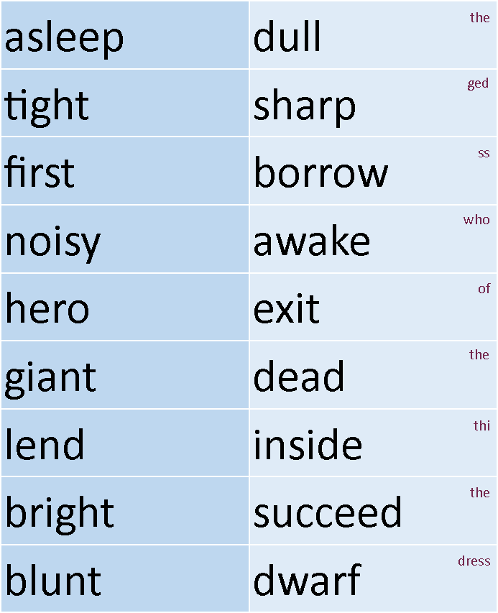
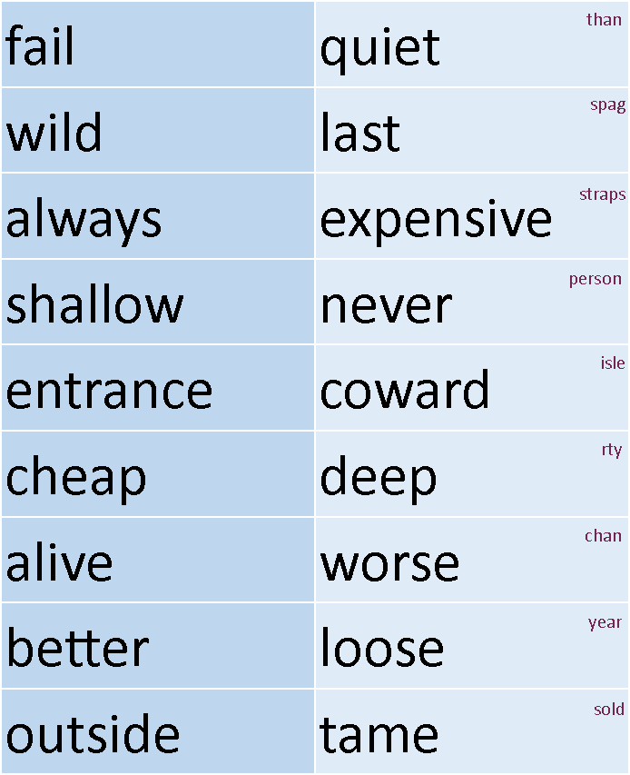
Clue 5 – Antonyms - A
Cut out the left hand column of words. Arrange the words in alphabetical order. Cut out the words in the right hand column. Match up the antonyms. The clue reads down on the right hand words.

Slide 20
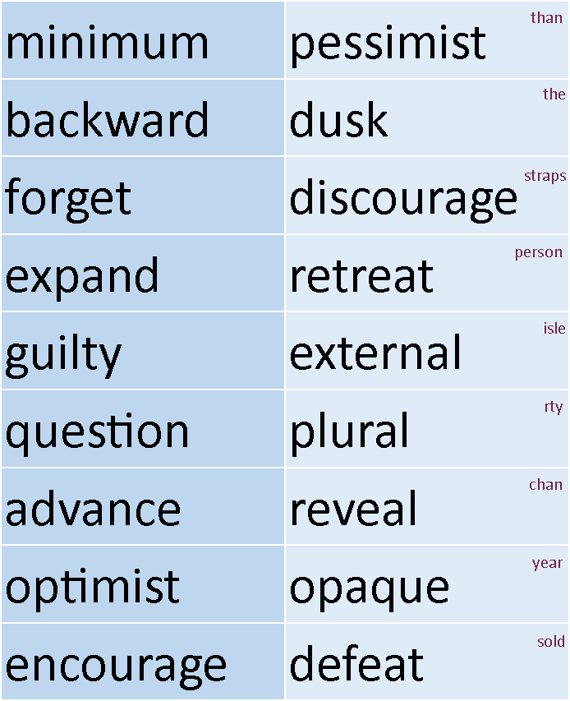
Clue 5 – Antonyms AA
Cut out the left hand column of words. Arrange the words in alphabetical order. Cut out the words in the right hand column. Match up the antonyms. The clue reads down on the right hand words.

Slide 21

Answers next!

Slide 22
Clue 1
Stacey pulled back her hood. Hope was fading fast. Gnats swarmed around Helen, some settling on her nose. Adrian, sensing the uncertainty, crossed the river warily, surrounded by a cloud of flies. Stacey thought she heard a hyena laughing. An eagle glided overhead, its eyes spotting vultures feeding below. A pride of lions hunting plovers disturbed an elephant, which in turn frightened a herd of swine who stampeded towards Rodney. He panicked, his nails scratched his wrist as he lowered his camouflage hood before running madly, his precious opal safely tucked into his sock.

Slide 23
Panting heavily, he noticed a swarm of bees milling around an owl which was holed up in a large tree. The team gathered together, relieved to have escaped the recent danger and looking forward to reaching safety. Adrian and Stacey held hands, their eyes showing the pride they both felt. Their courage, which had brought them to Kenya and to the slow-flowing Tsavo, was still burning bright.
Later, they visited the supermarket which they entered via a flight of stairs. They bought food and some Destroyer – to combat the army of ants that could be found on the same ledge as their Nescafe. The gender of the evil person who sabotaged the dress is female.

Slide 24
Clue 2
The girl in the fourth row of the plane removed the original wrapper from her new dress. (1,2,3) The straps were decorated with sequins that were blue or green. (2,3) The pilot with recently cut hair began to prepare for imminent take-off. (5,3) Leaving the airport shrouded with mist, a sharp turn would need to be executed. (4,2)
Sharp scissors were used by the stewardesses in their new red and blue uniforms to open the carefully prepared boxes of sandwiches. (2,7,2) One of the newly replaced light bulbs flickered in the toilet by the exit and then finally stopped working. (5,3)

Slide 25
“Someone with a phone needs to complain to the company with the maintenance contract,” complained the black-suited passenger. (1,3,2) His brown curly hair tinged with grey remained unbrushed. (4)
The original dress straps were cut off with sharp scissors and carefully replaced by someone with black hair.

Slide 26
Clue 3
James stopped in front of the department store because he spotted the person he was trying to ambush. He ducked behind the Doctor Who display very quickly and boldly he opened the cupboard door marked ‘Private’. Once adjusted to the dim light, he spotted a catapult high up on the third shelf next to a box of mouldy grapes. His first shot hit an old lady beside the summer dress rack. He retreated so quickly! He reloaded his catapult with raspberries from just beside that box of grapes. (10)

Slide 27
As it began to strike 10 o’clock he let fly at his arch enemy because he realised he would be caught. Two security guards appeared from behind the Fall Fashions display. Standing two metres apart, the guards stared. James ran because he knew it was time to escape. (5)

Slide 28
Not looking at the shoppers around him, he raced past the new-born nappy packs and into the street. In many ways, he was lucky. Staying well within the warmth of the store, the guards had given up the chase. Just beyond the United ground, he stopped running. He saw his father’s car parked further up Kingdom Street. (6)
The person who very boldly adjusted the dress so that it would fall apart was not born in the United Kingdom.

Slide 29
Clue 4
Following the __1__ (accidental) spillage of shampoo on the formerly __2__(spotless) pure, white carpet, it was now a __3__ (daily) ritual for__4__ (ladylike) Mrs Pemberton to wash it. However things were about to get worse – much worse. Two-year-old Jennifer, who later in life would develop a __5__(photographic) memory, had been watching her mother’s __6___(customary) practice of emptying her potty. At 10 o’clock Jennifer was sat on her potty.

Slide 30
After a __7__ (successful) time responding to her __8__ (basic) bodily urges, she had filled it. She had previously seen her mother tip the potty over (above the toilet) to empty it; so it seemed __9__(logical) that tipping it up would be a __10__ (useful) thing to do.
Her mother was tending to the __1__(momentary) distraction of her mobile phone as Jennifer toddled to the landing railing and tipped the __2__(smelly) contents out.

Slide 31
As the __3__ (poisonous) fumes drifted towards Mrs Pemberton’s nose, Jennifer looked for approval. She felt __4__(nervous) when she saw her mother’s reaction and started to look a little __5__(sheepish).
“You __6__(fool) girl!” Mrs Pemberton bellowed as she ran in a__7__(warlike) manner towards the __8__(dirty) antique hall table which had received most of the potty’s contents. This was undoubtedly a__9__(costly) incident.

Slide 32
Furthermore, the new Ocean Breeze air freshener seemed __10__(useless) in the face of such overpowering odours. She did at last begin to see the __1___(funny) side of the episode as the __2__(rhythmic) sound of the traffic thundered outside.
Lady Henrietta needs to fire an employee who has a job starting with a letter in the second half of the alphabet

Slide 33
 | 1 | 2 | 3 | 4 | 5 | 6 | 7 | 8 | 9 | 10
al | Lady | second | SPaG | for | pilot | one | Chinese | tutor | has | the
ary | job | Wales | can | by | will | an | security | invest | week | two
ful | Can | Pemby | Hall | one | guilty | not | employee | catch | pilot | a
ic | First | alphabet | once | you | fire | years | person | who | must | go
ical | same | gardener | Peng | age | the | bed | dress | melon | strap | as
ish | valet | sabotage | dress | by | letter | in | old | strap | who | can
less | about | Henrietta | first | now | male | more | chauffeur | fall | then | of
like | The | invest | catch | to | stap | guilty | the | PA | six | see
ly | We | waiter | needs | six | the | four | suspect | four | half | less
ous | ago | love | with | a | lose | clean | Spag Face | third | apart | one
y | the | starting | three | she | online | again | female | second | three | able

Slide 34
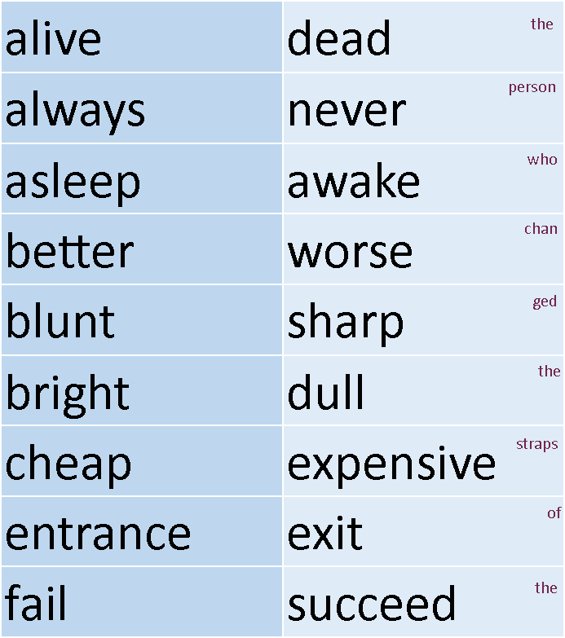
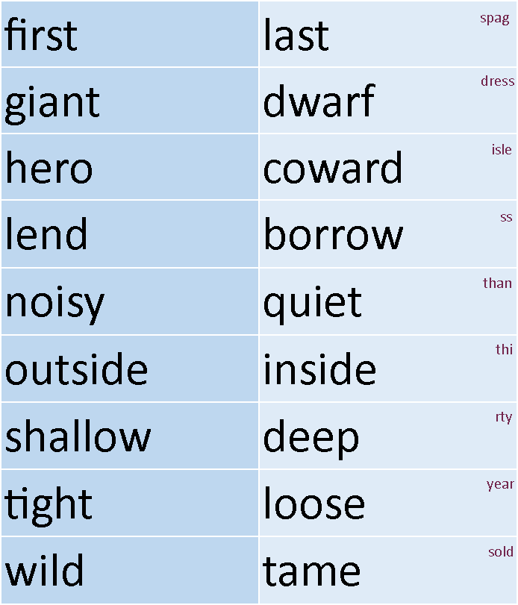
Clue 5 A
The person who changed the straps of the spag dress is less than thirty years old.

Slide 35
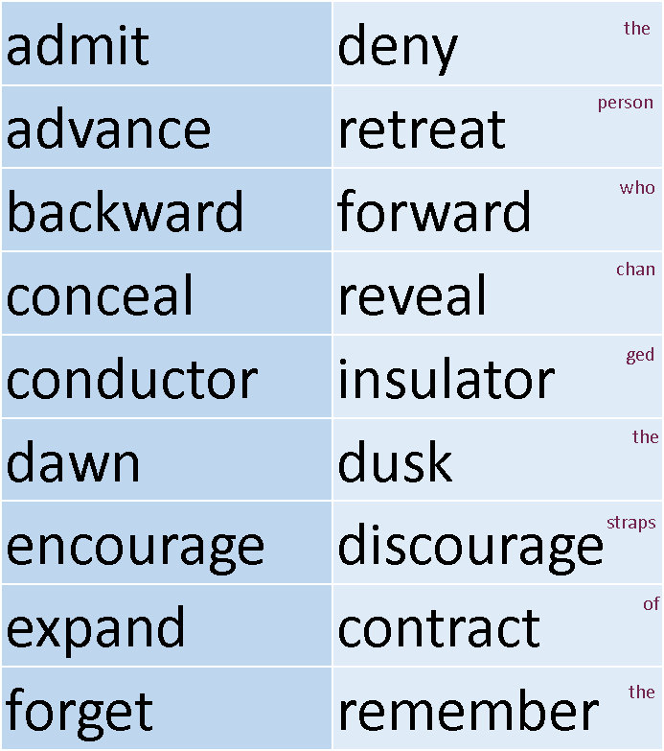
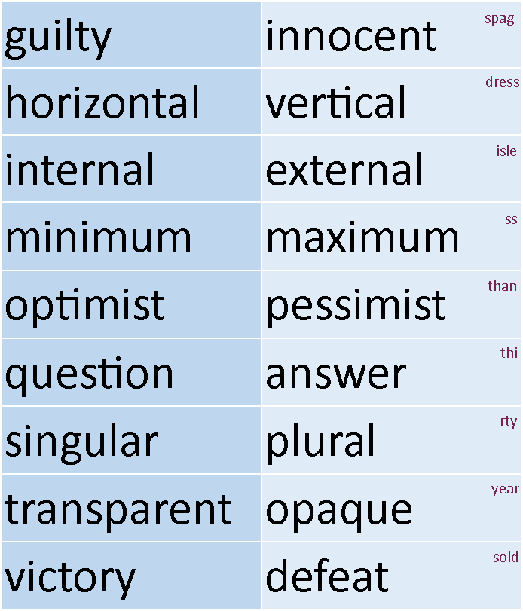
Clue 5 AA
The person who changed the straps of the spag dress is less than thirty years old.

Slide 36
Answers
The gender of the evil person who sabotaged the dress is female.
The original dress straps were cut off with sharp scissors and carefully replaced by someone with black hair.
The person who very boldly adjusted the dress so that it would fall apart was not born in the United Kingdom.
Lady Henrietta needs to fire an employee who has a job starting with a letter in the second half of the alphabet.
The person who changed the straps of the spag dress is less than thirty years old.
This identifies Sue Higgins as the culprit.

Slide 37
This is the fourth SPaG mystery I have written. Others in the series are:
Death at the Spag Bol
The Great British Spag Off
The Spag Bol Heist
These can also be downloaded free from the Primary Resources website.

