Slide 1
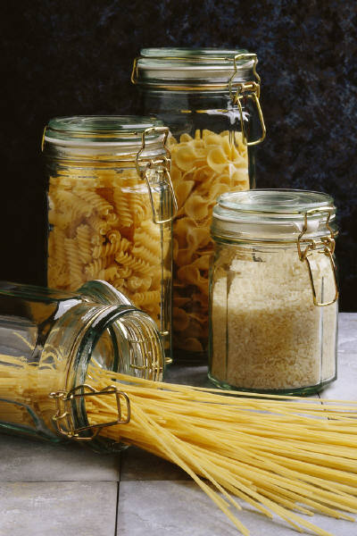
Murder Mystery
Death at the spag bol

Slide 2
The Spag Bol restaurant had for several years been recognised as the top Italian restaurant in London.

Slide 3
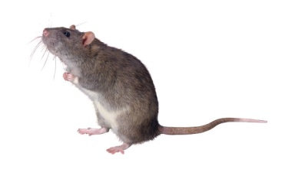
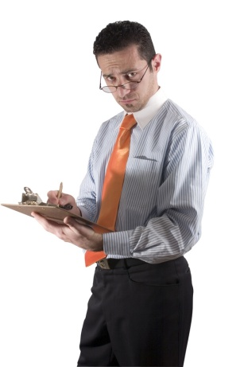
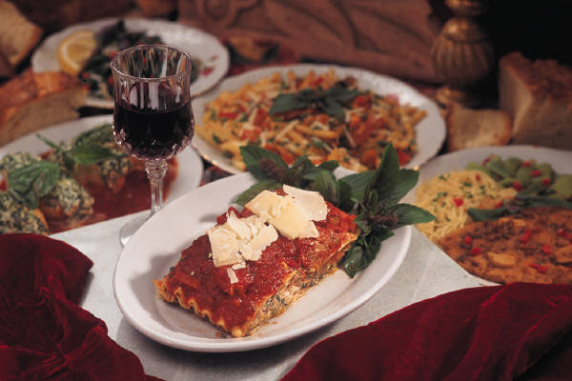
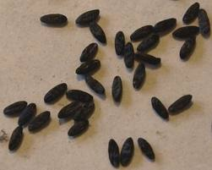

However, the local Health Inspector had paid a surprise visit and had been shocked to find, not only some moist mouse droppings in the Bolognese sauce, but the plaster from a chef’s finger embedded in a bowl of lasagne.

Slide 4
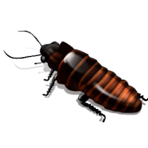
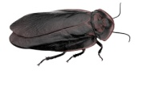
A visit to the kitchen revealed cockroaches scuttling about between the pans.

Slide 5
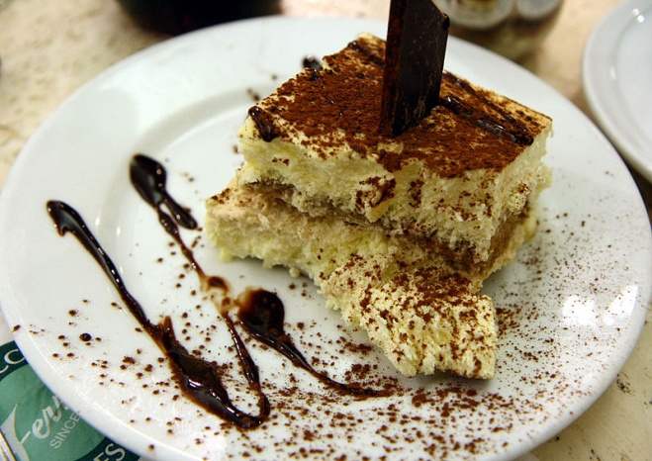
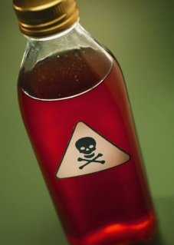
By the time the inspector ordered his dessert, it was clear that his report was going to be dreadful. His report was never published or even typed as he was found dead in his bed. The post mortem revealed that the dessert, a delicious Tiramisu gateau, had been laced with poison.

Slide 6
The 32 people who worked at the Spag Bol became immediate suspects. 5 clues in code were discovered. Each clue eliminates half the suspects.
Can you use your SPaG skills to solve the Murder at the Spag Bol?

Slide 7

Clue 1 - Apostrophes
Put in the missing apostrophes.
For apostrophes of possession, highlight the letter before the apostrophe.
For apostrophes of omission, write in the missing letters.
Example: Freds friend isnt sane. = Fred’s friend is not sane. = do

Slide 8
Freddy and June walked past a dog chasing its tail outside Jacks house. They paused outside the greengrocer, where plums, apples, oranges and pears were on sale. The tangerines (10 for £1) particularly caught their eye.
“Its cold,” commented Freddy as they entered Laurels Launderette. A dim light bulb shone its weak glow round the room. He emptied the first bag. Jills trousers, Reeces pants and Olivers shirt fell out on the floor. From his second bag, Bernards jacket, Ottos socks, Olives skirt and Charless vests tumbled out.

Slide 9
“I cant believe the smell of Berts smalls. Weve got a job on our hands here.”
“Good job we brought some of Vivs special washing powder and Eves softener; Im so pleased we remembered them.”
“Do you remember Deniss jumpers? They were really gross”
“Youre right there. They were nearly as bad as Sams pyjamas.
June gazed across the street. Situated between the shop selling boys toys and a lamp post, which looked like an emus head, were the mens toilets.
“What a pigs ear they have made of the High Street,” she thought.

Slide 10
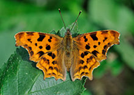
Clue 2 - Commas
Put in the missing commas.
Highlight every letter after a comma.
Read the message.

Slide 11
Ruth made a mental note of what she needed: trout kippers ice lentils leeks eggs and tofu. Her son John red from lying in the sun started to discuss his up-coming birthday.
“What I really want is a new pet” proclaimed the 10 year old.
“Pets aren’t just for birthdays – they’re for life” explained his mother.
“You never buy me what I really want. Callum’s Mum is letting him choose from a list: crocodile tarantula iguana snake Alsatian or scorpion” moaned John.
His mother alarmed at the thought of a dangerous pet moved swiftly to dampen his enthusiasm.
“Callum’s mother may be buying him one of those animals; nevertheless my home is going to stay safe and clean!”
“That’s not fair” argued John leaping up from the sofa.

Slide 12
Clue 3 – Past tense
Change the verbs in italics into the past tense. The number in brackets after each word tells you which letter to take from the past tense verb.
Example: The top spins (3) = The top span = a

Slide 13
I buy (6) some new plastic shoes and catch (5) the bus home. I wear (4) them to school. Because of the danger of scorpions, I shake (5) my shoes. My brother does (2) it differently - he kneels (4) down and then tells (3) me they are (2) clear. I prefer (7) my way. He does (3) this before the sun rises (2) above the trees and breaks (5) through the clouds.
He sits (1) down to breakfast before he goes (3) out. Outside the house, he finds (2) his bicycle and meets (3) his friends. He is (1) on time as usual. At break he drinks (3) his coconut milk and bites (2) into his fresh mango snack.

Slide 14
In class an enormous rat shoots (4) out from under the table. Mr Maserotoo finds (2) some droppings under the bench and sends (3) for a brush. Later the rat creeps (5) up to the river bank and swims (3) across to the other side.

Slide 15
Clue 4 - Homophones
Correct the spellings of the homophones in italics. The number after each word shows which letter is part of the message. So ‘This pear (3) of socks is blue’ = pair = i

Slide 16
The bowls, with remnants of the desert (7) from last knight’s (4) meal, had been left their (5) by the guests. Freda poured some serial (1)- found in the hire (6) of the two cupboards – and looked out of the window. A tall fur (2) tree cast a shadow over the beds of mint, rosemary and time (4). The postman sauntered up to deliver the male (3) as a large lorry turned left onto the mane (4) road. Piece (3) was restored as the lorry departed and the pail (3) sunlight revealed a squirrel’s twitching tale (3) on the bird-table.

Slide 17
Carrying the kitchen waist (3) up the garden, she saw a cue (4) forming down the road. It was plane (5) to see that the driver of a Fiat had not red (4) the One Way sign. She watched the seen (5) with interest as a large motorbike arrived with a raw, (4) the driver impatient with the weight. (4) He fort (5) his way through, the mussels (6) on his arms bulging, as reign (2) began to fall. Ate (3) minutes later the police arrived and find (4) the Fiat driver.

Slide 18
“I know I’m not aloud (4) that way but you shouldn’t prophet (4) from my mistake,” complained the driver.
Hearing a message on the radio, the policewoman replied, “We have to chute (5) off now, I hope this has taut (5) you a lesson.”
Freda went indoors and climbed the stares. (4) The storey (4) was fresh in her mind as she began to right (4) her diary. The raise (3) of the evening sun lit the room.

Slide 19
Clue 5 – identifying noun, verbs, adjectives and adverbs.
Highlight the first letter of every noun in the first paragraph, every adjective in the second paragraph etc.
Read the message.

Slide 20
The tiger crept slowly towards the sleeping hyena. A nearby elephant was being washed by a keeper. An iguana, an interesting lizard, lay camouflaged amongst the leaves. Eric and Rachel, full of hope, began their ascent to the summit. (nouns)
It was a beautiful day and the evergreen rainforest teemed with life. The energetic walkers soon passed the nearby monument . There was a tense moment as an orange snake leapt towards Rachel but she dodged it easily. (adjectives)

Slide 21
A wild boar ferreted among the dead leaves and opened a seed capsule.
“I understand,” remarked Eric, “Those seedpods smell so strongly, animals turn up from miles around.”
“I agree with you,” grunted Rachel. (verbs)
The two climbers became painfully aware of large number of mosquitoes who were avidly homing in on them. They reluctantly decided to stop for the night. Tiredly, they erected their tent and dragged their bodies inside. Lying under their mosquito nets, they listened interestingly to the loud calls of the nearby bull frogs as they enticingly tried to attract mates.
Suddenly they were disturbed by a loud crash behind them….(adverbs)

Slide 22
Answers – clue 1
Freddy and June walked past a dog chasing its tail outside Jack’s house. They paused outside the greengrocer, where plums, apples, oranges and pears were on sale. The tangerines (10 for £1) particularly caught their eye.
“It is cold,” commented Freddy as they entered Laurel’s Launderette. A dim light bulb shone its weak glow round the room. He emptied the first bag. Jill’s trousers, Reece’s pants and Oliver’s shirt fell out on the floor. From his second bag, Bernard’s jacket, Otto’s socks, Olive’s skirt and Charles’s vests tumbled out.
“I cannot believe the smell of Bert’s smalls. We have got a job on our hands here.”
“Good job we brought some of Viv’s special washing powder and Eve’s softener; I am so pleased we remembered them.”
“Do you remember Denis’s jumpers? They were really gross”
“You are right there. They were nearly as bad as Sam’s pyjamas.
June gazed across the street. Situated between the shop selling boys’ toys and a lamp post, which looked like an emu’s head, were the men’s toilets.
“What a pig’s ear they have made of the High Street,” she thought.
Killer does not have a Samsung

Slide 23
Clue 2 answers
Clue 2 – Commas
Ruth made a mental note of what she needed: trout, kippers, ice, lentils, leeks, eggs and tofu. Her son John, red from lying in the sun, started to discuss his up-coming birthday.
“What I really want is a new pet,” proclaimed the 10 year old.
“Pets aren’t just for birthdays – they’re for life,” explained his mother.
“You never buy me what I really want. Callum’s Mum is letting him choose from a list: crocodile, tarantula, iguana, snake, Alsatian or scorpion,” moaned John.
His mother, alarmed at the thought of a dangerous pet, moved swiftly to dampen his enthusiasm.
“Callum’s mother may be buying him one of those animals; nevertheless, my home is going to stay safe and clean!”
“That’s not fair,” argued John, leaping up from the sofa.
Killer’s pet is a mammal

Slide 24
Clue 3 answers
Clue 3 - Past tense
I bought some new plastic shoes and caught the bus home. I wore them to school. Because of the danger of scorpions, I shook my shoes. My brother did it differently - he knelt down and then told me they were clear. I preferred my way. He did this before the sun rose above the trees and broke through the clouds. He sat down to breakfast before he went out. Outside the house, he found his bicycle and met his friends. He was on time as usual. At break he drank his coconut milk and bit into his fresh mango snack.
In class an enormous rat shot out from under the table. Mr Maserotoo found some droppings under the bench and sent for a brush. Later the rat crept up to the river bank and swam across to the other side.
A warm wind blew as we children slept. My father ate his supper before he too slid into bed.
The killer does not wait on tables

Slide 25
Clue 4 answers
The bowls, with remnants of the desert (dessert) from last knight’s (night’s) meal, had been left their (there) by the guests. Freda poured some serial (Cereal) - found in the hire (higher) of the two cupboards – and looked out of the window. A tall fur (fir) tree cast a shadow over the beds of mint, rosemary and time (thyme). The postman sauntered up to deliver the male (mail) as a large lorry turned left onto the mane (main) road. Piece (Peace) was restored as the lorry departed and the pail (pale) sunlight revealed a squirrel’s twitching tale (tail) on the bird-table.
Carrying the kitchen waist (waste) up the garden, she saw a cue (queue) forming down the road. It was plane (plain) to see that the driver of a Fiat had not red (read) the One Way sign. She watched the seen (scene) with interest as a large motorbike arrived with a raw (roar), the driver impatient with the weight (wait). He fort (fought) his way through, the mussels (muscles) on his arms bulging, as reign (rain) began to fall. Ate (Eight) minutes later the police arrived and find (fined) the Fiat driver.
“I know I’m not aloud (allowed) that way but you shouldn’t prophet (profit) from my mistake,” complained the driver.
Hearing a message on the radio, the policewoman replied, “We have to chute (shoot) off now, I hope this has taut (taught) you a lesson.”
Freda went indoors and climbed the stares (stairs). The storey (story) was fresh in her mind as she began to right (write) her diary. The raise (rays) of the evening sun lit the room.
The criminal is under the age of thirty.

Slide 26
Clue 5 answers
The tiger crept slowly towards the sleeping hyena. A nearby elephant was being washed by a keeper. An iguana, an interesting lizard, lay camouflaged amongst the leaves. Eric and Rachel, full of hope, began their ascent to the summit. (nouns)
It was a beautiful day and the evergreen rainforest teemed with life. The energetic walkers soon passed the nearby monument . There was a tense moment as an orange snake leapt towards Rachel but she dodged it easily. (adjectives)
A wild boar ferreted among the dead leaves and opened a seed capsule.
“I understand,” remarked Eric, “Those seedpods smell so strongly, animals turn up from miles around.”
“I agree with you,” grunted Rachel. (verbs)
The two climbers became painfully aware of large number of mosquitoes who were avidly homing in on them. They reluctantly decided to stop for the night. Tiredly, they erected their tent and dragged their bodies inside. Lying under their mosquito nets, they listened interestingly to the loud calls of the nearby bull frogs as they enticingly tried to attract mates.
Suddenly they were disturbed by a loud crash behind them….(adverbs)
The killer has been to four stag parties.

