Slide 1
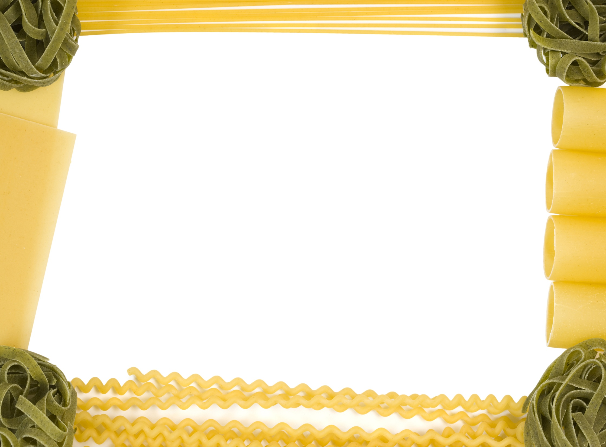
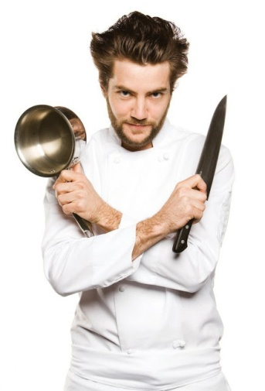
The Great British Spag Off
Who killed the chef?

Slide 2
Following the successful series The Great British Bake Off, the BBC was hoping to run a series called The Great British Spag Off. In this, chefs from around the world would cook their favourite spaghetti dishes. Judges would taste and comment on each dish and chefs would be eliminated each week until the winner was left.

Slide 3
However, after only one programme, the hot favourite Luigi Chilli Spagallini was found murdered in his hotel room. All the contestants were staying at the same hotel and the police quickly concluded that one of the other 32 chefs was the murderer.
Five clues had been cooked up by witnesses. Each clue eliminates half of the suspects. Can you use your SPaG skills to solve the mystery and make sure the killer gets their just desserts?
In clues 1, 3 & 4 the murderer is referred to as M.

Slide 4
Clue 1 – A Capital Crime
The writing below has no capital letters. Put in the capital letters and these make up the clue.
mark heard the autumn breeze rustling the trees as he walked down the street. unusually for a saturday, he was talking to eva – his swedish girlfriend.
aimlessly she remarked, “plums are cheap this week.”
“apples start getting more expensive in november,” observed mark. after that he switched off his dell tablet and thought about the homework he still had to do: geography, history, english and science.

Slide 5
occasionally they met at the weekend. usually tuesday was the day he took her out for a meal at the restaurant otto & frankie’s – situated behind the large christmas tree in ash street to the left of tesco. it had been flooded last year when the river ouse burst its banks and a village called naburn had been nearly washed away.

Slide 6
Clue 2 – Fix it
Pick the right prefix to replace the – and then work out which tense each sentence is written in. Use the table at the bottom to find one word of the clue from each sentence.
eg I will not -respect my teacher. (dis, future tense=scales)
He was -able to solve the clues.
It is -legal to skip school.
She will be more -responsible when she is a teenager.
The boiler is -firing again.
His excuse was complete and utter -sense.
He read the book and realised he was in an -possible position.

Slide 7
They are reading the -honest account of his trip.
The results will not be -accurate.
They are being extremely -patient.
It is very -helpful when you drop the plates on the floor.
If you ask her to help you with your homework, she will -inform you.
They are feeling -secure at the moment.
Bertie bought a -fiction book.
While she is taking the pills, her thinking will be a bit -logical.
What you suggest is -relevant.
What an -grateful child you are!
 | il- | ir- | in- | im- | dis- | un- | mis- | non-
Present | murderer | five | same | g | twice | kg | ninety | thirty
Present continuous | eighty | equal | more | fifty | hundred | thousand | less | forty
Past | twice | Pizza | same | one | half | the | double | than
Future | sixty | weighs | and | Italy | scales | tenth | but | triple

Slide 8
Clue 3 - Determiners
Take the first letter of each determiner in the writing below to find the clue.
My recipe involves plenty of herbs and umpteen spices. Those spices give several flavours and lots of interest. One Brussels sprout, two onions and six carrots make up our vegetables. Few spaghetti dishes include both beef and another meat like pork. Some chefs take hours to prepare food. Mint adds its delicate tang when used in little amounts. Its ability to dissolve in no time makes it popular. The chef always thought that his recipe was better than hers. Every few years one of our restaurants closes due to health and safety inspections. Caretakers ask for double money to look after empty restaurants.

Slide 9
Clue 4 - I have a preposition for you
Find all the prepositions in the writing below. The numbers in brackets show which letter of the preposition is part of the clue.
eg I will go to the shops near the market. (2,1) to, near = on
Sam ran along the quiet road and jogged through the gate towards the town centre. (1,1,1) Throughout his run, he had seen no animals except a fox. (2,1) Since 8am his path had taken him across several muddy fields and he was now five minutes behind schedule. (1,2,3) The swollen river had spilled over its banks and onto the A57 like a great flood. (1,1,1)

Slide 10
Sam ambled among the many shoppers alongside the town hall then headed to the library which was open till 6pm. (2,1,1,1) Excluding Waitrose, there wasn’t another supermarket near the town centre. (1,1) During his journey, his heart rate had not dropped below 100bpm even when he was jogging down Steven Hill. (1,2,1) Entering the library, his sharp eyes detected movement. Putting his head to the floor, he spotted a small white mouse scampering through the Thriller section, behind the Family section before disappearing under the Romance shelves. (1,2,2,5)
Behind the library counter, Mrs Fusty the librarian, without a smile, hummed the tune ‘Silence is Golden’. (2,1) Under the Romance section, she had spotted a notice regarding late books. (4,1) Below that notice, alongside the book “100 Kisses Every Day” sat four round blobs of mouse poo. (2,4,1) By the time her scream had echoed around the library and travelled beyond the building, Sam had decided it was quite the loudest screech he had heard since 1965. (1,3,3,1)

Slide 11
Clue 5 – What’s the word?
Decide what part of speech each word in italics is. Then use the first vowel in that word to find a word from the clue using the table below.
eg. icicle (noun, first vowel i = killer)
It was a cold night in December. Freda smiled warmly as she handed
six crackers in a colourful box to her lovely mother.
“I’m feeling as lively as a sloth!” her mother commented. “I’ve had a
nasty cold all week and pulling these will drive me crackers! Please go
and tidy your bedroom before supper.”

Slide 12
“I’ve done it already – I finished vacuuming before I wrapped the
presents.”
“Unless your room is spotless and your clothes are tidy, you won’t
be going out tonight. Recently you’ve been leaving rubbish all over
your bed. I will be going up those stairs to check!”
Vowel | noun | verb | adverb | adjective | pronoun | conjunction | preposition
a | Europe | cook | a | this | born | city | letter
e | comes | Bari | half | Rome | within | letter | city
i | killer | from | stop | first | begins | Italy | Genoa
o | of | with | pasta | the | second | Bologna | the
u | of | knife | Turin | chef | London | in | alphabet

Slide 13
Answers

Slide 14
Clue 1 – A Capital Crime
Mark heard the autumn breeze rustling the trees as he walked down the street. Unusually for a Saturday, he was talking to Eva – his Swedish girlfriend.
Aimlessly she remarked, “Plums are cheap this week.”
“Apples start getting more expensive in November,” observed Mark. After that he switched off his Dell tablet and thought about the homework he still had to do: geography, history, English and science.
Occasionally they met at the weekend. Usually Tuesday was the day he took her out for a meal at the restaurant Otto & Frankie’s – situated behind the large Christmas tree in Ash Street to the left of Tesco. It had been flooded last year when the River Ouse burst its banks and a village called Naburn had been nearly washed away.
M uses a pan made out of cast iron.

Slide 15
Clue 2 – Fix it
He was -able to solve the clues. the
It is -legal to skip school. murderer
She will be more -responsible when she is a teenager. weighs
The boiler is -firing again. less
His excuse was complete and utter -sense. than
He read the book and realised he was in an -possible position. one
They are reading the -honest account of his trip. hundred
The results will not be -accurate. and
They are being extremely -patient. fifty
It is very -helpful when you drop the plates on the floor. kg
If you ask her to help you with your homework, she will -inform you. but
They are feeling -secure at the moment. more
Bertie bought a -fiction book. than
While she is taking the pills, her thinking will be a bit -logical. sixty
What you suggest is -relevant. five
What an -grateful child you are! kg
The murderer weighs less than one hundred and fifty kg but more than sixty five kg.

Slide 16
Clue 3 - Determiners
My recipe involves plenty of herbs and umpteen spices. Those spices give several flavours and lots of interest. One Brussels sprout, two onions and six carrots make up our vegetables. Few spaghetti dishes include both beef and another meat like pork. Some chefs take hours to prepare food. Mint adds its delicate tang when used in little amounts. Its ability to dissolve in no time makes it popular. The chef always thought that his recipe was better than hers. Every few years one of our restaurants closes due to health and safety inspections. Caretakers ask for double money to look after empty restaurants.
M puts lots of basil in the food.

Slide 17
Clue 4 - I have a preposition for you
Sam ran along the quiet road and jogged through the gate towards the town centre. (1,1,1) Throughout his run, he had seen no animals except a fox. (2,1) Since 8am his path had taken him across several muddy fields and he was now five minutes behind schedule. (1,2,3) The swollen river had spilled over its banks and onto the A57 like a great flood. (1,1,1)
Sam ambled among the many shoppers alongside the town hall then headed to the library which was open till 6pm. (2,1,1,1) Excluding Waitrose, there wasn’t another supermarket near the town centre. (1,1) During his journey, his heart rate had not dropped below 100bpm even when he was jogging down Steven Hill. (1,2,1) Entering the library, his sharp eyes detected movement. Putting his head to the floor, he spotted a small white mouse scampering through the Thriller section, behind the Family section before disappearing under the Romance shelves. (1,2,2,5)

Slide 18
Behind the library counter, Mrs Fusty the librarian, without a smile, hummed the tune ‘Silence is Golden’. (2,1) Under the Romance section, she had spotted a notice regarding late books. (4,1) Below that notice, alongside the book “100 Kisses Every Day” sat four round blobs of mouse poo. (2,4,1) By the time her scream had echoed around the library and travelled beyond the building, Sam had decided it was quite the loudest screech he had heard since 1965. (1,3,3,1)
At the school m attended there were no boys.

Slide 19
Clue 5 – What’s the word?
It was a cold (adjective) night (noun) in December (noun). Freda smiled (verb)warmly (adverb) as (conjunction) she (pronoun) handed six
crackers (noun)in a colourful box to her lovely (adjective) mother.
“I’m feeling as lively (adjective) as (preposition) a sloth!” her mother commented. “I’ve had a nasty cold (noun) all week and pulling these will drive me crackers (adjective)! Please go and tidy your bedroom before (preposition) supper.”
“I (pronoun)’ve done (verb) it already (adverb) – I finished vacuuming before (conjunction) I wrapped the presents.”
“Unless (conjunction) your room is spotless (adjective) and your clothes are tidy (adjective), you won’t be going out tonight. Recently (adverb) you’ve been leaving rubbish (noun) all over (preposition) your bed. I will be going up (preposition) those stairs to check!”
The killer comes from a city within Europe. The first letter of this city begins with a letter in the first half of the alphabet.

Slide 20
The answers to the 5 clues are:
1. M uses a pan made out of cast iron.
2. The murderer weighs less than one hundred and fifty kg but more than sixty five kg.
3. M puts lots of basil in the food.
4. At the school m attended there were no boys.
5. The killer comes from a city within Europe. The first letter of this city begins with a letter in the first half of the alphabet.
The murderer is therefore Palmira Porcini

