Slide 1
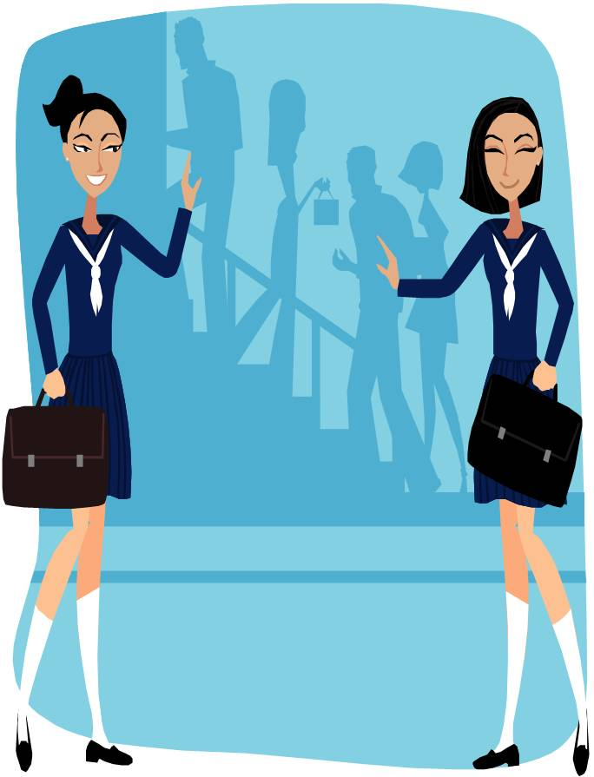
Prepositons
of time

Slide 2
The wedding was ______ 3 p.m.
at

Slide 3
Let’s meet at
the cinema ___________
8 o’clock.
at

Slide 4
Jane likes to sit in the garden ____ Spring.
in

Slide 5
Betty’s birthday is ____ Saturday.
on

Slide 6
All the family come to lunch ____ Christmas Day.
on

Slide 7
Thomas usually has lunch ____ 12:00
at

Slide 8
We often go skiing
______ February
in

Slide 9
My sister plays golf ____ Sundays.
on

Slide 10
We usually have a chocolate log ____ Christmas.
at

Slide 11
Jo was born
____ 1970.
in

Slide 12
Paul was born _____ 20th March.
on

Slide 13
They’re getting married _____ June.
in

Slide 14
Not many people had cars _____ the early nineteen hundreds.
in

Slide 15

What are you doing _____ the weekend?
at

Slide 16
Alice gets up
____ 7 o’clock.
at

Slide 17
Do you watch television ____ the evenings?
in

Slide 18
Hi, what are you doing ____ the moment?
at

Slide 19
I’ll call you back _____ half an hour.
in

Slide 20
They’re getting married _____ Saturday.
on

