Slide 1
Sorting your nouns!
Do you know which noun is which?

Slide 2
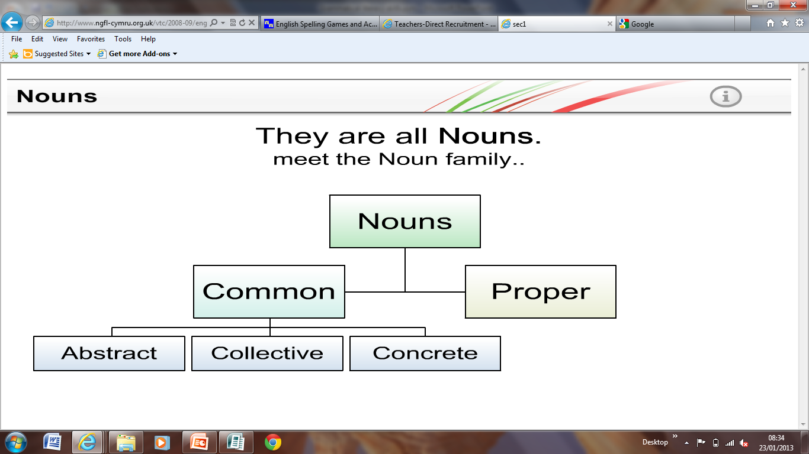
The different types of nouns:

Slide 3
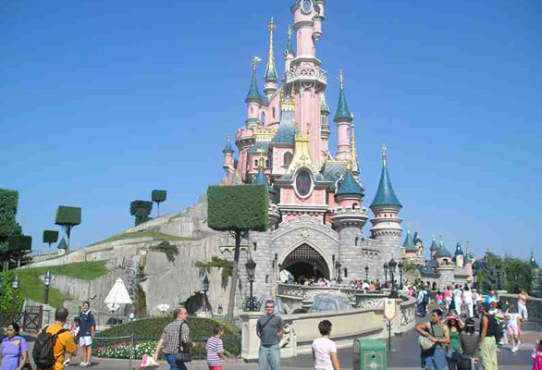
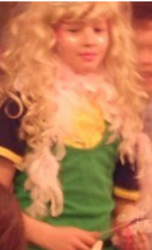
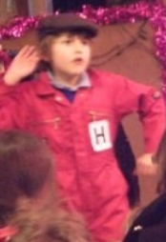

Proper nouns
These are specific names of places, animals or person. They always have a capital
letter.

Slide 4
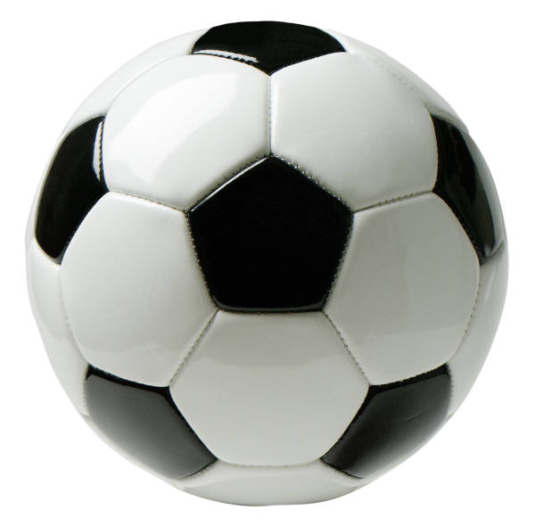
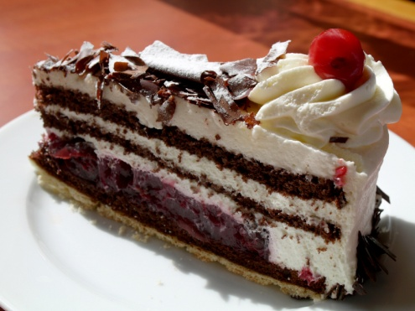
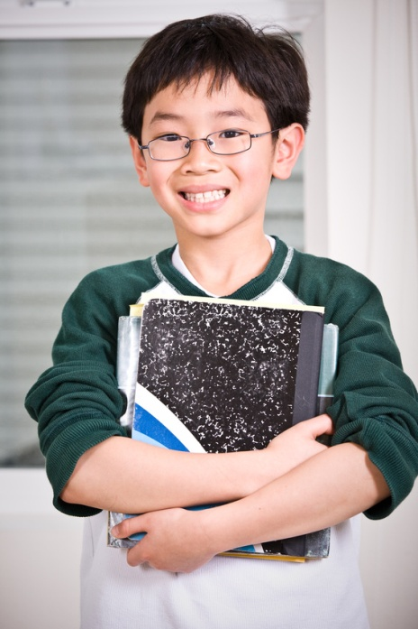
Common nouns -
concrete nouns
These are the objects and ‘things’ that we can see, hear, taste, touch or smell.

Slide 5
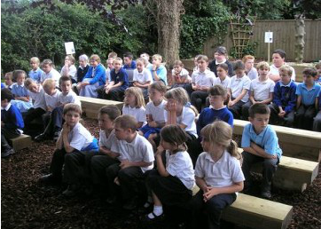
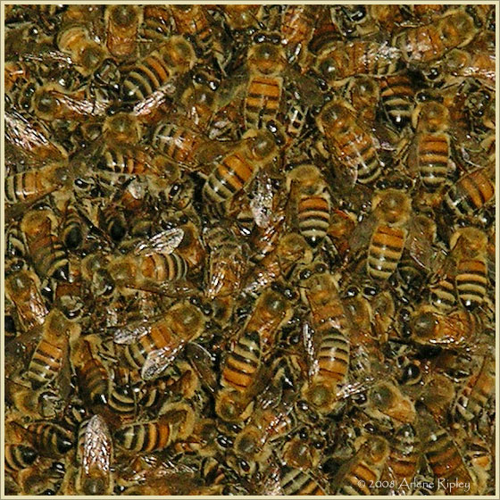
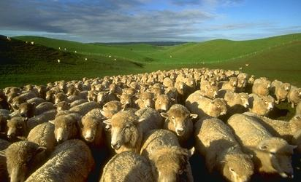
Common nouns -
collective nouns
These are groups of nouns.

Slide 6
Common nouns -
abstract nouns
Pain
These are nouns that we can’t see but have.
Pride
Dreams
Friendship
Love

Slide 7

Are you ready for a quiz?
Not yet!

Slide 8
What sort of noun is…
Proper?
Collective?
Concrete?
Abstract?

Slide 9
Not quite…
Try again!

Slide 10
Well done!
Next one…

Slide 11

What sort of noun is…
Proper?
Collective?
Concrete?
Abstract?

Slide 12
Not quite…
Try again!

Slide 13
Well done!
Next one…

Slide 14
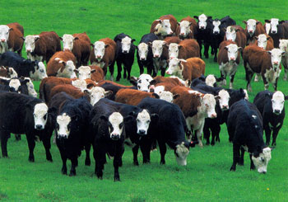
What sort of noun is…
Proper?
Collective?
Concrete?
Abstract?

Slide 15
Not quite…
Try again!

Slide 16
Well done!
Next one…

Slide 17
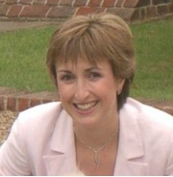
What sort of noun is…
Proper?
Collective?
Concrete?
Abstract?

Slide 18
Not quite…
Try again!

Slide 19
Well done!
Next one…

Slide 20
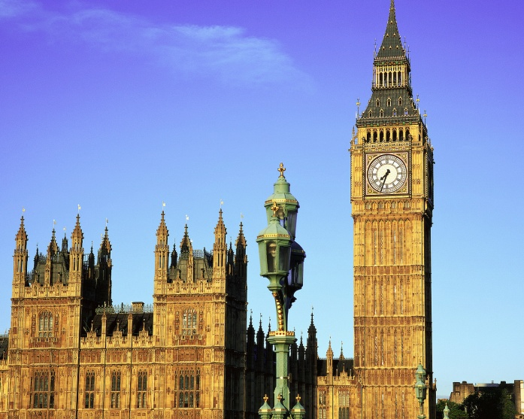
What sort of noun is…
Proper?
Collective?
Concrete?
Abstract?

Slide 21
Not quite…
Try again!

Slide 22
Well done!
Next one…

Slide 23

What sort of noun is…
Love
Proper?
Collective?
Concrete?
Abstract?

Slide 24
Not quite…
Try again!

Slide 25
Well done!
Next one…

Slide 26
Which word is the noun?
The cat was sleeping.
The
was
cat
sleeping

Slide 27
Not quite…
Try again!

Slide 28
Well done!
Next one…

Slide 29
Which word is the noun?
My dream was funny.
My
dream
was
funny

Slide 30
Not quite…
Try again!

Slide 31
Well done!
Next one…

Slide 32
Which word is the noun?
The flock had escaped from the field.
flock
Flock and field
field
escaped

Slide 33
Not quite…
Try again!

Slide 34



Well done!
How confident are you at your different nouns?

Slide 35
Don’t worry!
We’ll have another look at them.

Slide 36
OK!
We’re nearly there.
What do you think we could do next
to help?

Slide 37

Well done!
See if you can spot different nouns
when you’re reading.

Slide 38

Congratulations!
Can you make up your own interactive quiz?

Slide 39

The end!

