Slide 1
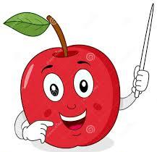
WAL: how UN changes the meaning of a word.

Slide 2

‘un’ is a prefix.
That means it is added to the beginning of a word.
‘un’ changes the meaning of the word to become the opposite.

Slide 3
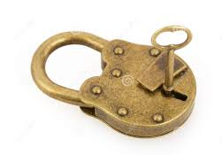
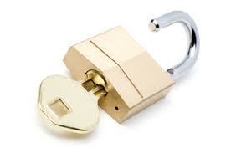


lock
unlock
happy
unhappy

Slide 4
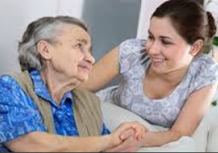
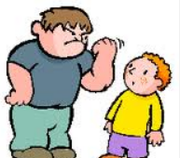
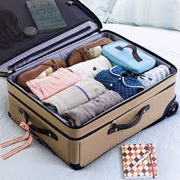
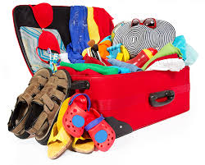
kind
unkind
unpack
pack

Slide 5

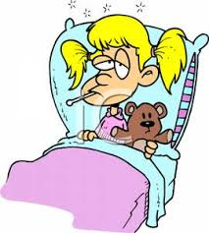
well
unwell

Slide 6
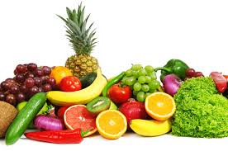
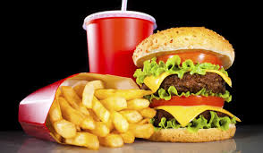
healthy
unhealthy

Slide 7
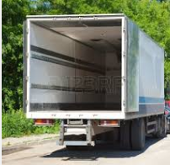
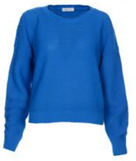

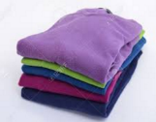
Now its your turn. You need to fill in the words and opposites on your sheet.
Lets have a go together
fold | load | unfolded | unload

Slide 8
Now its your turn!
Look carefully at the pictures.

Slide 9
Plenary
How did you find the work?
What have learnt to do today?

Slide 10
Can you add un- to all of these words?
sad
unsad
comfortable
uncomfortable
run
unrun
wrap
unwrap

