Slide 1
Winter Poems

Slide 2
PERSONIFICATION
Giving an inanimate object or abstract idea the qualities of a living being.
The wind was a prowling tiger
The telephone bleated angrily
Merrily dodging through the traffic, the VW Beetle pottered back home.

Slide 3
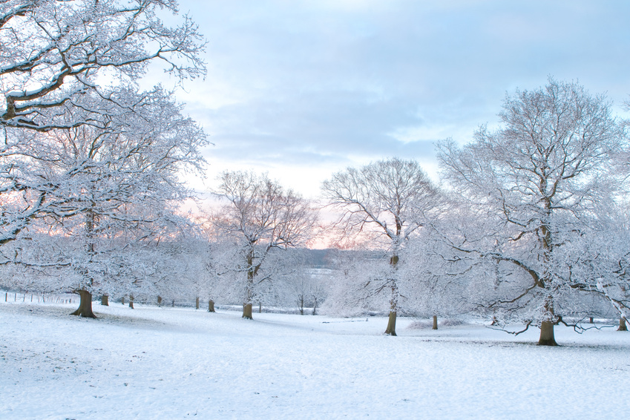
Winter-Time by Robert Louis Stevenson
Late lies the wintry sun a-bed, A frosty, fiery sleepy-head; Blinks but an hour or two; and then, A blood-red orange, sets again. Before the stars have left the skies, At morning in the dark I rise; And shivering in my nakedness, By the cold candle, bathe and dress. Close by the jolly fire I sit To warm my frozen bones a bit; Or with a reindeer-sled, explore The colder countries round the door. When to go out, my nurse doth wrap Me in my comforter and cap; The cold wind burns my face, and blows Its frosty pepper up my nose. Black are my steps on silver sod; Thick blows my frosty breath abroad; And tree and house, and hill and lake, Are frosted like a wedding cake.

Slide 4
Late lies the wintry sun a-bed, A frosty, fiery sleepy-head; Blinks but an hour or two; and then, A blood-red orange, sets again. Before the stars have left the skies, At morning in the dark I rise; And shivering in my nakedness, By the cold candle, bathe and dress.

Slide 5
Close by the jolly fire I sit To warm my frozen bones a bit; Or with a reindeer-sled, explore The colder countries round the door. When to go out, my nurse doth wrap Me in my comforter and cap; The cold wind burns my face, and blows Its frosty pepper up my nose.

Slide 6
Black are my steps on silver sod; Thick blows my frosty breath abroad; And tree and house, and hill and lake, Are frosted like a wedding cake.

Slide 7
Winter-Time by Robert Louis Stevenson
Late lies the wintry sun a-bed, A frosty, fiery sleepy-head; Blinks but an hour or two; and then, A blood-red orange, sets again. Before the stars have left the skies, At morning in the dark I rise; And shivering in my nakedness, By the cold candle, bathe and dress. Close by the jolly fire I sit To warm my frozen bones a bit; Or with a reindeer-sled, explore The colder countries round the door. When to go out, my nurse doth wrap Me in my comforter and cap; The cold wind burns my face, and blows Its frosty pepper up my nose. Black are my steps on silver sod; Thick blows my frosty breath abroad; And tree and house, and hill and lake, Are frosted like a wedding cake.

Slide 8
What is personified here?
The sun
“A frosty, fiery sleepyhead”
The fire “jolly”
The wind
“ blows
Its frosty pepper up my nose.”

Slide 9
What are they personified as?
The sun is……
A lazy person
The wind is …..
A joker, or a cook

Slide 10
Other Techniques
Rhyme
Rhythm
Alliteration
Assonance
Repetition
Simile
Metaphor

Slide 11
In Verse One, find rhyme and alliteration:
Late lies the wintry sun a-bed, A frosty, fiery sleepy-head; Blinks but an hour or two; and then, A blood-red orange, sets again.

Slide 12
In verse three find assonance:
Close by the jolly fire I sit To warm my frozen bones a bit; Or with a reindeer-sled, explore The colder countries round the door.

Slide 13
In verse five, find repetition and simile
Black are my steps on silver sod; Thick blows my frosty breath abroad; And tree and house, and hill and lake, Are frosted like a wedding cake.

Slide 14
What could YOU personify winter as?
Jack Frost
An old woman
A polar bear
A fox
A queen
?????

