Slide 1
World War 2
Evacuation

Slide 2
What have we already learnt about evacuation?
Evacuation

Slide 3
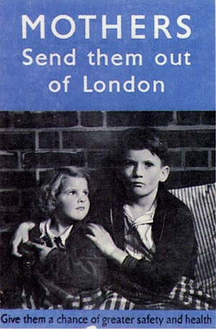
Evacuation: The Facts & Figures
Evacuation was introduced in 1939 – the government decided that the cities were simply too dangerous for children.

Slide 4
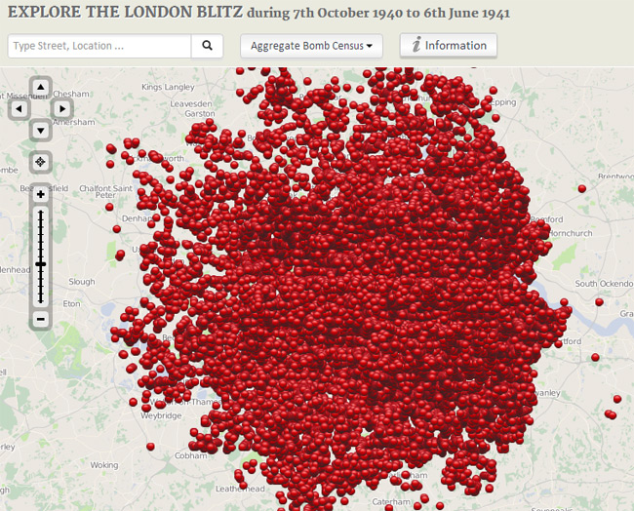

Slide 5
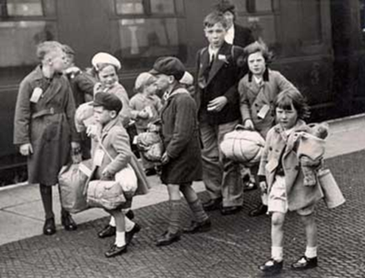
Evacuation: The Facts & Figures
One and a half million children and pregnant women were sent to live in the countryside.
A smaller number of children (perhaps 10,000) went to other countries such as Canada, Australia and the United States.

Slide 6
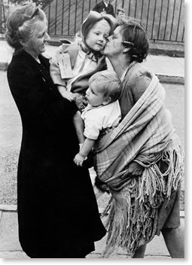
Evacuation: The Facts & Figures
Many children stayed away from their homes for the full six years that the war lasted – and only saw their parents occasionally.
They were often not sent to the same place as their brothers or sisters.

Slide 7
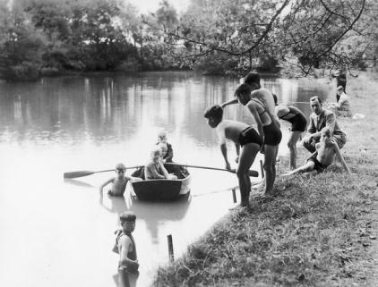
Evacuation: The Facts & Figures
Some children enjoyed the experience; they got to try a new way of life, ate better food in some cases, and were away from the danger, bombs and pollution of London

Slide 8
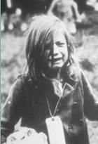
Evacuation: The Facts & Figures
For other children, it was a time of great hardship.
Not all of the families that took children in were nice.
Many children from the big cities were poor and this surprised their new families.
Some children were rude and this upset the kind people who had offered to take them in.

Slide 9
38,000
children never saw their parents again after evacuation
That’s roughly equivalent to every child in Middlesbrough under the age of 18 never seeing their parents again
Some were fostered by their countryside families
Some stayed in the countries they were sent to
Some had no-one to return home to

Slide 10
Evacuation: Keeping in touch
How did children keep in touch with their families?
Did they have telephones to use?
Email?
Could they visit?
Facebook?
No. Letters were the only way.

Slide 11
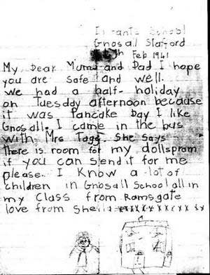
Gnosall Stafford
Feb 1941
My Dear Mum and Dad I hope you are safe and well. We had a half-holiday on Tuesday afternoon because it was Pancake Day I like Gnosall. I came in the bus with Mrs Tagg. She says there is room for my dolls pram if you can send it for me please. I know a lot of children in Gnosall School all in my class from Ramsgate
love from Sheila xxxxxxxxxxxxx

Slide 12
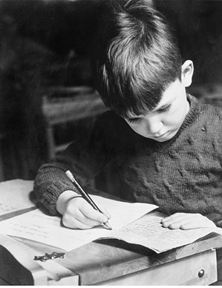
Where do you think this boy was writing home from?
Canada

Slide 13
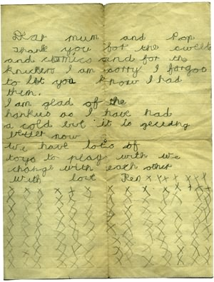
Do you think the letters home were sad, or happy?
What news did the children send?
What would they ask about?
Do you think they liked writing letters?

Slide 14
LO:
To write an evacuee letter home from the countryside

