Slide 1
Guatemala
Land of the Maya
Notes:
A Powerpoint on Guatemala used with our Year 4 unit on the Mayans to give a contrast with the present day

Slide 2
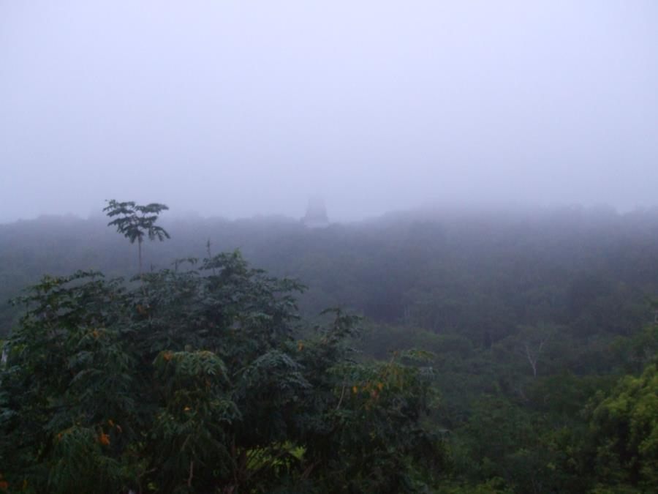
What is the landscape like?

Slide 3
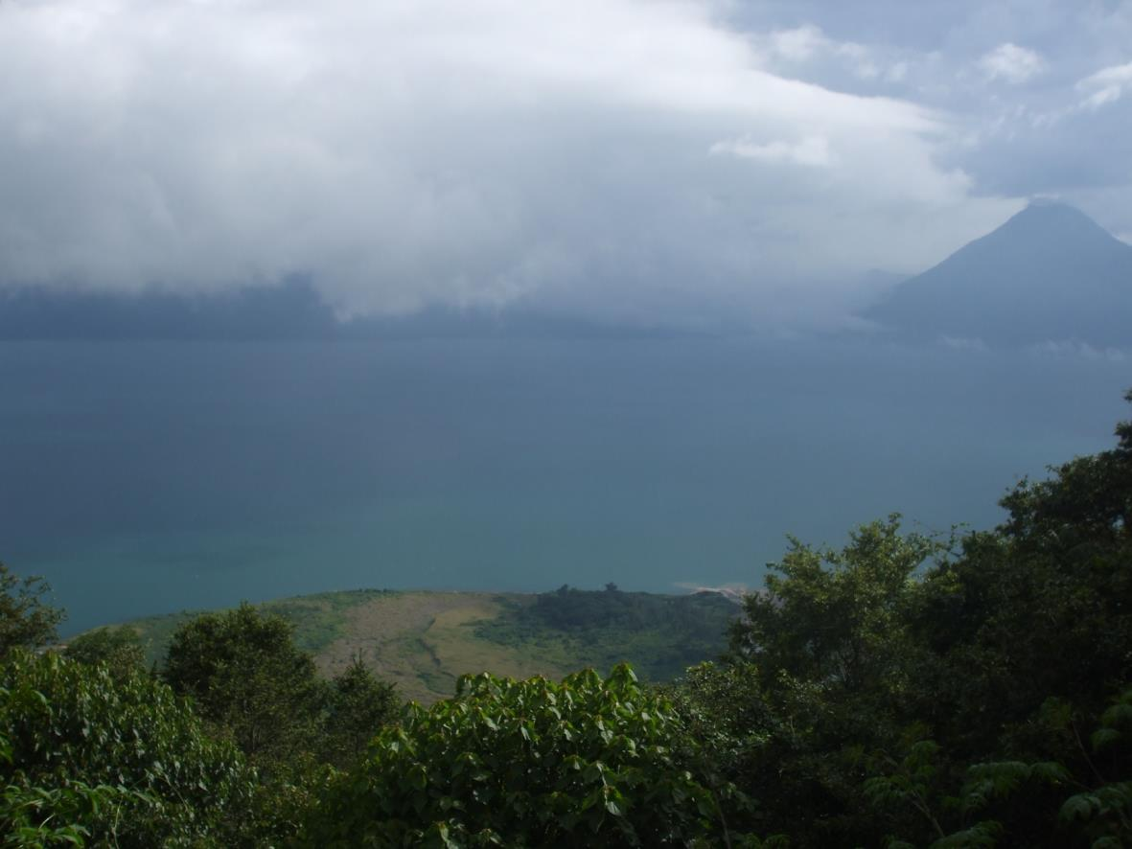

Slide 4
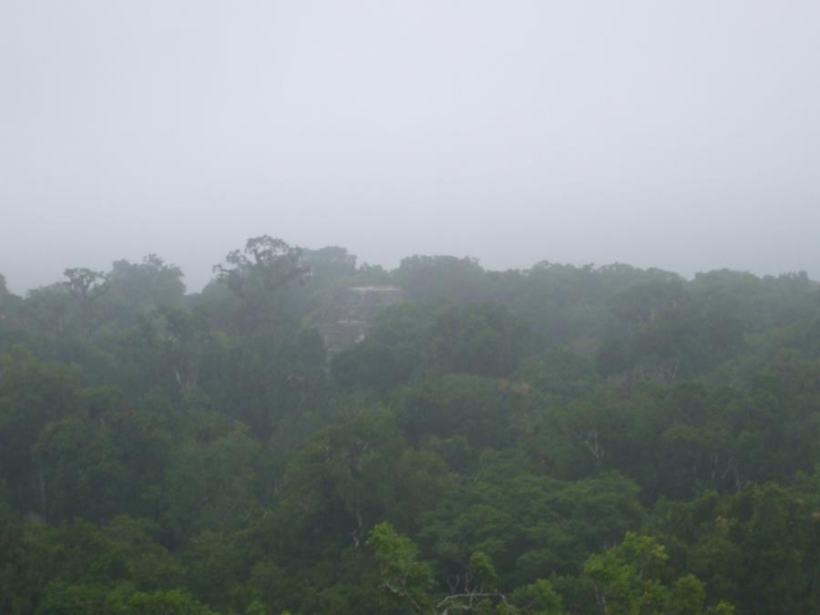

Slide 5
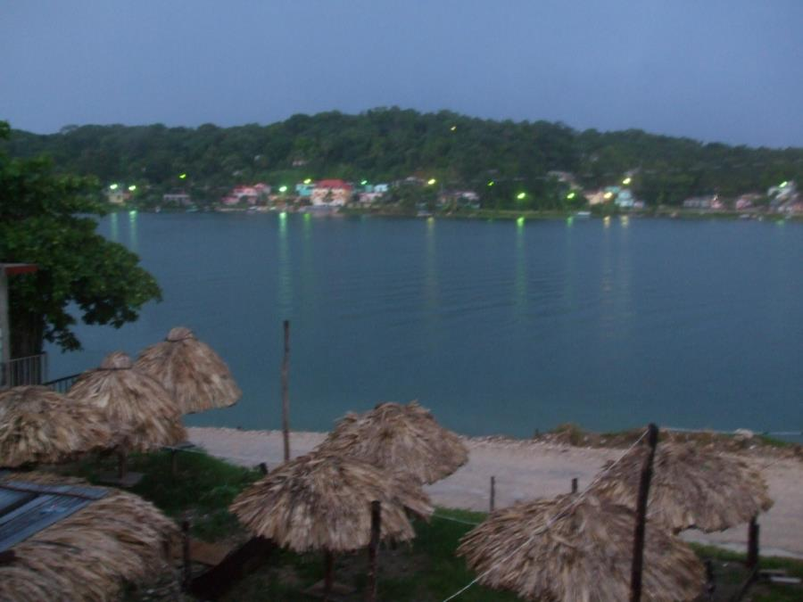

Slide 6
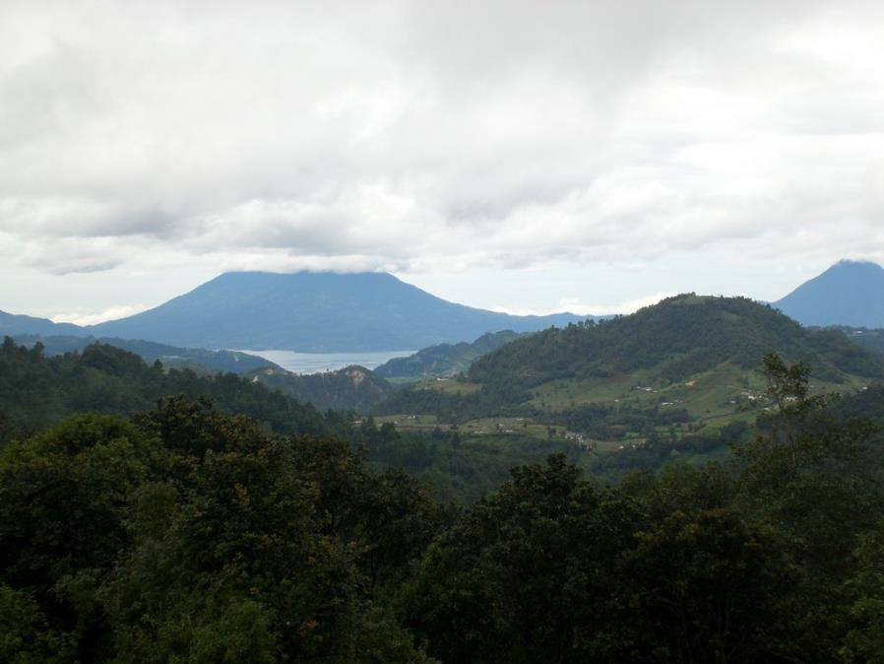

Slide 7


Slide 8
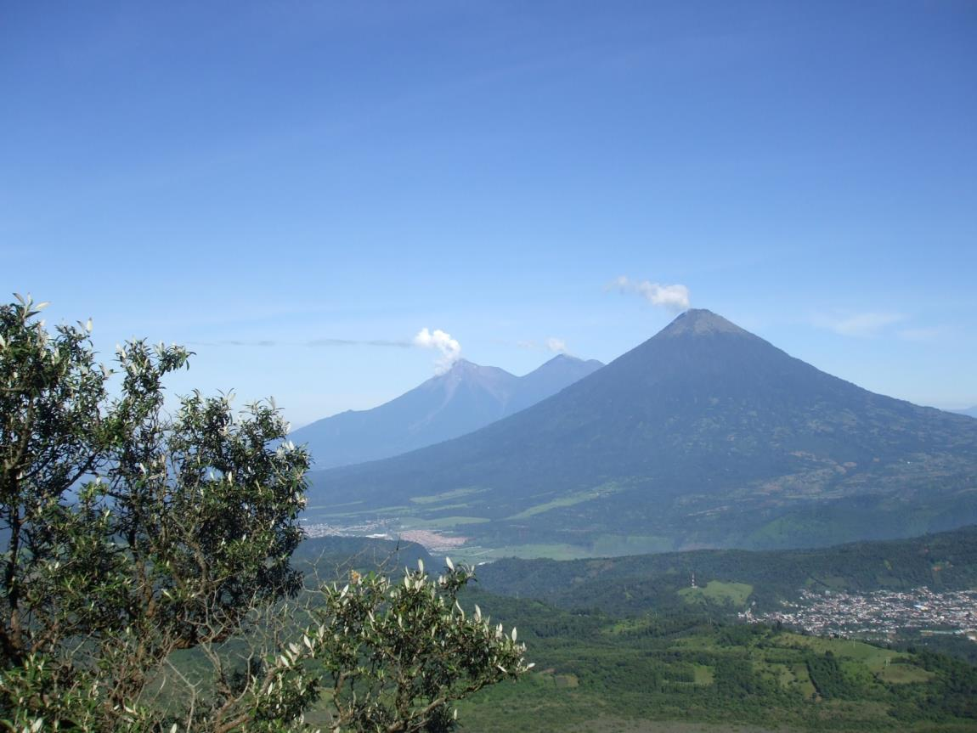

Slide 9
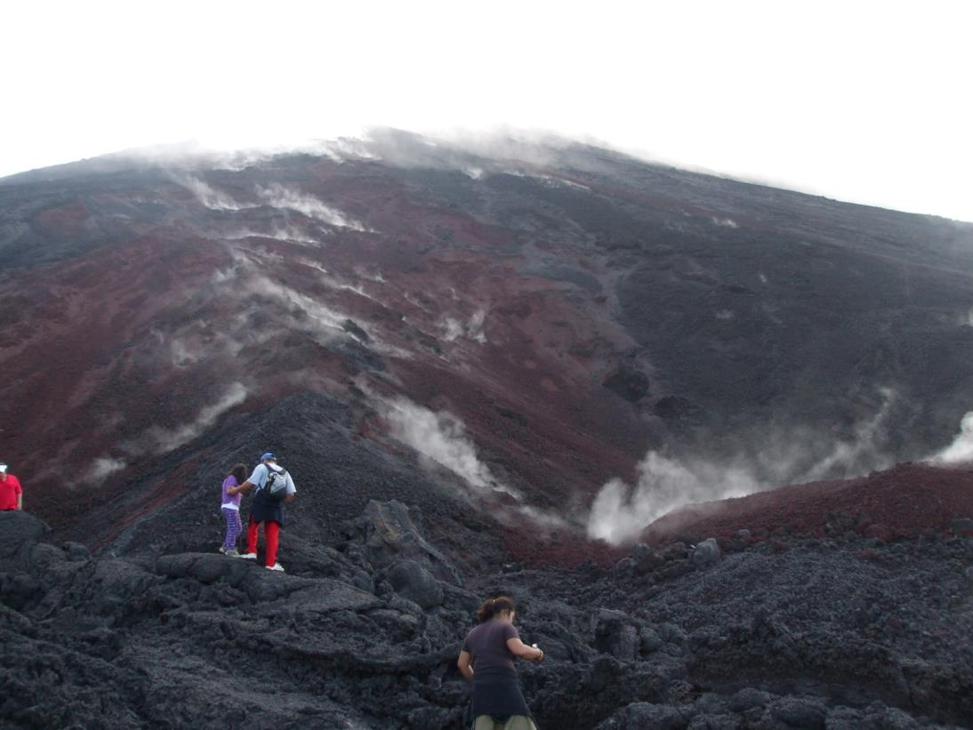

Slide 10
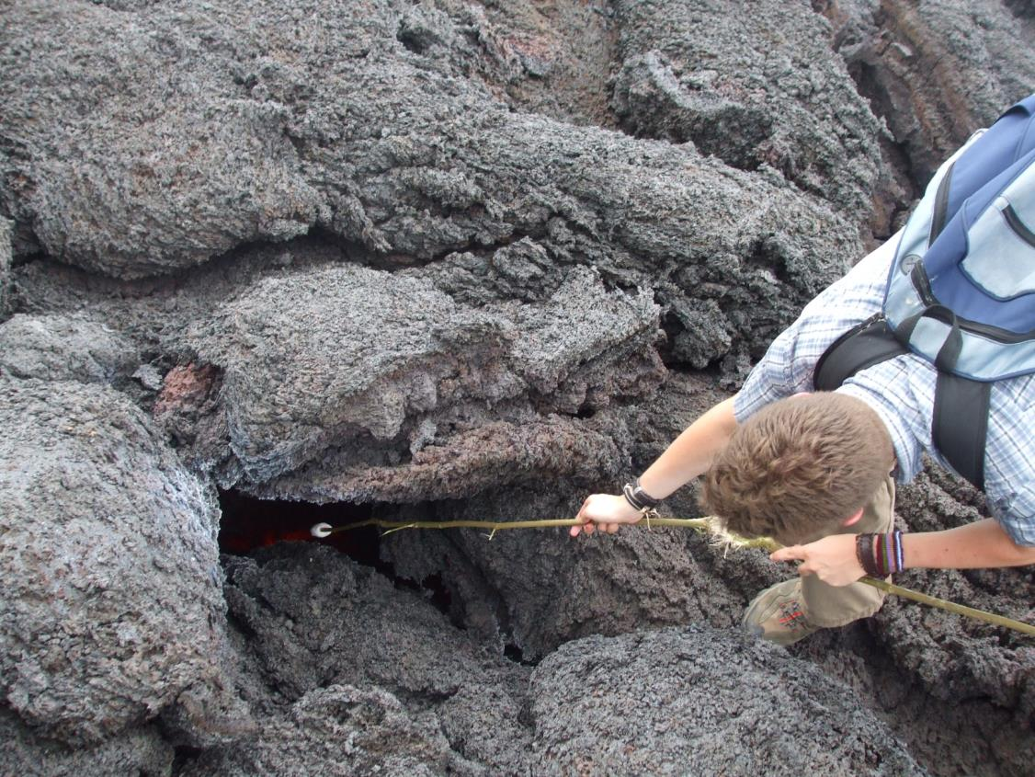

Slide 11
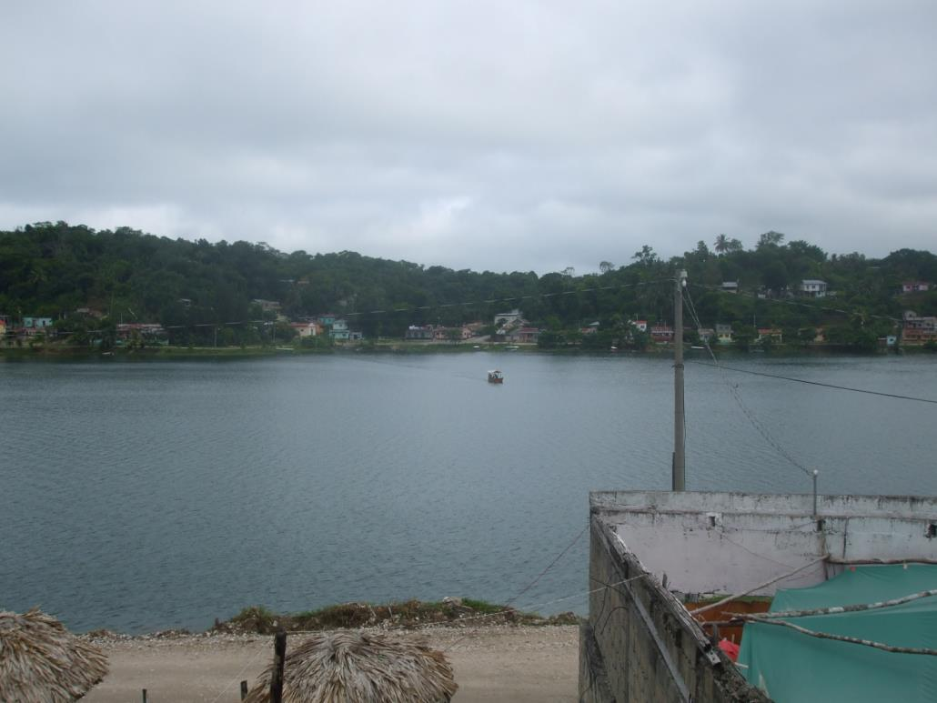

Slide 12
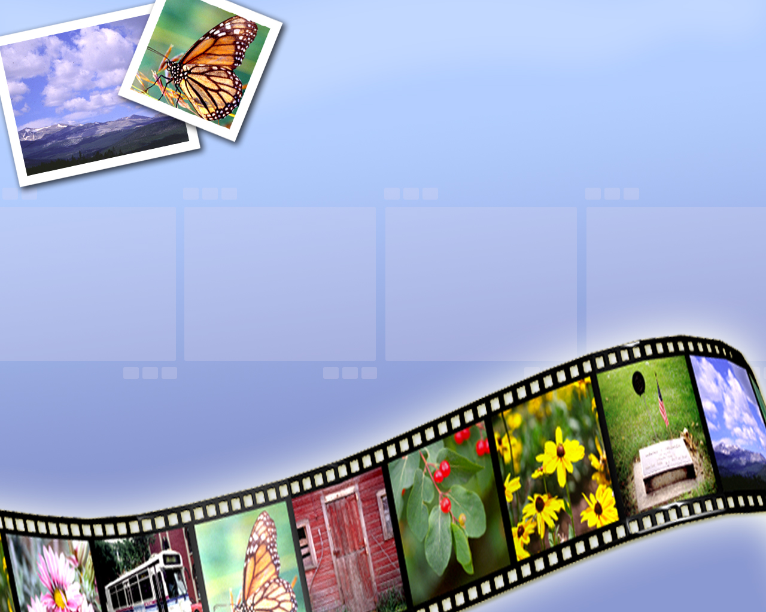
What is it like in the city and towns?

Slide 13
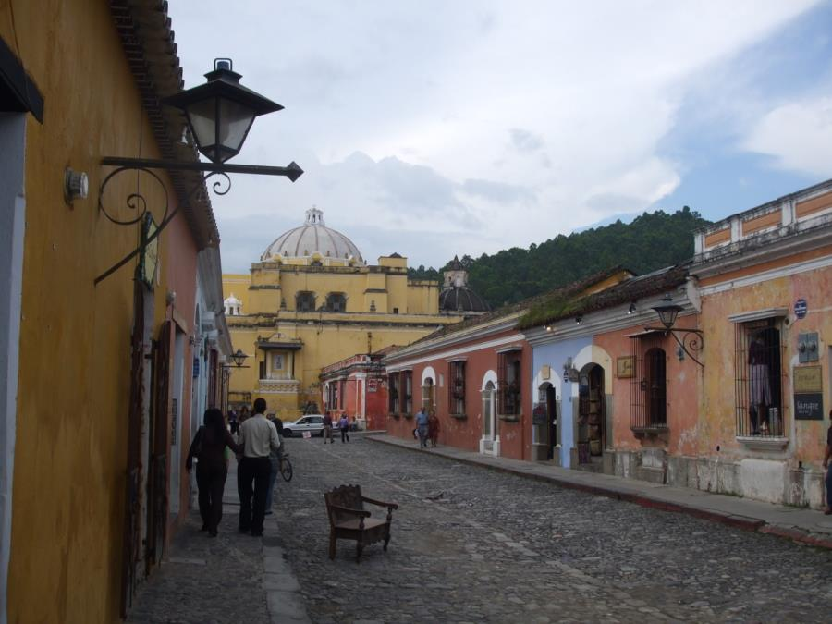
A Guatemalan street

Slide 14
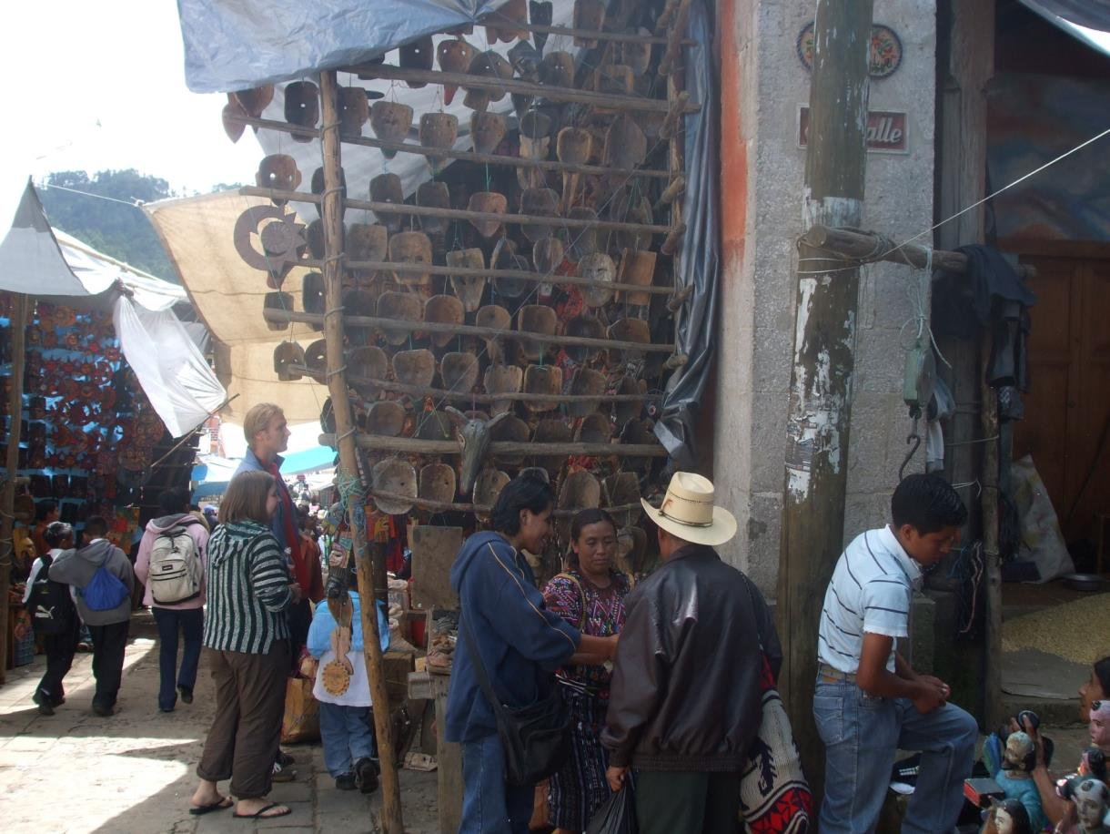

Slide 15
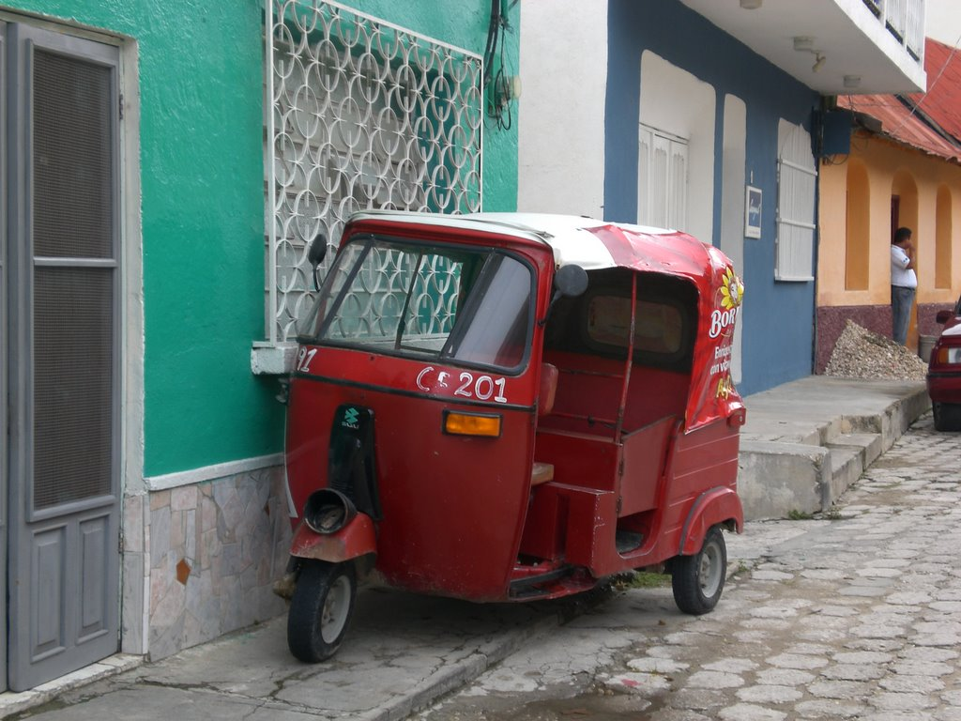

Slide 16
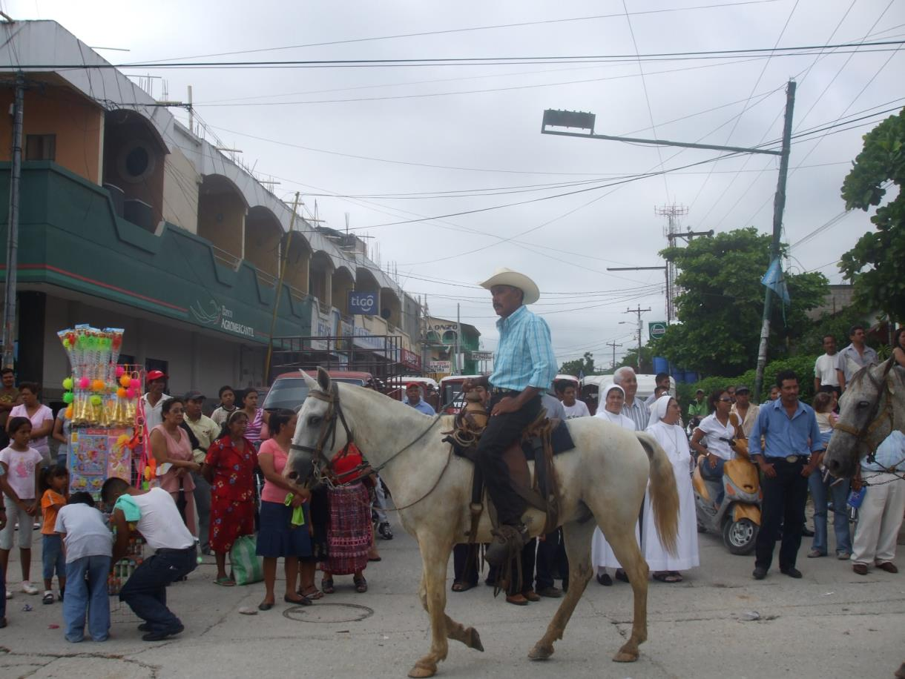

Slide 17
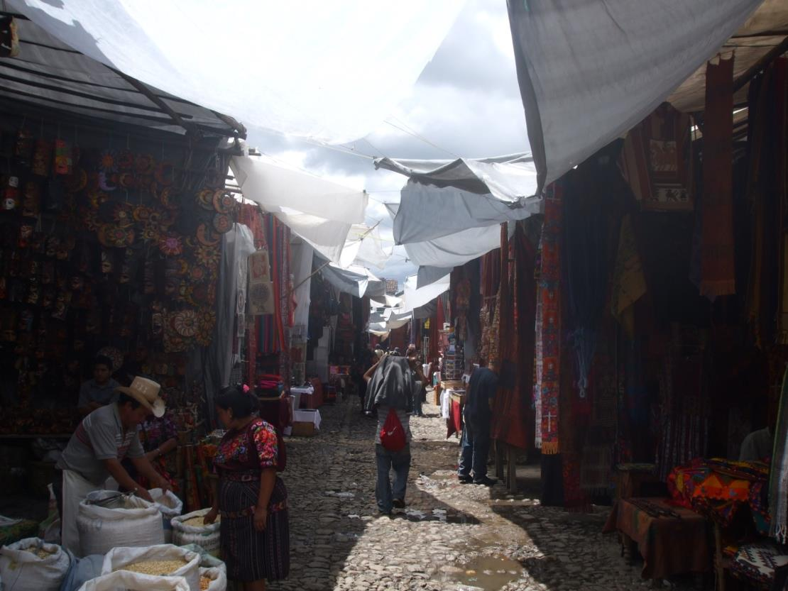

Slide 18
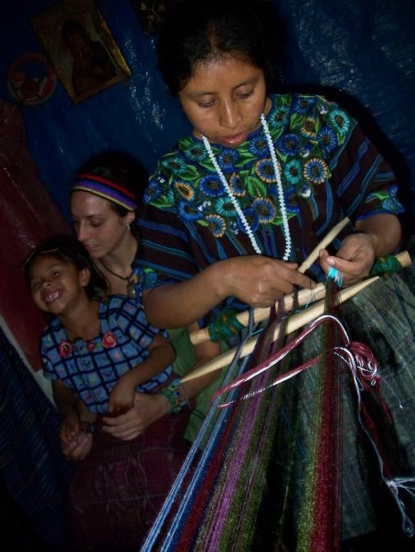
Traditional patterns

Slide 19
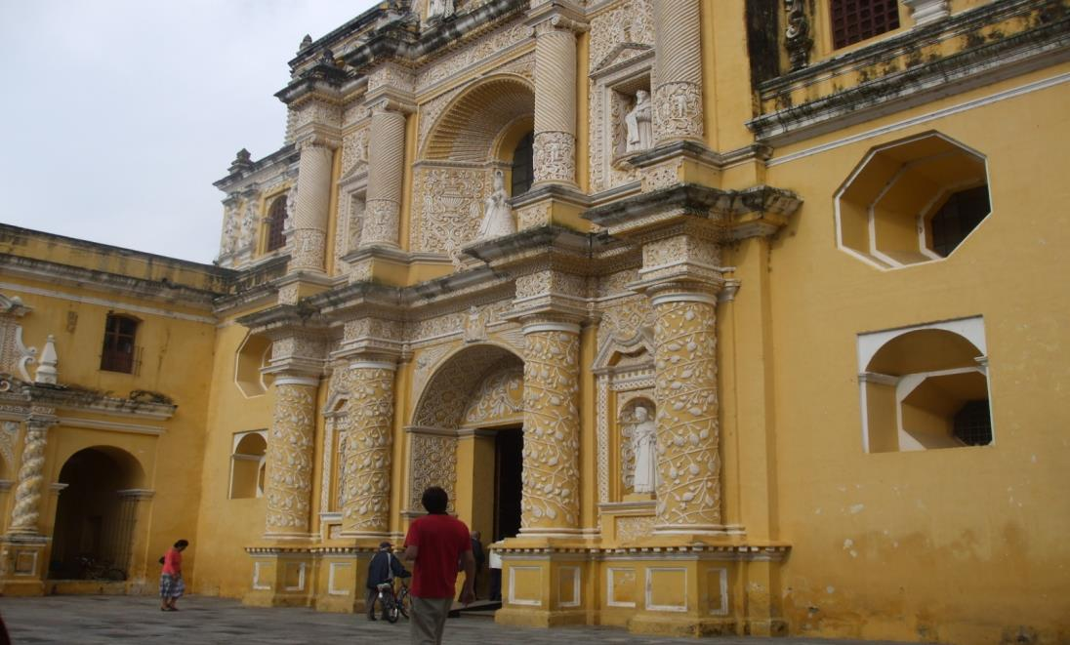

Slide 20
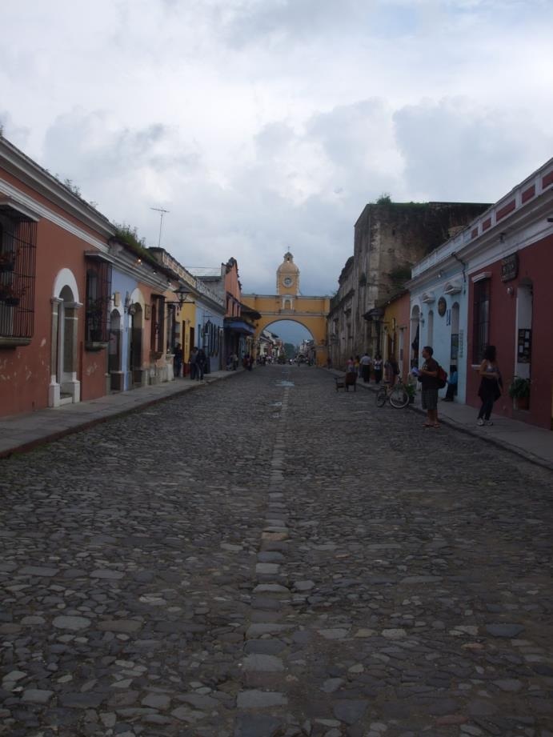

Slide 21
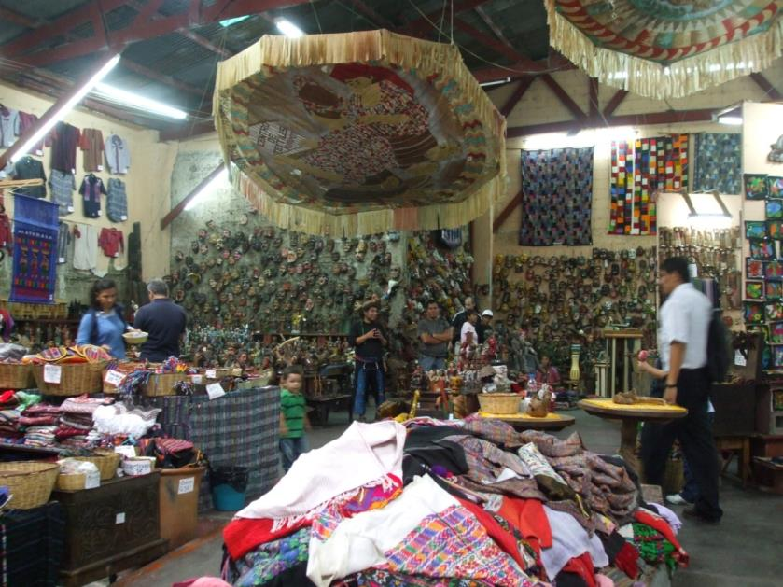
Now do this
LANDSCAPE
Write a short extract for a travel brochure about the Guatemalan landscape. Make your readers want to visit it.
CITY LIFE
You have just arrived in Guatemala and take a stroll around the city.
Write a postcard/letter describing your first impressions.

