Slide 1
What did Henry VIII do each day?

Slide 2

What sort of things do you think Henry did?
Cook his lunch?
Read books?
Cut wood for the fire?
Go hunting?
Tidy his room?
Look after his children?

Slide 3
What sort of things do you think Henry did?
Go to church?
Go on holiday?
Eat?
Wash his clothes?
Go Jousting?
Feed his horses?

Slide 4

What sort of things do you think Henry did?
Meet foreign kings?
Go shopping?
Write poetry?
Play music on the lute?
Sign important papers?
Wash himself?

Slide 5
What sort of things did Henry do?
As King there wasn’t much that Henry had to do each day. He probably only actually worked for about 1 hour a day, when he’d sign a few documents!
Of course there were decisions to be made in running the country, but generally Henry left most of these decisions to the people who worked for him.
This allowed him time to do the things that he enjoyed doing.

Slide 6
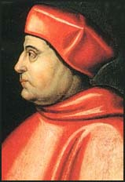
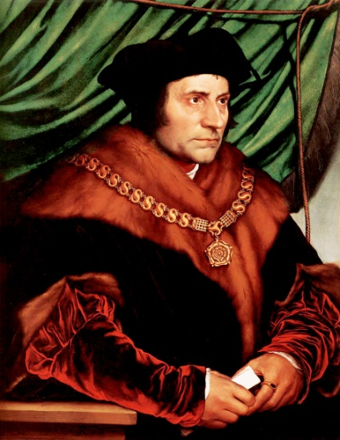
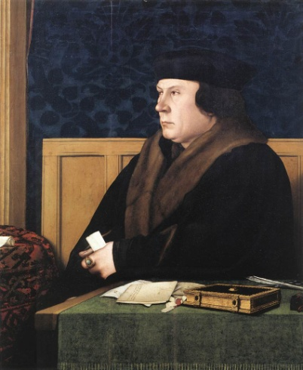
Who ran the country?
Three of the men who Henry left to run the country were….
As these men ran the country, they became very powerful and wealthy themselves.
Thomas Wolsey
Thomas More
Thomas Cromwell

Slide 7
Who ran the country?
Things were fine for these men… as long as they managed to do what Henry wanted.
Unfortunately, all three of them failed to get everything Henry wanted… and paid with their lives.
Arrested & died
Executed
Executed
Thomas Wolsey
Thomas More
Thomas Cromwell

Slide 8
Your task?
As King Henry, you are to write your diary for the week. What sort of things did you do each day?
Success criteria
You must make sure that you write about the fun activities that you the King enjoy doing
You must make sure that you have found time to sign important documents and meet with your ministers for at least an hour a day (put a * next to these)
Describe the exciting events – where they will take place, and with whom they will be done

