Slide 1

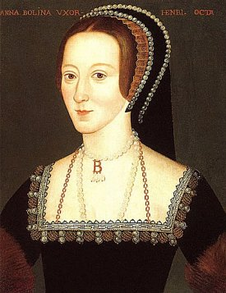
Did marrying Anne Boleyn solve Henry VIII’s problems?

Slide 2
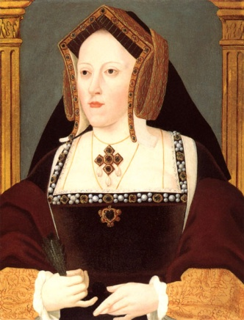
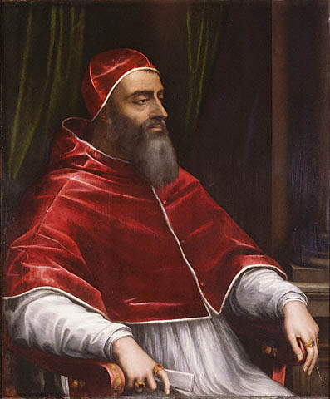
What were Henry VIII’s problems?
Can you remember the reasons why Henry decided to marry Anne Boleyn? And to become Head of the church of England?
Henry loved Anne, but he was unable to marry her.
Henry had a daughter, but he really wanted a son.
Catherine was too old to have more children
Henry owed a lot of money, and need more to pay his debts.
Henry didn’t like the pope telling him what he could or could not do.

Slide 3
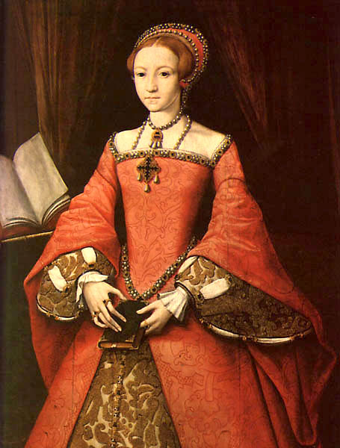
Did marrying Anne solve Henry’s problems?
A son?
Henry finally married Anne Boleyn on 25th January 1533.
The marriage started well. Anne became pregnant, and in 7th September 1533, she had a baby!
However, it wasn’t a boy as Henry wished, but a girl. She was named Elizabeth, and later in 1558, she would become Queen of England.
Anne became pregnant again two more times, but on both occasions the babies died before being born.
Did marrying Anne fix Henry’s problem?

Slide 4
Did marrying Anne solve Henry’s problems?
Love?
Although Henry was madly in love with Anne before he was married, Henry found his feelings toward Anne changed after he was married.
Anne was intelligent, and wanted to get involved in the running of the country.
This was a role that Henry had given to advisers such as Thomas Cromwell. They didn’t like Anne’s involvement in running the country, and certainly didn’t like her bossing them around. Henry himself, tired of her bossiness.
Did marrying Anne fix Henry’s problem?

Slide 5
Did marrying Anne solve Henry’s problems?
The Pope not telling him what he could do?
In order to marry Anne, in January 1533, Henry made himself Head of the Church of England, so he could divorce Catherine.
He had decided that this was necessary because the Pope wouldn’t allow him to divorce Catherine. In becoming Head of the Church in England, Henry made the decisions about what happened in the Church, rather than the Pope.
One of the first things that he did was to stop money being sent to the Pope.
Did marrying Anne fix Henry’s problem?

Slide 6
Did marrying Anne solve Henry’s problems?
Getting money to pay off his debts?
When Henry made himself Head of the Church of England, he came into ownership of all the Church’s buildings and land.
The church in Tudor times was very wealthy, and owned maybe a third of all the land in England.
From 1536 to 1541, Henry got rid of the monasteries in England and sold off their land. This made him very popular with the nobles of England, and also made him rich.
Did marrying Anne fix Henry’s problem?

Slide 7
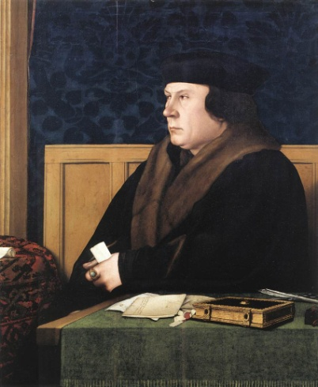
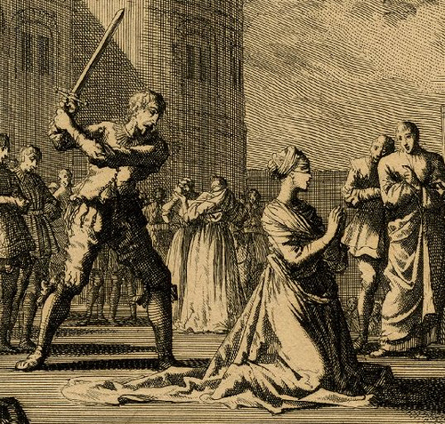
Anne beheaded
As Anne became more bossy towards Henry’s advisors, they started to dislike her more and more, and sought to find a way to get rid of her. In particular, Thomas Cromwell saw Anne as a threat to his job as Henry’s chief advisor.
In April 1536, Anne was accused of having many lovers. If guilty she would be executed, by having her head chopped off.
Those accused of being her lovers were tortured and subsequently confessed to the crime. One 2nd May 1536, Anne was arrested, and later found guilty.
On 19th May 1536, she was taken to Tower Green, and was beheaded by a French Swordsman, Jean Rombaud.

Slide 8
Did marrying Anne solve Henry VIII’s problems?
Did marrying Ann solve Henry’s problems? What do you think?
To find love with Anne?
To get a son?
To stop the Pope ruling the church and telling Henry what he could do?
To pay his debts?

Slide 9
Your task
Learning objective: Did marrying Ann solve Henry’s problems?
Success criteria
You need to look at each of Henry’s problems, and consider if marrying Anne Boleyn solved his problems.
You must explain your answers, not merely write ‘yes’ or ‘no’. Give details of what happened.
You could comment on whether you think Henry was right in marrying Anne?

