Slide 1
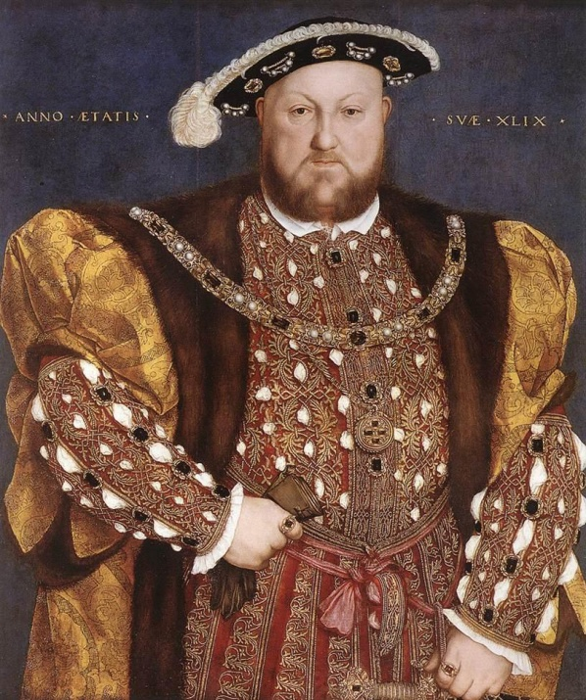
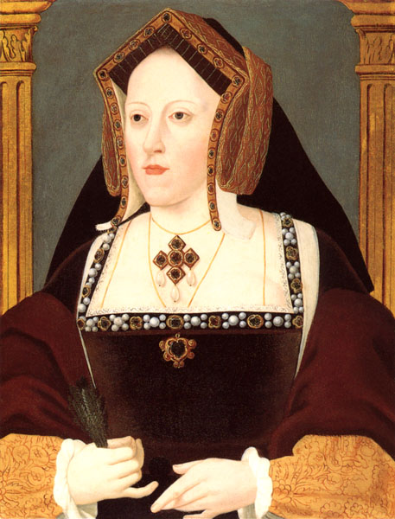
Why did Henry VIII divorce Catherine of Aragon?

Slide 2
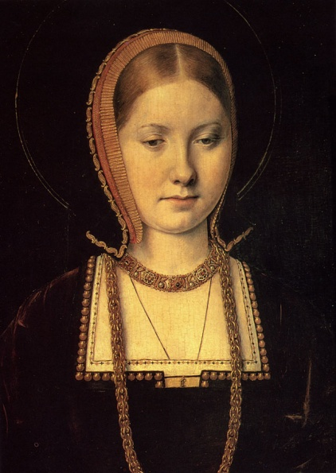
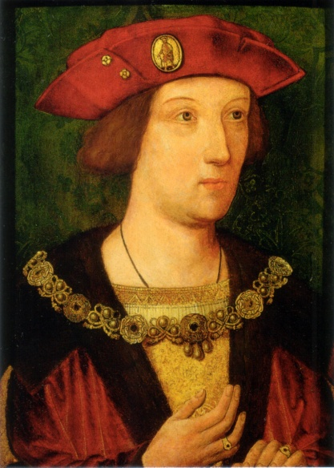
Catherine of Aragon
Catherine of Aragon was the daughter of the King and Queen of Spain. She was born in 1485, and so she was 6 years older than Henry VIII.
Catherine had originally come to England to marry not Henry, but his older brother Arthur.
Catherine as a young woman
In Tudor times, Kings and Queens did not marry for love, as people do today. Rather, they married in order to form a friendship between countries. By Catherine marrying Arthur, England and Spain would be friends, and allies in war.
Prince Arthur

Slide 3
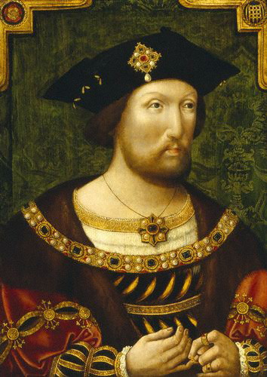

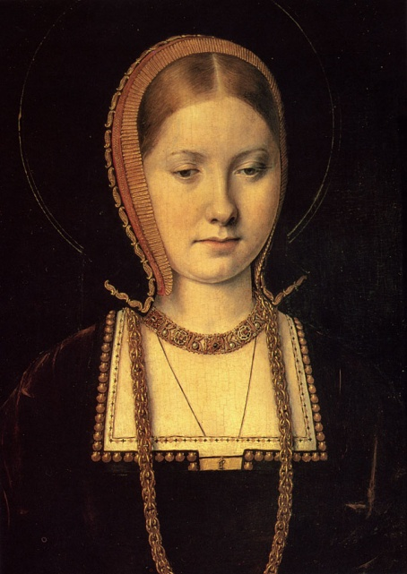
Henry marries Catherine - 1509
However, shortly after Catherine married Arthur, he died.
Henry VIII
So it was decided by Catherine’s parents and Henry’s father, that Catherine should marry Arthur’s younger brother Henry.
In 1509, after he became King, Henry did marry Catherine. It appears that Henry and Catherine loved each other.

Slide 4
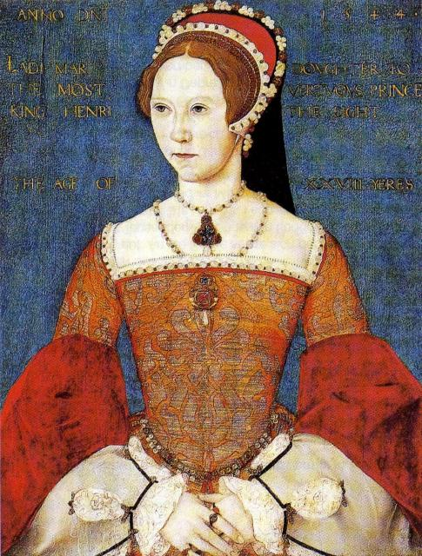
Catherine has a child - Mary
Above all other things, Henry wanted to have a son, so that the House of Tudor would continue to rule England.
However, although Catherine had six children, only one survived, and this was a girl – Mary, who was born in 1516.
By 1525, Catherine was too old to have more children.
Without a son, the throne of England be taken over by someone who was not a Tudor?
What do you think Henry should do?
Mary Tudor

Slide 5
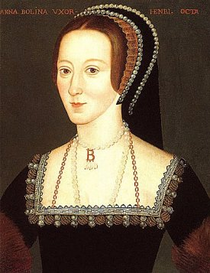
Anne Boleyn
In 1522, a young woman called Anne Boleyn, became one of Catherine’s ladies-in-waiting.
Anne was attractive, educated, witty and charming. Soon she had many male admirers at court…. including King Henry.
During the next few years, Henry fell in love with Anne, and in May 1527, he decided to divorce Catherine, in order to marry Anne.
Not only could he find love with Anne, but she might also give him the son that he so desired.
Anne Boleyn

Slide 6
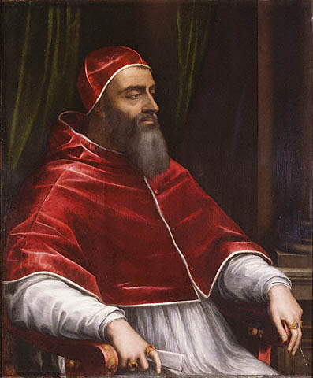
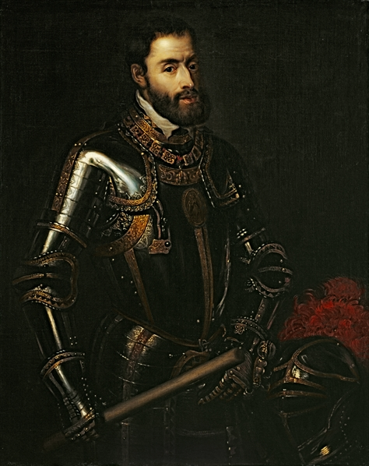
Divorce – getting the Pope to agree
However, in order to divorce Catherine, Henry would need the agreement of the Pope (Clement VII) in Rome, who was head of the Church in Western Europe, including England.
Alas, the city of Rome had recently been captured by Catherine’s nephew, Charles V (the new King of Spain). Charles certainly didn’t want the Pope to allow Henry to divorce Catherine. So he ‘persuaded’ the Pope to refuse Henry’s request.
Pope Clement VII
By 1529, Henry realised that the Pope would not give in. Henry knew he would have to find another way to divorcing Catherine.
Charles V

Slide 7
Divorce – The Pope v’s The Bible
Anne Boleyn was a Protestant (those who didn’t agree with the Pope ruling the church.) She persuaded Henry to talk with some Protestant professors at Cambridge University, who might be able to advise him what to do about his divorce.
One of these professors was Thomas Cranmer, who convinced Henry that he didn’t need the Pope to agree to the divorce.
Rather, Henry only needed to see what the Bible had to say about the matter.
Cranmer advised Henry that only the Bible could tell Henry what to do, not the Pope, and that the Bible agreed with Henry divorcing Catherine.

Slide 8

Money
However, Henry realised that if he should reject the Pope ruling over his divorce, why should he not get rid of the Pope ruling the church in England as well!
If Henry made himself Head of the Church in England instead of the Pope, then he could also take ownership of all the Church’s land and buildings. This would make him rich.
This was quite tempting to Henry, as he owed a lot of money from fighting wars with France.
He could sell the church’s land and buildings to pay off his debts.
What do you think Henry should do?

Slide 9
The Church of England
The new, protestant way of thinking, made Henry decide that the Pope should not have any right to tell him what he could do… whether it be divorce, or anything else.
Henry decided that the Pope should not be the head of the Church in England, but rather that he, Henry should be!
In January 1533, the English bishops met at Westminster Abbey and agreed to Henry becoming Supreme Head over the Church in England.
The Church of England was born. England had become a Protestant country.

Slide 10
Anne becomes Queen
On 25th January 1533, Henry married Anne, and she became Queen.

Slide 11
Your task…
Task 1 Imagine that you are Henry VIII, and that you are writing your diary about your decision to divorce Catherine of Aragon.
Success criteria
Write about the reasons why you have decided to divorce Catherine
Write about your hopes in marrying Anne
Task 2. As Henry VIII, write your diary entry of your decision to become Head of the Church of England instead of the Pope.
Success criteria
Write about the reasons why you have decided to replace the Pope as Head of the Church of England
Write about your hopes in doing this

