Slide 1
Mayan Masks
L.O. To design and make a Mayan mask

Slide 2
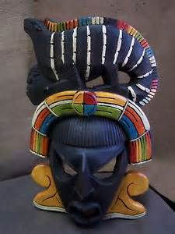
Mayan Masks
Mayan masks had a wide variety of uses, and the importance of the masks dictated how intricate the designs on various masks were. The most sacred Mayan masks featured complex and delicate mosaics made out of jade.
Other materials used were stone, wood, gold, shell and
obsidian (a hard, dark, glass-like volcanic rock)

Slide 3
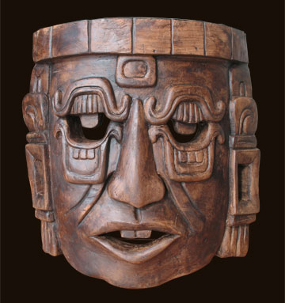
Why were they used?
The Maya used masks for a variety of reasons and occasions. These included:
To adorn (decorate) the faces of the dead
To be worn at important events
To be worn during battle

Slide 4
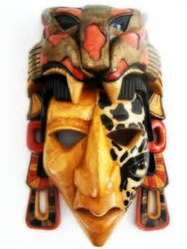
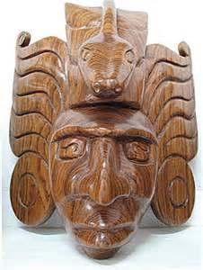
Battle Masks
Some masks which were simple in style were worn by the Mayans during important events like Battles, and usually carved from wood or stone.
These designs focussed on the use of darker colours.
They were worn for one of two reasons:
      To protect the wearer during battle by adding spiritual power
      To intimidate the enemy

Slide 5
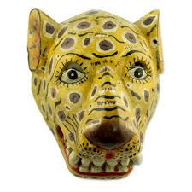
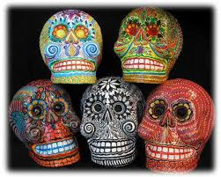
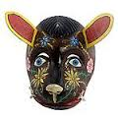
Event Masks
Other masks were designed to be worn during important events such as weddings and birth ceremonies. These masks often used heavenly beings, animals or designs for entertainment purposes.
These masks used amazing designs with bright, vibrant colours painted onto wooden surfaces.

Slide 6
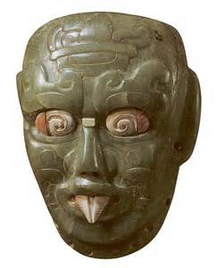
Death Masks
Finally, those masks used to adorn the faces of the dead were often seen as the most sacred and therefore were the most elaborate.
These masks used a mosaic patterning of the beautiful greens and blues of the Jade stone to show the close sacred connection between the people and their Gods.
The funeral masks protected the individual while
descending into the underworld "Xibalba" in
order to defeat the gods of death and to be able
to ascend as the Mayan "God of the Corn".

Slide 7
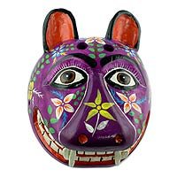
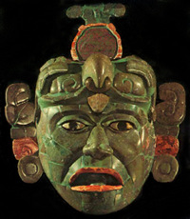
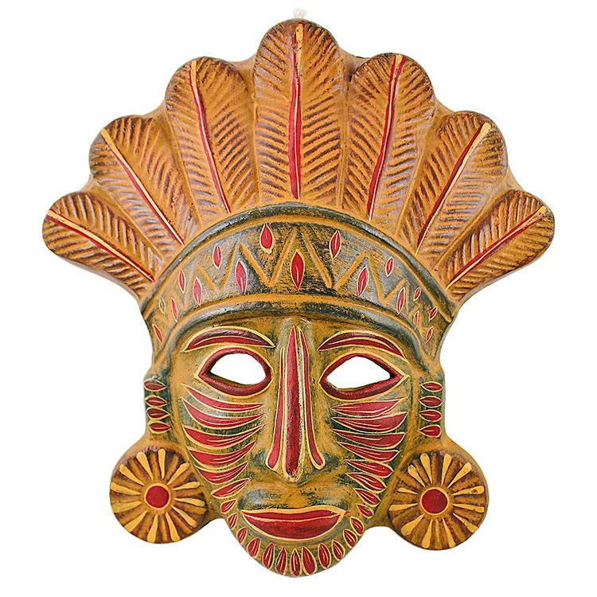
Other designs

Slide 8
Over to you!
Think about the different types of Mayan masks. Choose one and sketch out your design in your topic book. Will it be a death mask, or a mask for a special occasion? What colours will you use? How will you make it fit the purpose it is being worn for? What materials will you need?
When you are ready, you may begin.

