Slide 1
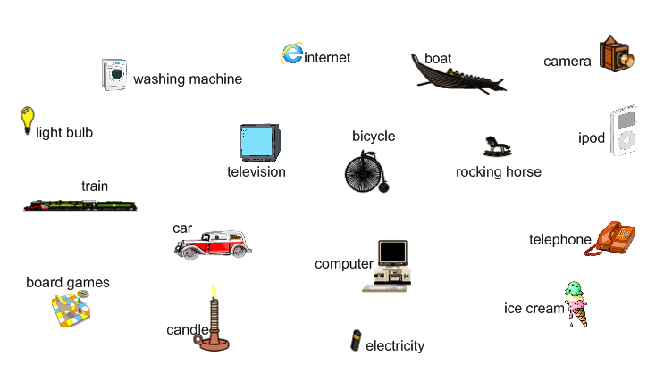
Which of these inventions are Victorian?

