Slide 1
Areas of the SCRATCH 2 Screen
N Hutson 2018

Slide 2
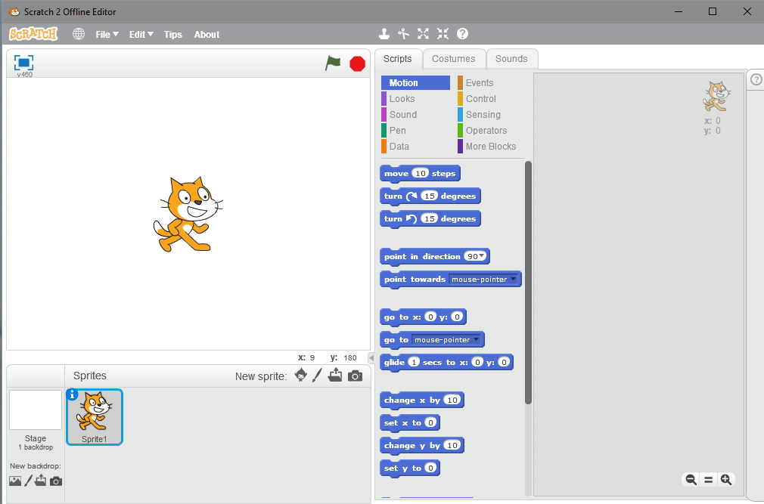
The Scratch Screen
The SPRITE AREA
This is where your characters are edited/created. A sprite is anything you want to move in your game/animation.

Slide 3
The Scratch Screen
The SPRITE AREA
To add a new sprite use these buttons. This allows you to select a premade sprite. The paint brush allows you to draw one.
To delete the cat, RIGHT click on it ans select delete.

Slide 4
The Scratch Screen
The STAGE area
This is where you edit the backgrounds. These are the scenery for your game/animation and contain the things that will not move, which the sprites move over. For your game this will be some kind of maze.

Slide 5
The Scratch Screen
This is where the action takes place. Whatever you code the characters to do takes place here.

Slide 6
The Scratch Screen
This starts and stops the game

Slide 7
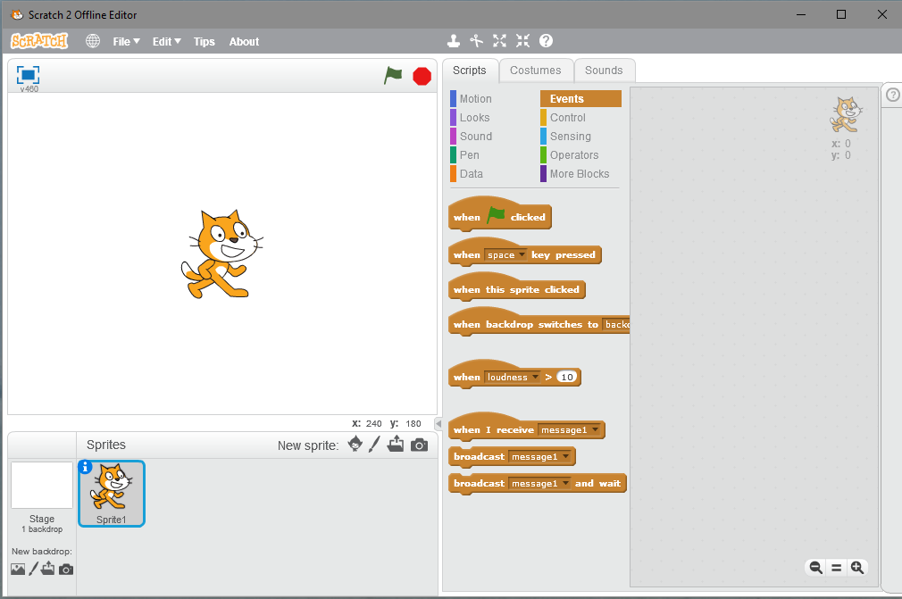
The Scratch Screen
The SCRIPTS
This is where you can find the codes to add to the right hand box to make thing happen.

Slide 8
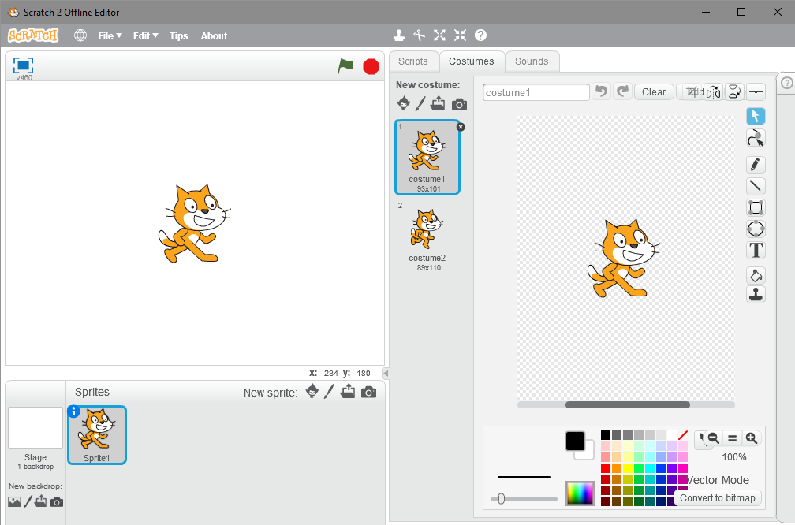
The Scratch Screen
The COSTUMES
This is where you can change the “Costumes” of your sprite so that it can appear in different ways such as walking.

Slide 9
The Scratch Screen
The COSTUMES
Here you can edit the way you sprite looks or draw a completely new one.

Slide 10
The Scratch Screen
The COSTUMES
These buttons let you change the size of your sprite on the screen.

Slide 11
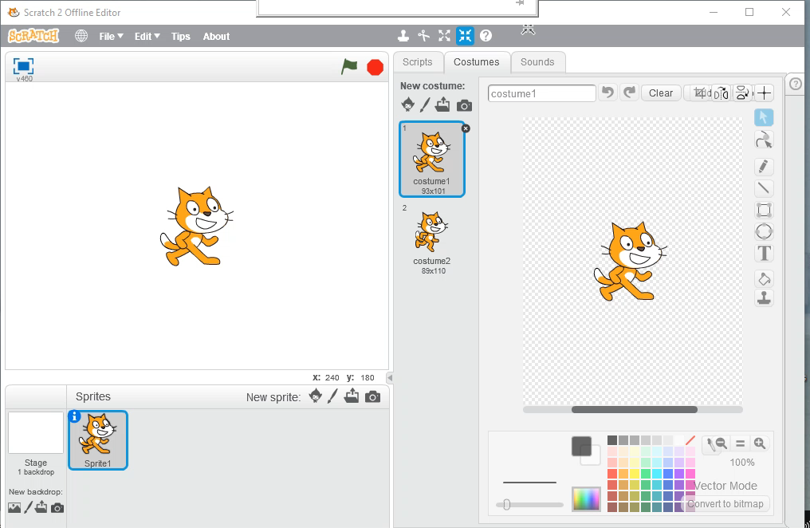
The Scratch Screen

