Slide 1

Welcome to Scratch
By Miss Key

Slide 2
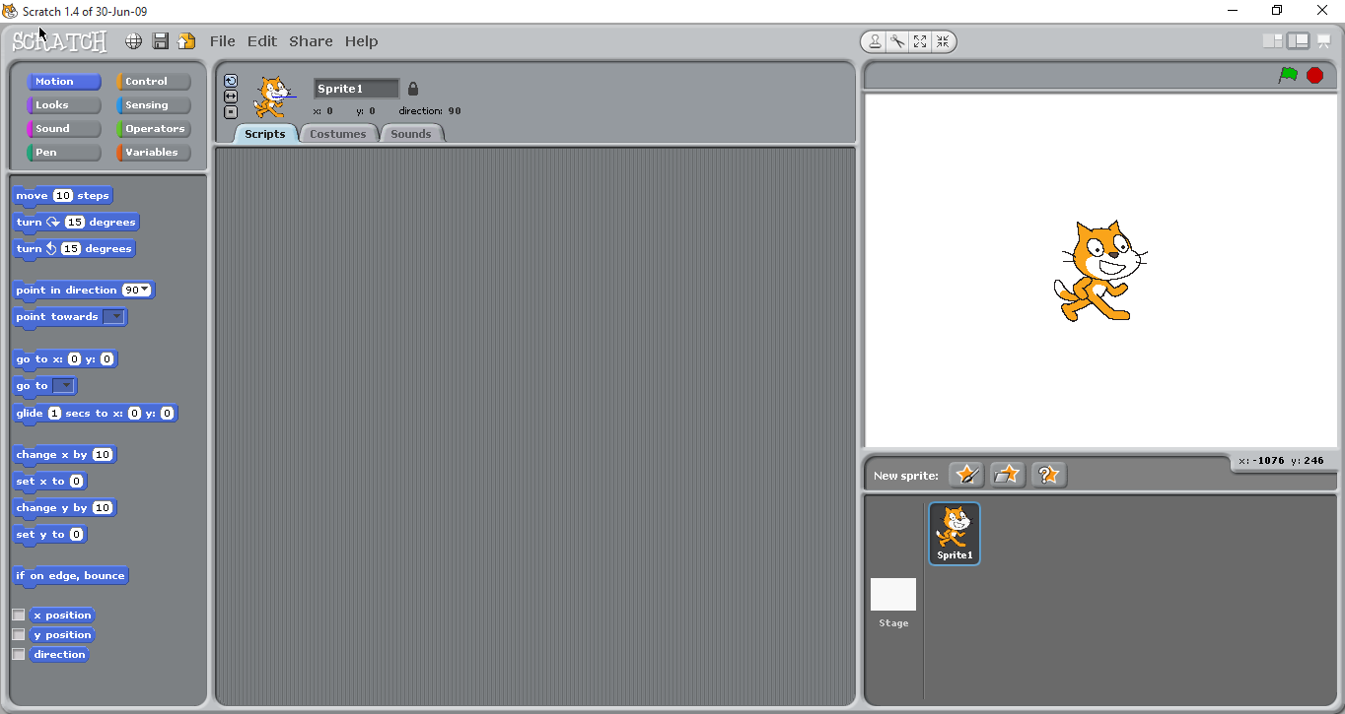
The Main Screen
Viewing screen with choice of views

Slide 3
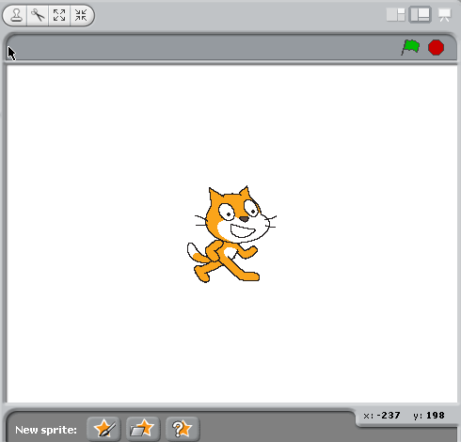
The Viewing Screen

Slide 4
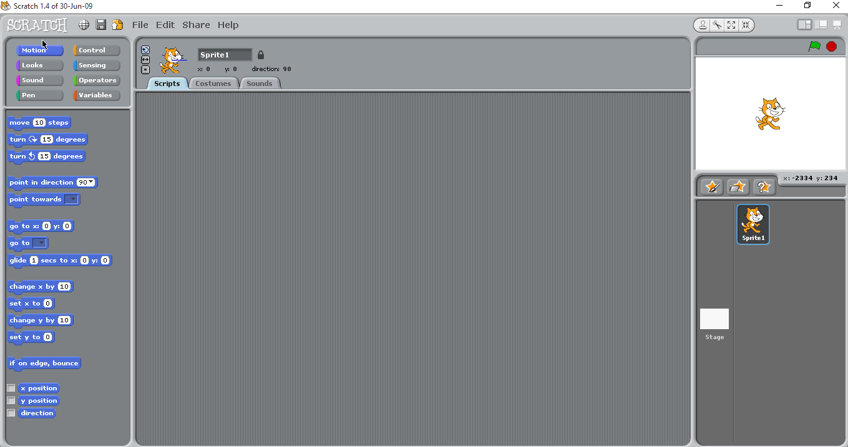
Small Viewing Screen

Slide 5
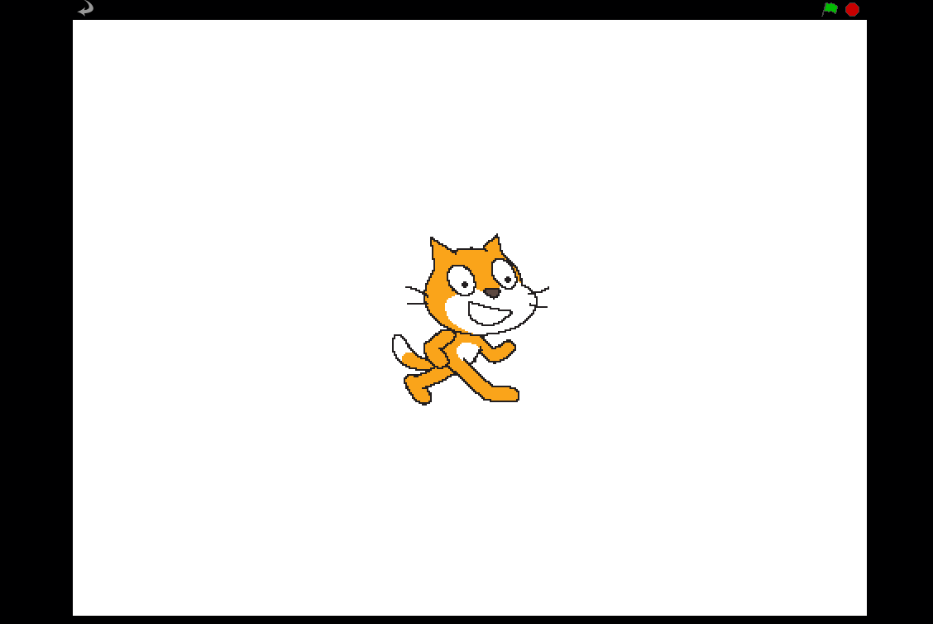
Full Screen View
Use the return arrow to go back to normal sized viewing screen

Slide 6
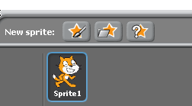
Sprite Screen
Use this button to insert a sprite from a file
Use this button to get a surprise sprite
Use this button to paint your own sprite

Slide 7
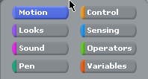
Programming Tabs

Slide 8
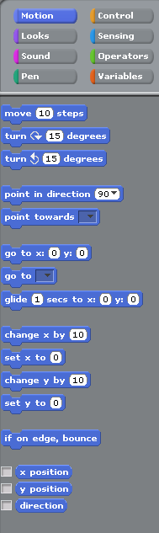
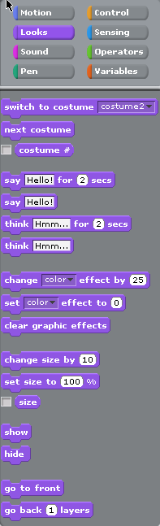
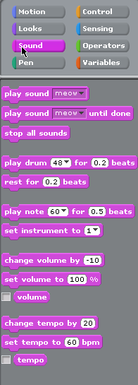
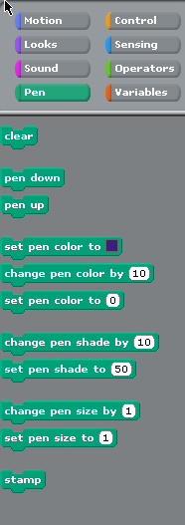

Slide 9
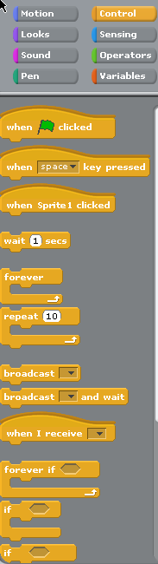
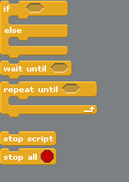

Slide 10
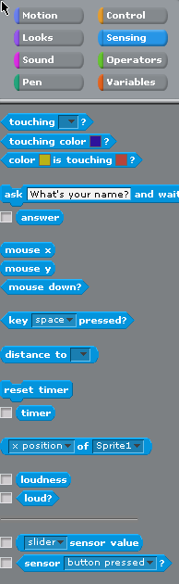
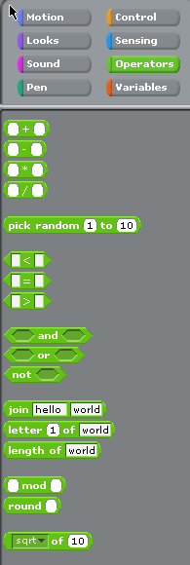
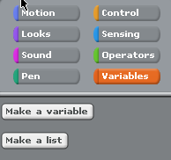

Slide 11
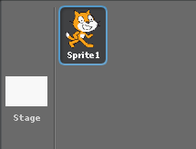
When the sprite is highlighted…

Slide 12
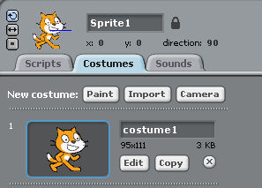
Sprite Working Space is shown
This is where the script/programming is written
This is where you can copy/edit your sprites
This is where sound can be added
This is the name of your sprite and also where you can re-name your sprite

Slide 13
Sprite Working Space Continued
This shows us the co-ordinates of where the sprite is on the ‘stage’ and the direction it’s facing.
These buttons control the direction that the sprites can go in, the top one means that it can move 360º, the 2nd button allows it only to go side to side, handy when you don’t want your sprite to go upside down!

Slide 14

Other Controls
Stamp Button
Clicking on this button decreases the size of your sprite
Cut Button
Clicking on this button increases the size of your sprite
Changing the sized of your sprite once you have designed it means that you can add more detail when drawing them free-hand then shrink them to the size you want whilst maintaining the detail you have added.

Slide 15
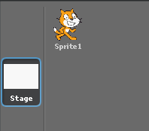
When the Staging is highlighted…

Slide 16
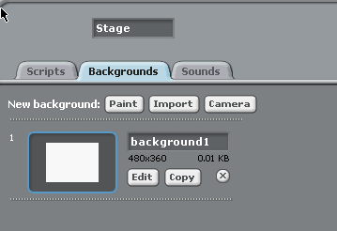
Stage Working Space is shown
This works in exactly the same way as the Sprite working space, scripts is where you write the code, backgrounds is where you copy/edit background and sounds is where you add sounds.

Slide 17
How to start/stop the programme
The green flag starts the programme running
The red button stops it running

Slide 18

Green Flag on Control
The green flag on the control icon, will run the code for just the script page that you are on so that you can check if it is working as you go along.

Slide 19
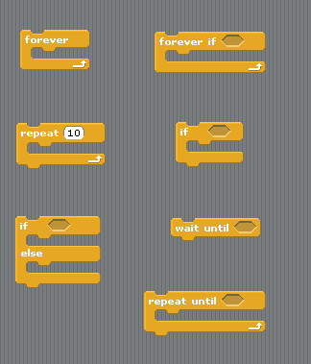
Special Control Buttons
These controls have a space in them where other codes can be added. If you hover them over the code they will stretch to the size of the code automatically
Some of them also have a small space which will take one of the operator instructions

