Slide 1
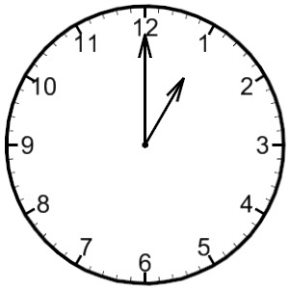


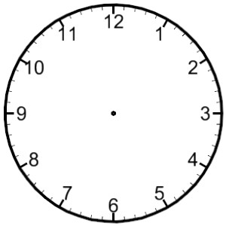
LO: read analogue and digital time (in 5 minutes)
Analogue time
Minnie Minute
Analogue Time
O’Clock
five minutes to
five minutes past
ten minutes to
ten minutes past
Minutes to
Minutes past
quarter to
quarter past
twenty minutes to
twenty minutes past
twenty five minutes to
twenty five minutes past
half past

Slide 2

Analogue Time
past o’clock
to o’clock
o’clock
Happy Hour
twelve o’clock
past twelve
half past twelve
to one
one o’clock
past one
half past one
to two
two o’clock
past two
half past two
to three
three o’clock

