Slide 1
Choose the units
Vote for A, B or C

Slide 2
The weight of a pencil case…
Centimetres (cm)
Grams (g)
Kilograms (kg)
Choose A, B or C!
B

Slide 3
The height of a child…
Centimetres (cm)
Kilometres (km)
Litres (l)
A

Slide 4
The capacity of a bottle…
Kilometres (km)
Grams (g)
Litres (l)
C

Slide 5

The length of a mini beast
Centimetres (cm)
Millilitres (ml)
Millimetres (mm)
C

Slide 6
The amount of medicine…
Litres (l)
Millilitres (ml)
Grams (g)
B

Slide 7
Dry Cake ingredients…
Grams (g)
Kilograms (kg)
Millilitres (ml)
A

Slide 8
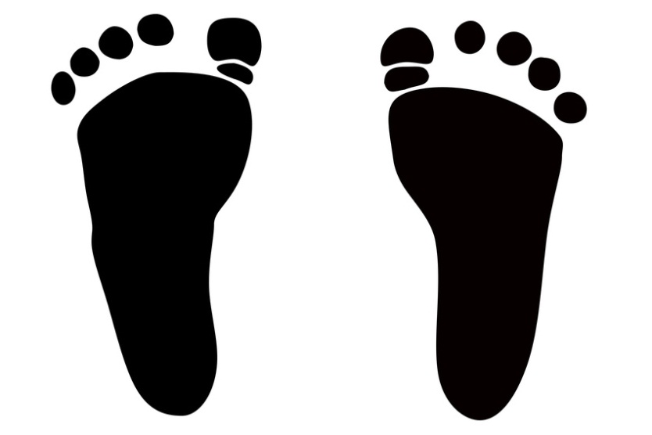
Length of your foot…
Millimetres (mm)
Metres (m)
Centimetres (cm)
C

