Slide 1
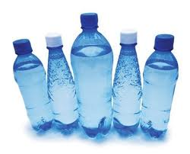
Comparing Capacity

Slide 2
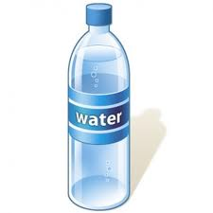
1
-
2
L
500ml

Slide 3
1L
1000ml

Slide 4
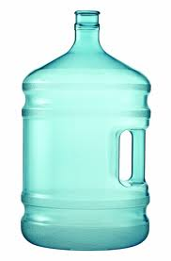
6L
6000ml

Slide 5
1.5L
1500ml

Slide 6
How many of these would you need to fill
This?
1L
6000ml

Slide 7
1L
1L
1L
=
6000ml
1L
1L
1L

Slide 8


