Slide 1
How to draw a cube using isometric paper.
By Theo Farrer

Slide 2
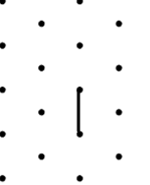
Step 1
Start off with a straight line. Starting with 1 dot and going down 1 dot.

Slide 3
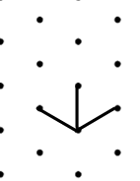
Step 2
Draw 2 lines left and right from the bottom dot. The picture on the right shows you what it looks like.

Slide 4
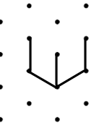
Step 3
On the ends of the lines you have just drew, draw another line upwards 1 dot to look like the image on the right.

Slide 5
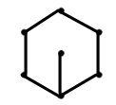
Step 4
Draw 2 equal lines from the top of the lines you drew from the last step.

Slide 6
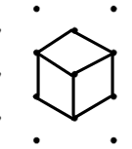
Step 5
From the line you drew on step 1, connect the using lines to the other dots. The picture on the right shows what it should look like joining the lines together.

Slide 7
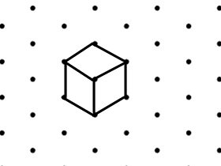
Your final product!

Slide 8
Challenge…
Can you use your isometric paper to draw two cubes sitting side by side?
Can you draw a tower of three cubes?
Can you draw a cuboid?
Can you draw a cube that is 2 x 2 x 2?
Use cubes to draw your own complicated 3D shapes. Can you work out their volumes?

