Slide 1
Exchange rates
Dealing with foreign currency

Slide 2






€1 is worth:
$1.06 American Dollars
£0.85 British Pounds
$1.43 Canadian Dollars
7.44kr Danish Krone
¥119.76 Japanese Yen
$1.42 Australian Dollars

Slide 3
How much do I get?
€32 in Japanese Yen?
€56 in British Pounds?
€47 in Australian Dollars?

Slide 4
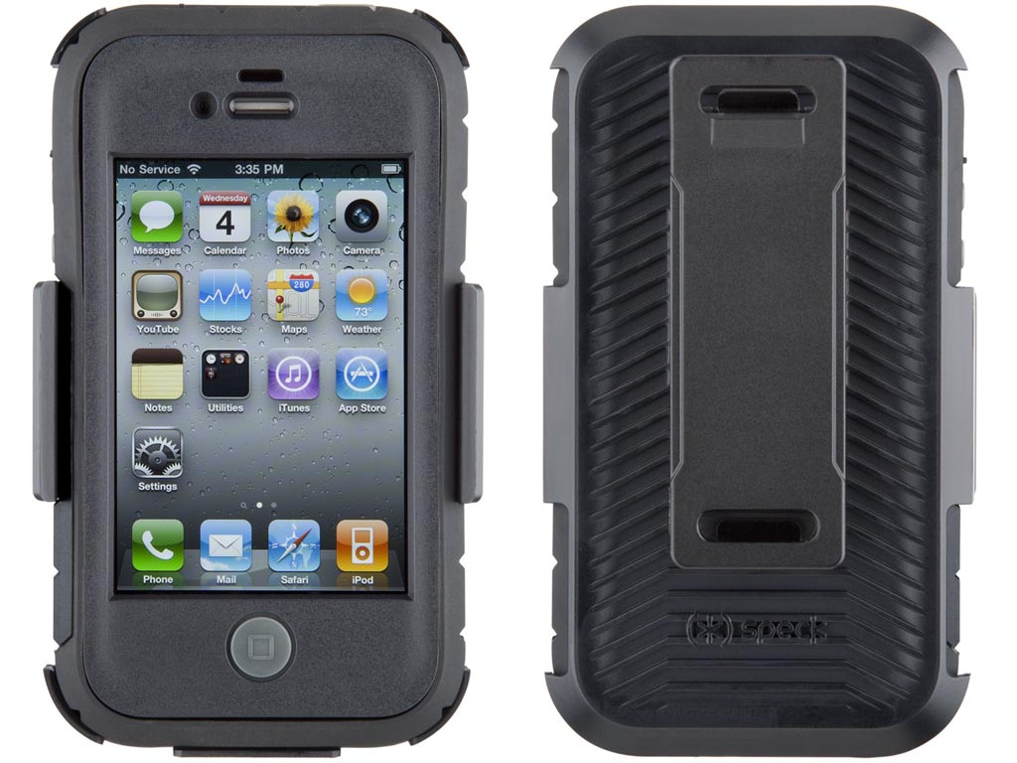
Where should I buy?
While shopping online, I saw a phone case on an Australian website for $11.85. On an English website, it was advertised for £9.50.
Which is more expensive in € and by how much?

Slide 5

Holiday time
I am going to New York after Christmas and want to have $550 with me, how much € will I need to bring to the bank to convert?

Slide 6

Coming home
Laura is coming home from Japan and has ¥650 leftover after her trip.
James has been to Denmark and is coming home with 190kr.
Who will have the most € when they return and by how much?

Slide 7

CAN I AFFORD IT?
While working in London, I saved up £22,000 my brother was working in Florida and earned $24,000.
We both want to purchase a car that costs €25,000, which of us can afford it?

