Slide 1
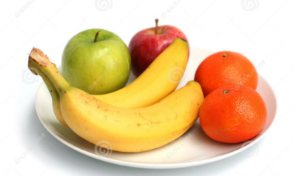
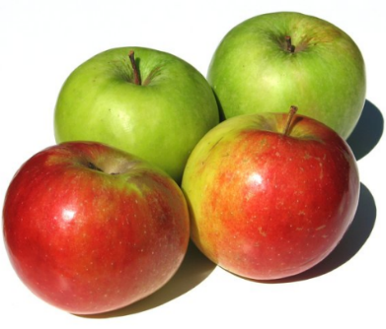
Mastery - fractions
Sam and Tom share the fruit equally. There 4 apples, 10 oranges, 6 pears and 1 banana. How many of each fruit do they receive? Fill the table.
 | Apples | Oranges | Bananas | Pears
Sam
Tom

Slide 2
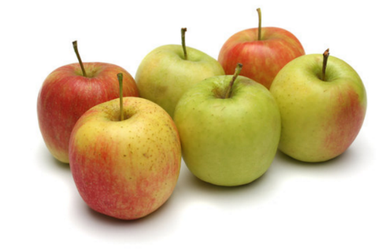
Mastery - fractions
Jack and Jill share the fruit equally. There 6 apples, 1 orange, 4 pears and 2 bananas. How many of each fruit do they receive? Fill the table.
 | Apples | Oranges | Bananas | Pears
Jack
Jill

Slide 3
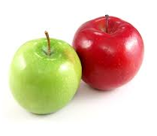
Mastery - fractions
Jay and Anya share the fruit equally. There 2 apples, 6 oranges, 1 pear and 2 bananas. How many of each fruit do they receive? Fill the table.
 | Apples | Oranges | Bananas | Pears
Jay
Anya

